Slide 1
The Accidental Abyss
Kelly FitzGerald
Manager, Product Security
1
1

Slide 2
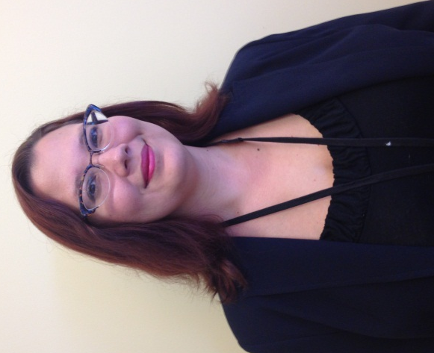
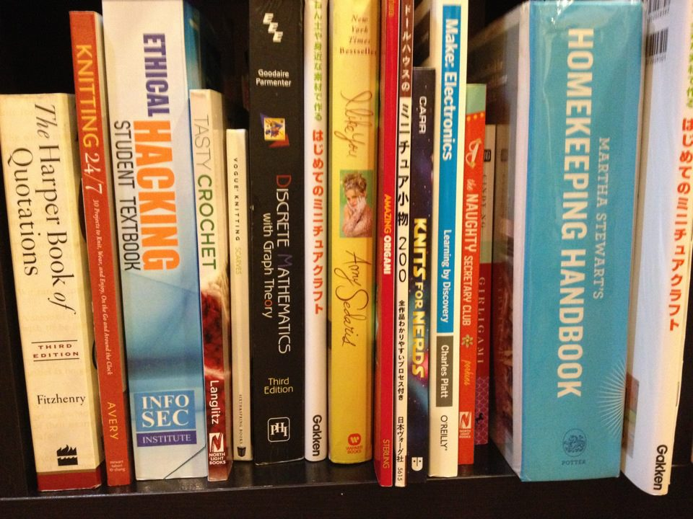
Begin At The Beginning
Kelly FitzGerald
@Symantec Since 2003
Worked on: Consumer, Enterprise and Product Security
Spend a lot of time at hacker conferences and hacker drinkups
Manage internal pen test personal
Facilitator for the Cryptography Review Board
Serious Nerd

Slide 3
How The Idea For The Talk Was Born

Slide 4
Smart, Selfless, Lady

Slide 5
LIAR

Slide 6
Too Cool For School

Slide 7
Still Lying

Slide 8
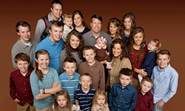

Slide 9
“Bob Smith”: Cheap Guy

Slide 10
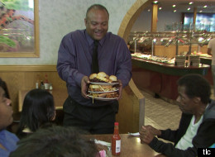
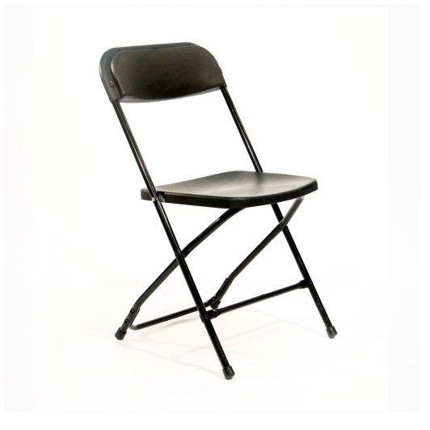
Why Is This Guy Cheap

Slide 11
A Smart Man Keeps a Secret Budget

Slide 12
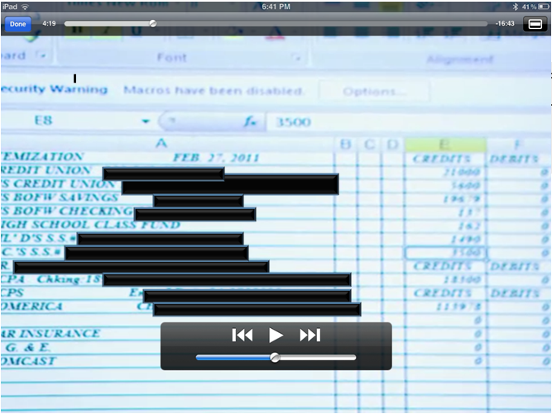
All Your Base Belong to Me
Social Security #’s
Bank Account Numbers
Employee ID

Slide 13
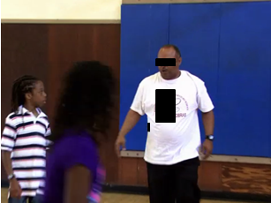
Better Learning Through Television
<BLEEP> College Preparatory School
Graduated Last Class as of 2011

Slide 14
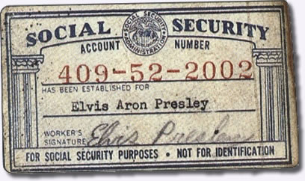
We’ve got his Social Security Number..
What can we do illegally?
What information do we learn legally?
AAA-GG-SSSS
Area you are in when you filed it
All 3 Social Security Numbers are allotted to California.
When do you get it?
Born Before 1986, you got it around 14
Born Between 1986-1990 you get it by 5
Post 1990 you get it at birth

Slide 15
Oh Hey, Isn’t Your Social 549-Uhhhhh.. Silly Me!
545-XX-XXXX - California 546-XX-XXXX - California 602-XX-XXXX - California 603-XX-XXXX - California 604-XX-XXXX - California 605-XX-XXXX - California 606-XX-XXXX - California 607-XX-XXXX - California 608-XX-XXXX - California 609-XX-XXXX - California 610-XX-XXXX - California 611-XX-XXXX - California 612-XX-XXXX - California 613-XX-XXXX - California 614-XX-XXXX - California 615-XX-XXXX - California 616-XX-XXXX - California 617-XX-XXXX - California 618-XX-XXXX - California 619-XX-XXXX - California 620-XX-XXXX - California 621-XX-XXXX - California 622-XX-XXXX - California 623-XX-XXXX - California 624-XX-XXXX - California 625-XX-XXXX - California 626-XX-XXXX - California
547-XX-XXXX - California 548-XX-XXXX - California 549-XX-XXXX - California 550-XX-XXXX - California 551-XX-XXXX - California 552-XX-XXXX - California 553-XX-XXXX - California 554-XX-XXXX - California 555-XX-XXXX - California 556-XX-XXXX - California 557-XX-XXXX - California 558-XX-XXXX - California 559-XX-XXXX - California 560-XX-XXXX - California 561-XX-XXXX - California 562-XX-XXXX - California 563-XX-XXXX - California 564-XX-XXXX - California 565-XX-XXXX - California 566-XX-XXXX - California 567-XX-XXXX - California 568-XX-XXXX - California 569-XX-XXXX - California 570-XX-XXXX - California 571-XX-XXXX - California 572-XX-XXXX - California 573-XX-XXXX - California

Slide 16
What Do We Know
At 14 “Bob” was living in CA(since it appears he is born before 1986)
Both of his children were living in CA when they got their cards
They still live in Oakland, California(as per the show)
He ran the <bleep> School
He’s frugal

Slide 17
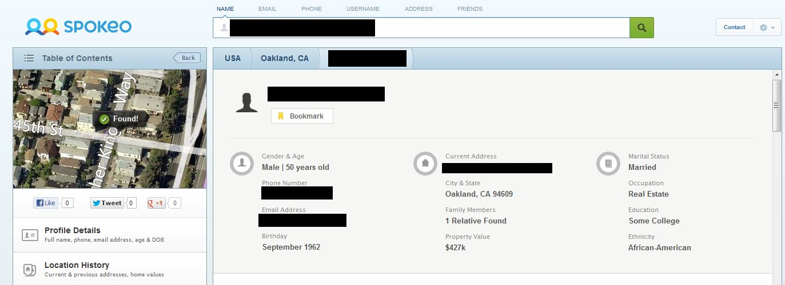
Spokeo, Spokeo

Slide 18
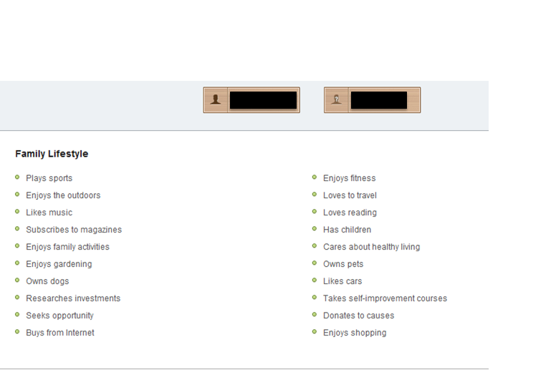
What Do Credit Cards and Car Salesman Think?

Slide 19
Reconaissance
Get the email, Get the gold.
Single Signon helps my recond
If you can get their main non-work email you can probably puzzle out all of their other accounts(facebook, amazon)
Spokeo revealed “Bob’s” as Bob7@gmail.com
On the internet he is Bob7 everywhere

Slide 20
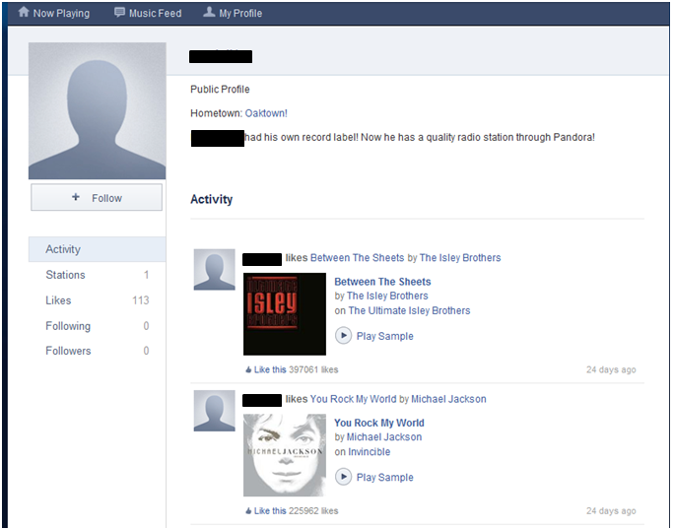
Pandora: What kind of stuff is he into?

Slide 21
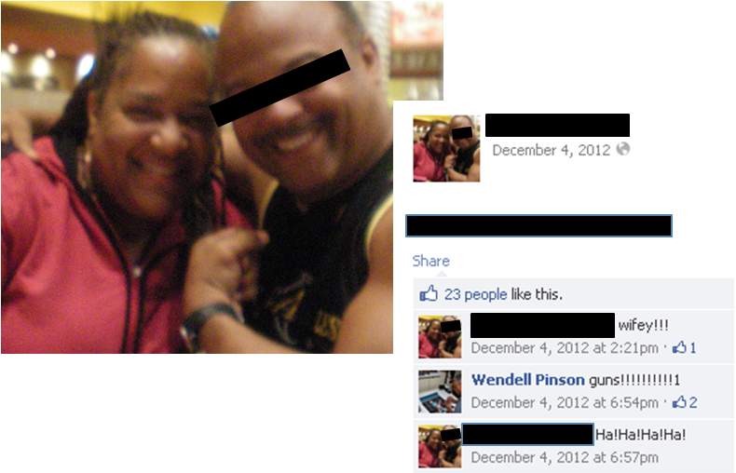

Slide 22
“Bob Smith”
Major PII leak through a TV Show
I just used boring info
Name, Job, Location
I constructed a detailed dossier of:
What music he likes
Where he lives
His Facebook page
His preferences in general

Slide 23
Masterclass

Slide 24
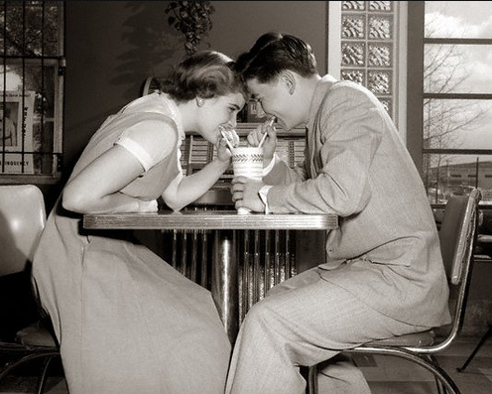
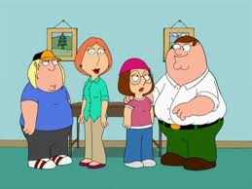
Where to Use These Skills?

Slide 25
Goal 1: Get Primary Social Email/Handle
What you usually know about your target
Name
Rough Idea of Age
Rough Idea of Location

Slide 26
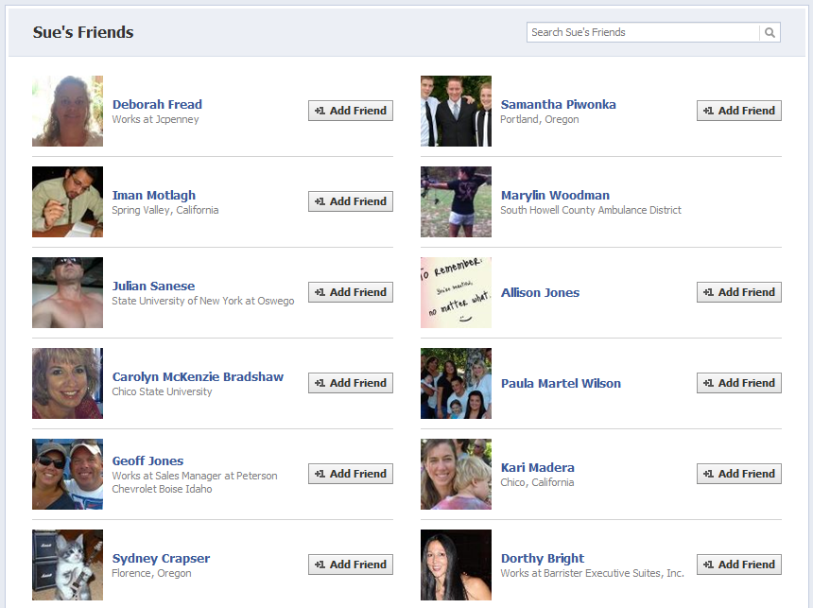
Go Facebook Yourself

Slide 27
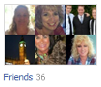
You’re Timeline Summary

Slide 28
Bing.com/social

Slide 29
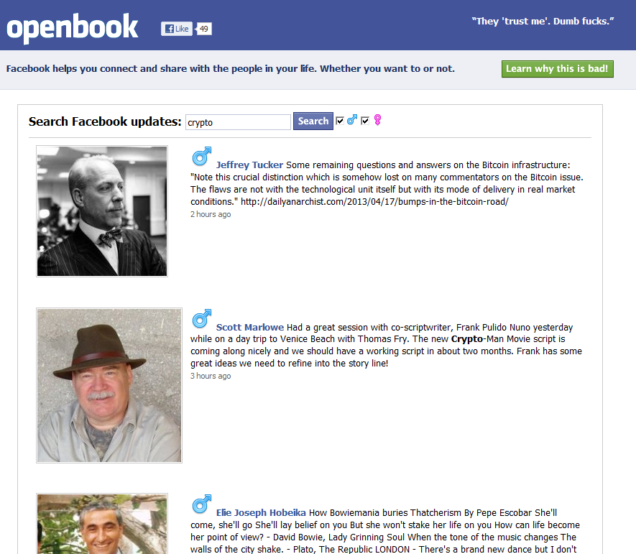

Slide 30
OpenStatusSearch.com

Slide 31
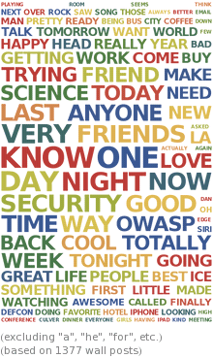
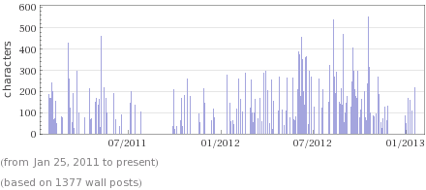
Wolfram Alpha Self-Analytics: WolframAlpha.com

Slide 32
Information is Power
FB chooses which posts to show you in your feed based on a variety of factors.
Someone commenting regularly will stay in your feed
Someone gazing at your page regularly and expanding your posts also seems to get them to have increased play in your feed.
Anybody notice anything else?

Slide 33
Tips for Looking at Strangers
Hunt for non-friends to your hearts content. They likely will never know.
Profile pictures are generally unlocked.
Pictures frequently unlocked.
Friends lists are also frequently unlocked
Family
Spouse
Friends
Look at the backgrounds in photos. Surroundings, books, reflections in glass, computer monitors.

Slide 34
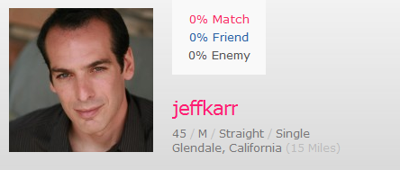
Date Smarter

Slide 35
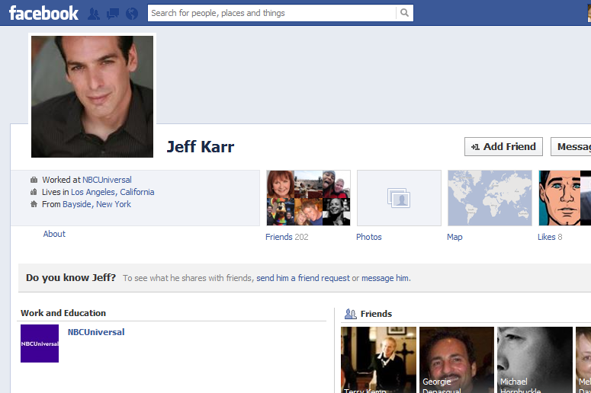
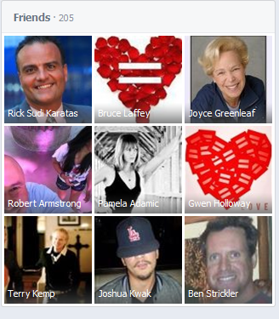
Oh Jeff! Change Up The Headshots

Slide 36
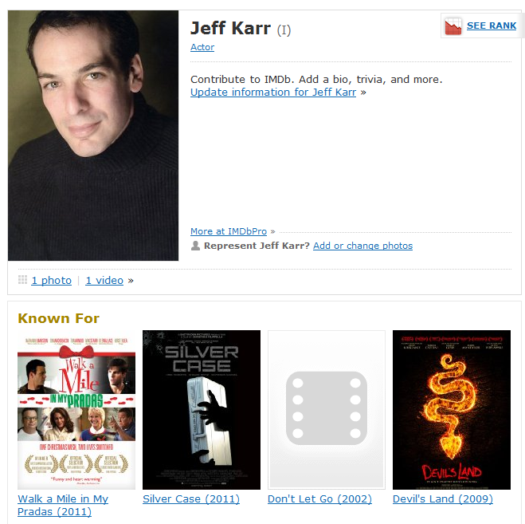
A Man With Some Fame!

Slide 37
TinEye and Google Googles

Slide 38
Google Googles

Slide 39
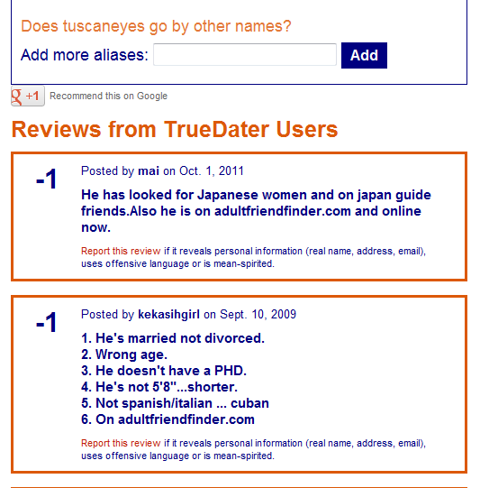
Ohhh Watch Out!! TrueDater.com

Slide 40
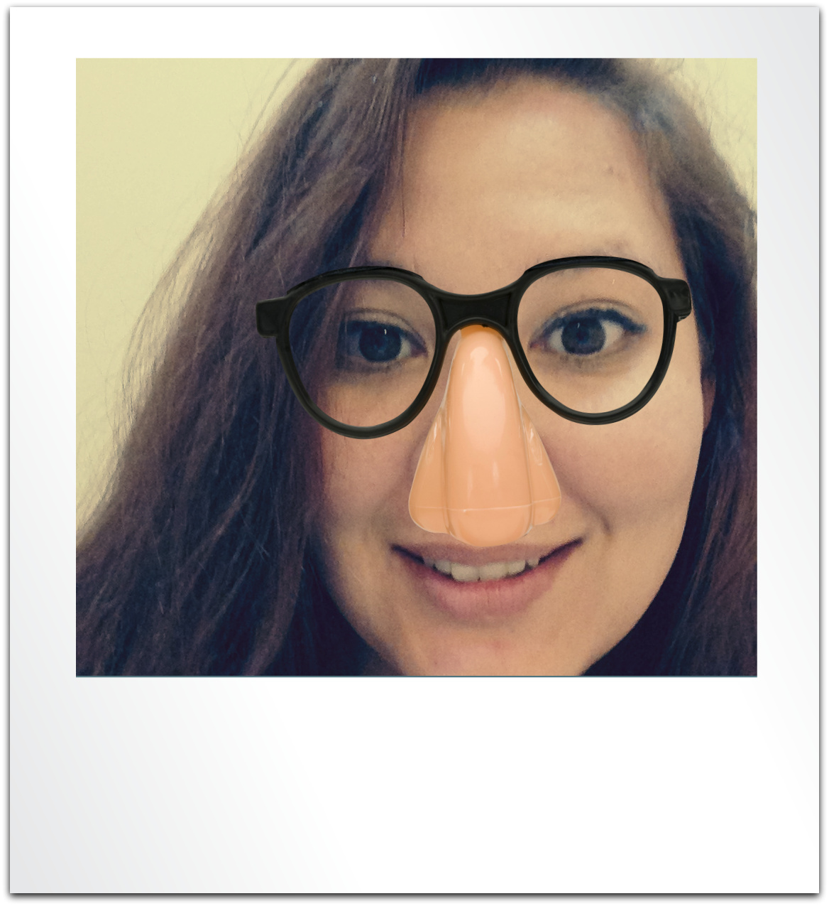
DefinatelyNotKelly

Slide 42
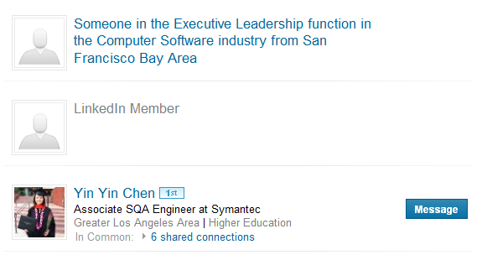
LinkedIn: Interesting, But Not Very Anonymous
Most people don’t pay LinkedIn memberships($20-$75/month)
If you are logged out you can only look at 1-2 profiles before LinkedIn cuts you off.
As an anonymous unpaid member, you aren’t so anonymous.
You aren’t able to see who looked at your profile
You Show up as “Someone…”

Slide 43
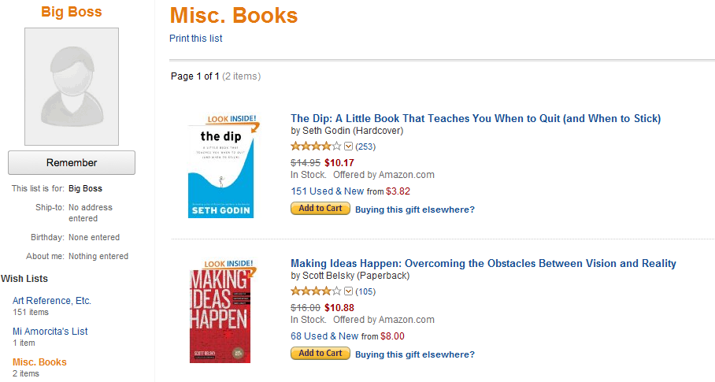
Targeted Gifts and Great Conversations

Slide 44
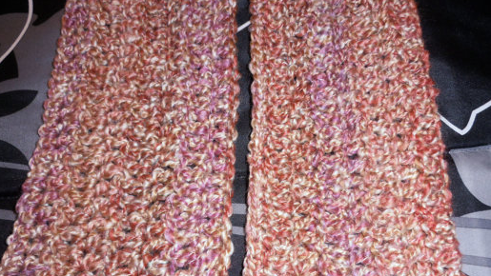
To Thy Own Frenemy Be True

Slide 45
Not So Friendly Skies

Slide 46
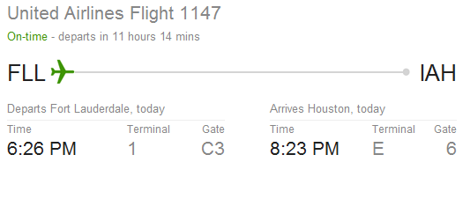
Flying is Private, Right?

Slide 47
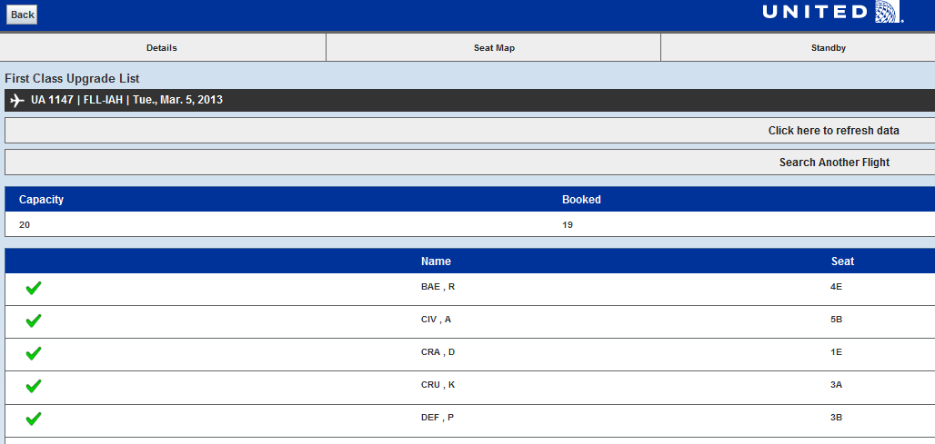
United Upgrade List

Slide 48
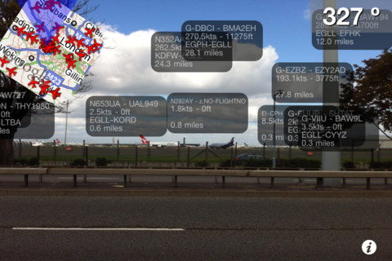
I Can See You: Planefinder

Slide 49
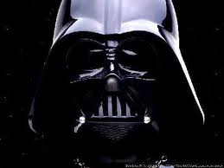
The Dark Side: Not illegal, but it might not feel right.

Slide 50
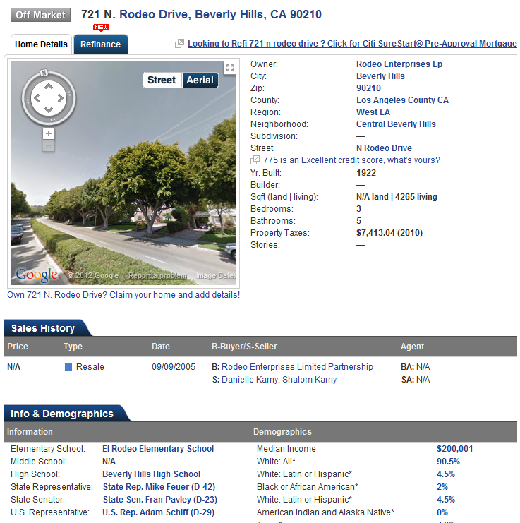
Zillow; Trulia; Spokeo; Blockshopper

Slide 51
Mugshots: Book Em’ Dano

Slide 52
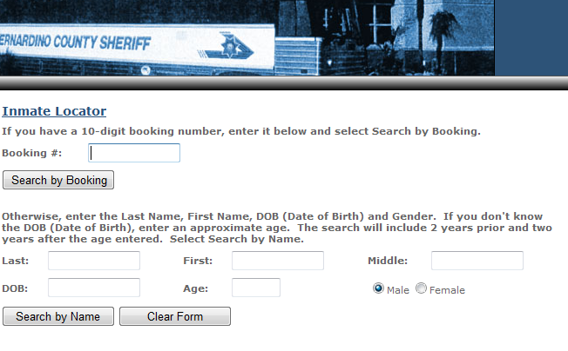
Finding Criminals Can Be Tough

Slide 53
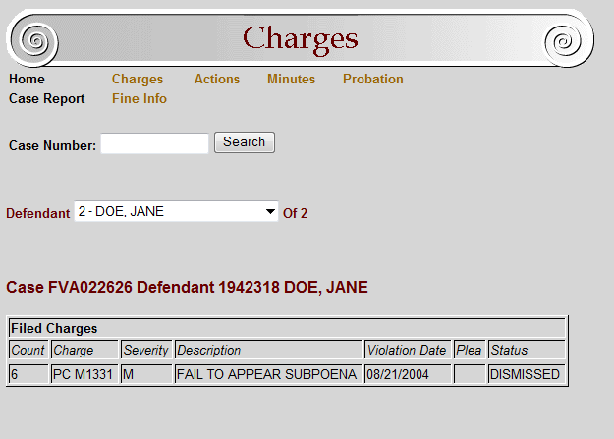
San Bernardino Criminal Search

Slide 54
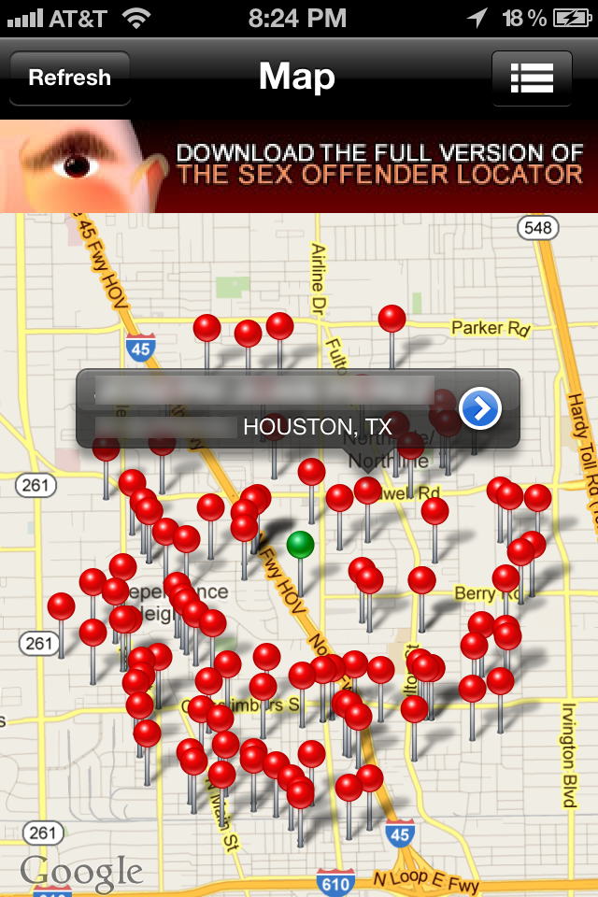
Megan’s Law: Offender Lite App

Slide 55
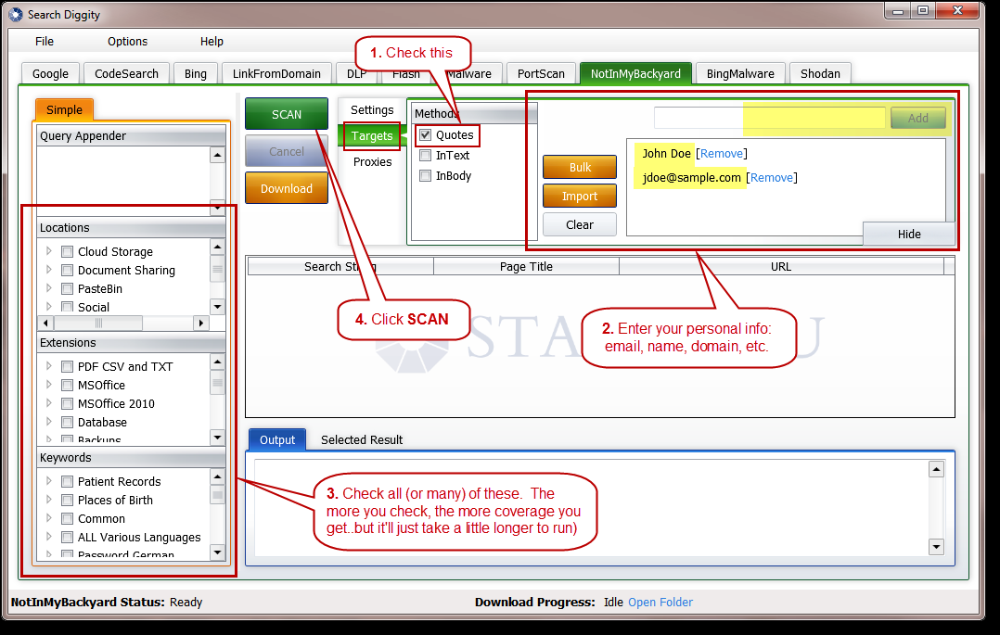
SearchDiggity: Free Tool From Stach and Liu

Slide 56
Should All This Information Be Accessible
Should what you do at 16 still be with you at 40?
The generation that is about to graduate grew up with the internet since 4 or 5.
Would you want to justify your purchases and posts from 20 years ago?

Slide 57
What Can I do?
Do sensitive things on other accounts
Don’t use Oauth for touchy situations
Remove yourself from Spokeo
Periodically Google yourself
Track old accounts and delete ones

Slide 58
Questions
???

