Slide 1
The Perilous Future of Browser Security
Robert Hansen
Director of Product Management

Slide 2
Robert “RSnake” Hansen
Director of Product Management (Labs)
International presenter
Ran ha.ckers.org
Author
Website Security for Dummies
Detecting Malice
Cross-site scripting attacks
Hobbies
Breaking the web so you don’t have to

Slide 3
Let me start by saying…
I love (most) people who work on browsers.
When I talk to them they seem:
Smart
Honest/Ethical
And they DO get the problem and understand the solutions
I mean guys like Dan Veditz (FF), David Ross (Chrome), Katie Moussouris (IE), etc. no disrespect. They’re awesome (really–buy them a drink, give them hugs, etc.).
However, I will argue that they are not allowed to do their jobs due to how their company’s business models are structured.

Slide 4
Question: Why are you here?
I don’t mean here as in this presentation.
I mean, why are you in security?
Money?
Fame/glory?
Protecting yourself?
Protecting others?
Jeremiah and I got into this to protect others and fix things.
If you want to have the biggest impact on security, browsers matter.

Slide 5
Scale of our problem (not to scale)
People using the Internet (2.4BN)
People who care about security/privacy (84-90%* = 2.16BN)
People we know and could theoretically help directly (probably millions)
People who use Noscript (1.9M users = 0.1%)
* http://www.innovationexcellence.com/blog/2013/03/14/when-do-people-care-about-privacy/

Slide 6
“…different people want different experiences, and are going to choose their browser based on that preference”
Chris Blizzard Director of Web Platform Mozilla

Slide 7
Security
Functionality
Usability

Slide 8
Shrinking bandwidth: managing competing demands
Monetizing users
Advertisers
Google
High conversion
Low CPC
High CTR
Good ROI
Higher ad spend
Fast performance
Fast performance
Users
Quality products
Search quality
Privacy
Security

Slide 9
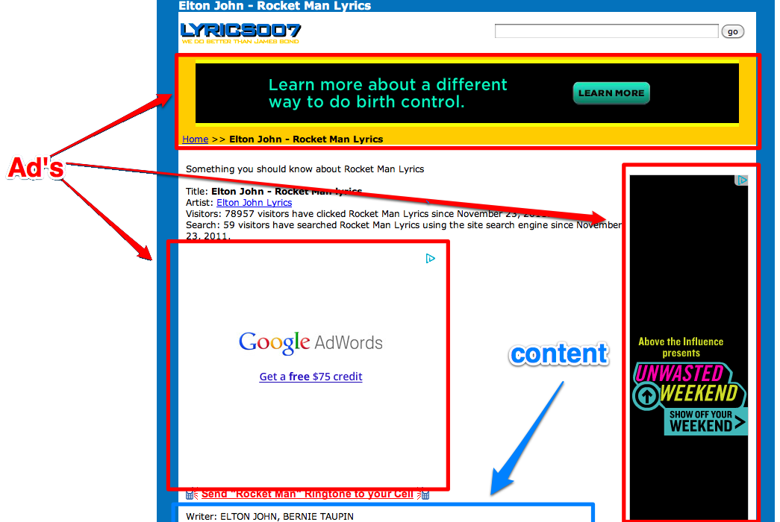
Yes, Google’s ads compete with advertisers
http://www.stateofsearch.com/wp-content/uploads/2012/01/ad-page-labeled.png

Slide 10
The goal…

Slide 11
You can’t start a project without a goal
Simplest goal possible:
Protect sensitive information.
My personal path to achieve that goal:
Every potential vulnerability should have at least two measures of defense because we should always assume at least one vulnerability in every defense mechanism.

Slide 12
Why can’t you just use Tor Browser?
The “Grandpa” problem
Tor Exit nodes are compromised (100 embassy password issue)
Grandpa sends sensitive info over HTTP
Exit node grabs data and steals Grandpa’s retirement

Slide 13
Anonymity vs. Privacy
Action | Anonymity | Privacy | Explanation
Want to submit a loan app | No | Yes | You must let the loan company know who you are anyway, so anonymity is inherently broken.
Want to surf legal adult material | Probably not | Yes | Unless your profession/relationships hinge upon morality, privacy is only required
Want to be a dissident | Yes | Yes | No one can be trusted – even relatives.
Research pressure cookers | Yes | Probably not | Someone may take it the wrong way if you search for something “bad” while your family will ask you first.

Slide 14
Average websites today

Slide 15
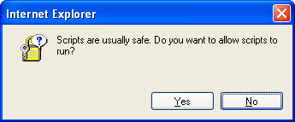
What I am personally willing to sacrifice…
Usability
I don’t personally need anything to be fast. In fact, speed kills (but I do want to be efficient).
I don’t need bookmarks, autofill, prefetching, web slice gallery, etc…
I don’t need “whizbang” websites, and if I do I’m willing to do “work” to get them to function as intended
I don’t care about popups or warnings as long as they are useful warnings of possible irreversible impending danger

Slide 16
Our Enemies

Slide 17
Xdomain*?
1
Solution:
RequestPolicy
Noscript (for iframes, JS and objects)
ABE
Port blocking
(both locally egress and at a network level via BSD pf)
Removing credentials often/upon logout
Split horizon DNS (when applicable)

Slide 18
Command execution
2
Solution:
Noscript & QuickJava
Removing protocol handlers (or they must ask for permission)
Click to play
Sandboxie (possibly similar to sandbox-exec or jailkit)
Windows 7 (gold images) – ASLR (go MS!!)
BSD chrooted jail (again, possibily similar to sandbox-exec or jailkit)
Anti-virus
Geli–similar to ftimes–data integrity
Application whitelisting and content integrity monitoring

Slide 19
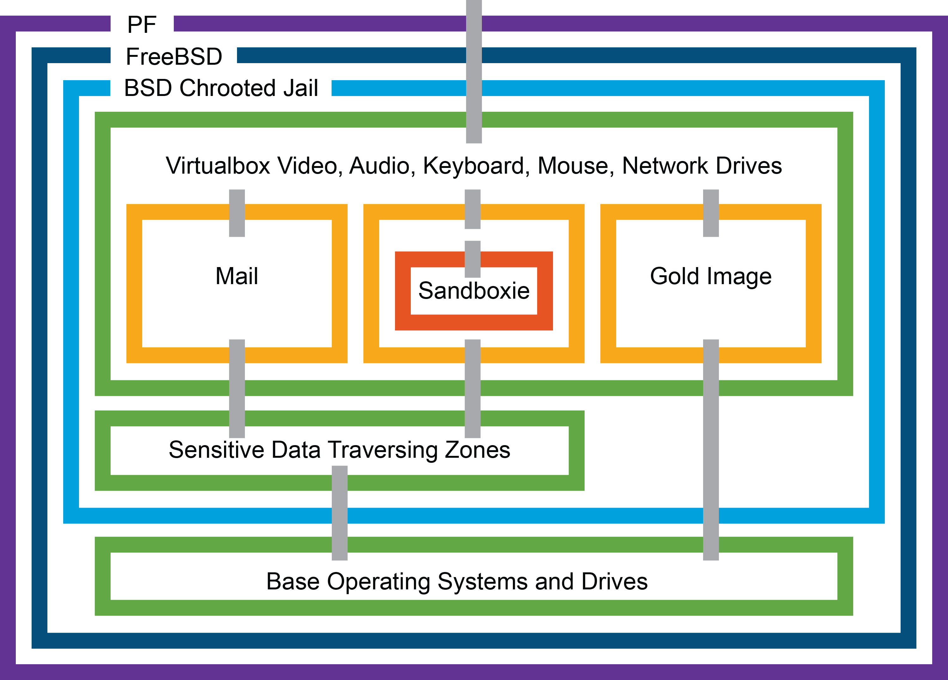
It’s like an onion…
FreeBSD building chrooted jails wrapping every VM individually, wrapping OSs, wrapping Sandboxie, wrapping Firefox

Slide 20
Data exfiltration and privacy
3
Solution:
Disabling Aero transparency theme (Windows 7+)
Removing credentials upon logout
Disabling anti-phishing and anti-malware support
RequestPolicy > AdBlock
Settings require plugin permissions
BurpProxy + Wireshark + processexplorer
Firefox built in lack of access to res:// file:// and Windows variables, but chrome:// and about:// could be just as deadly…
Gold image upon reboot removes old Flash cookies, etc… and has no access to “sensitive” files
FF is fixed CSS history hack

Slide 21
Man in the middle
4
Solution:
Internal CA instead of relying on Verisign, etc…
Gold image to remove temporarily allowed certs
Stand alone proxy support in Firefox + FoxyProxy
SSH and/or VPN tunnels (both are preferable)
Perspectives or sslvis (Just wish it worked!)
Problem! What about burp proxy!?
Chain Firefox -> Burp -> local SSH tunnel
Or use a VPN in a VM and wrap all traffic

Slide 22
Pretexting/phishing
5
Anti-phishing lists can’t be trusted
No good solutions, but there are funky solutions:
OpenDNS’s phish tank (if you trust them and can use them)
NoScript + ABE + Request Policy to disable JS in superbait scenarios and break links to high value pages (if they don’t break, that’s a problem). Of course this doesn’t work with email.
Education!
I worked on anti-phishing products at eBay, am a life-member of APWG, am on the advisory board of phishme.com, etc… so….
No password re-use minimizes potential impact

Slide 23
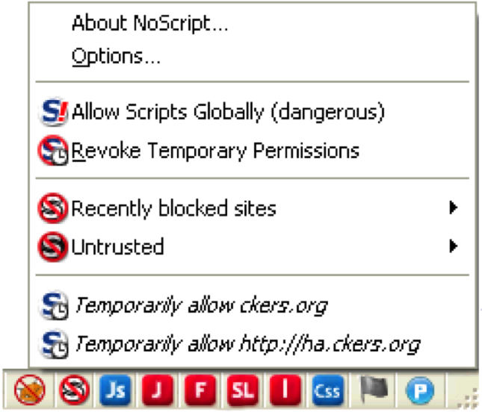
Some of my plugins
Noscript
XSS, clickjacking, ABE
Foxyproxy
FF has stand alone proxy support (both good and bad)
RequestPolicy
CSRF, clickjacking, some XSS
QuickJava
Redundancy
Perspectives
MitM
Noscript
Foxy Proxy
Quick Java
Request Policy
Perspectives

Slide 24
Scorched earth approach

Slide 25
What must my browser look like? (be afraid…)

Slide 26
Behold: CNN

Slide 27
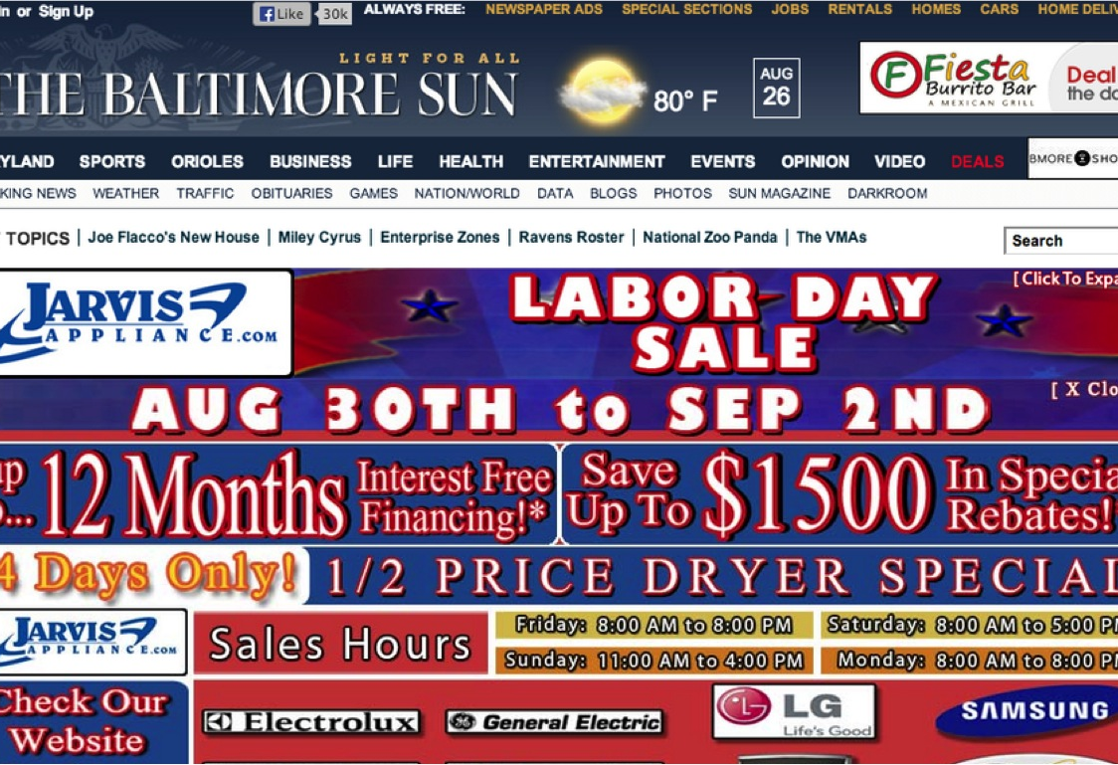

Slide 28
Ads
“…we couldn't run our system if everything in it were encrypted because then we wouldn't know which ads to show you. So this is a system that was designed around a particular business model.”
– Vince Cerf, Google
“You get the smartest people in the world together, the best people this industry has to offer, for the sole purpose of serving up ads?”
– Jeremiah Grossman, WhiteHat Security

Slide 29
People actively dislike advertisers
Percent of adult internet users who say they have used the internet in ways to avoid being observed or seen by…

Slide 30
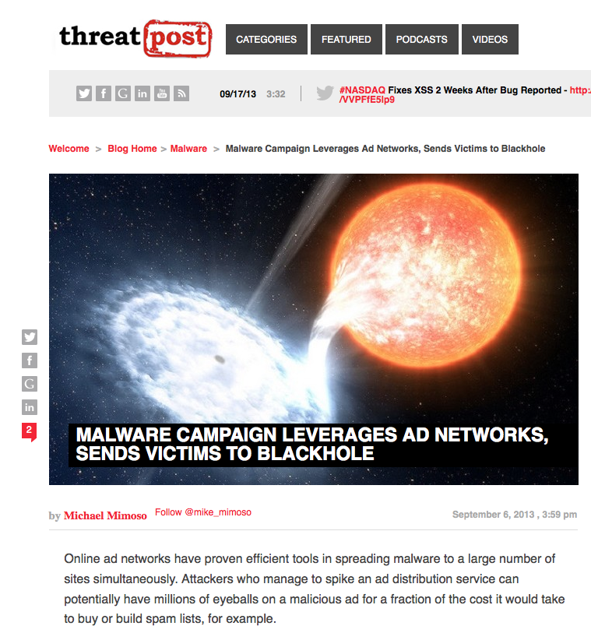
Why are ads so bad anyway?
Often fraudulent (E.g., Malvertising, virii)
Waste of time/ bandwidth/page load
Synonymous with tracking
Often very offensive (E.g.: women/children)
Obnoxious to the eyes and ears

Slide 31
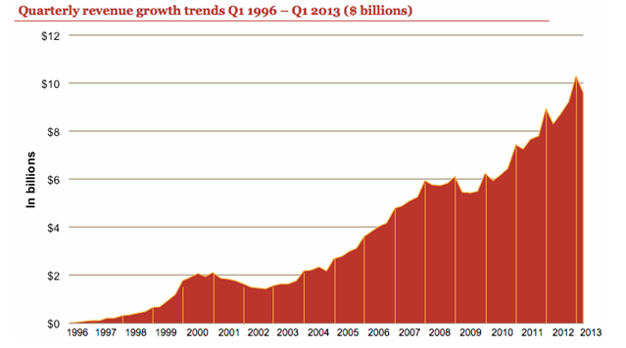
Big business drives big data

Slide 32
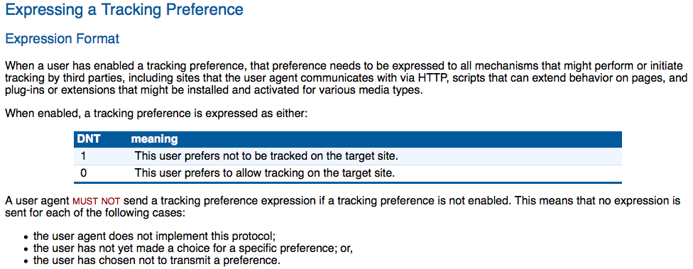
DNT: number one complaint
IE10 doesn’t respect the spec.

Slide 33
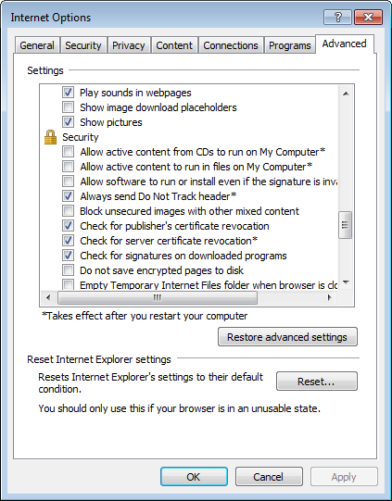
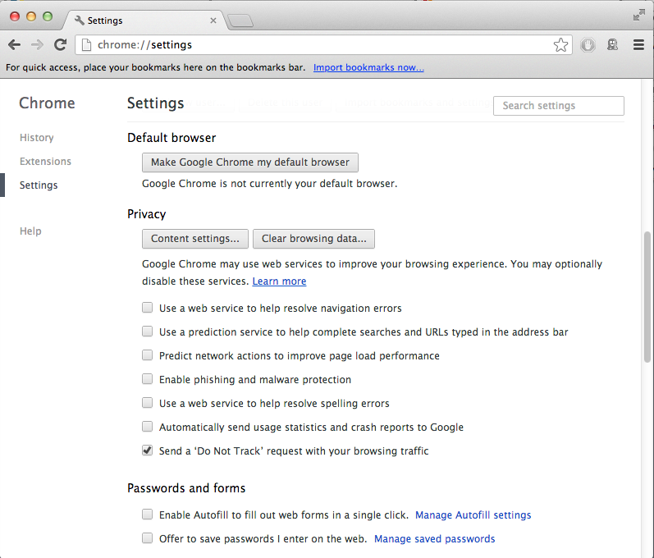
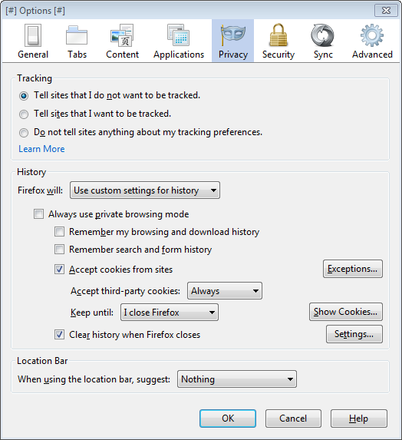
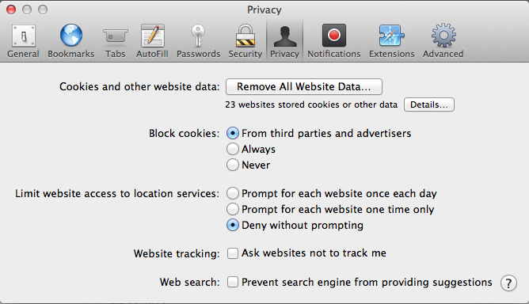
DNT UI: not compliant

Slide 34
DNT
Yahoo/Pinterest/Twitter support it, sorta
When asked, consumers want privacy:
http://www.neowin.net/news/microsoft-only-47-percent-of-people-try-to-protect-their-privacy-online (84%)
http://www.innovationexcellence.com/blog/2013/03/14/when-do-people-care-about-privacy/ (90%)
Ad co’s are backing out of compliance

Slide 35
DNT by the numbers: Part I
How many clicks away?
IE10: ALT, Tools, Internet Options, Advanced, Scroll, Click, OK (7, however on by default so really, 0)
FF: Click on Firefox, Options, Privacy, Click, OK (5)
Chrome: Click on Chrome, Preferences, Scroll, Click “Show advanced settings”, Scroll, Click (6)
Safari: Click on Safari, Preferences, Privacy, Click, OK (5)

Slide 36
DNT by the numbers: Part II
It’s not how the spec works – it’s how browsers user it. Opt out = no signal.
If we believe the Trueffect numbers:
IE10: 86.46%* Now sends DNT
FF: 19.27%* Now sends DNT
Chrome: 2.85% Now sends DNT
http://blog.trueffect.com/bid/328804/Microsoft-Internet-Explorer-10-and-Trueffect-Changes-To-Do-Not-Track
http://news.softpedia.com/news/17-Percent-of-Firefox-Users-Have-Enabled-Do-Not-Track-351175.shtml

Slide 37
DNT by the numbers: Part III
Which browser (IE10, Chrome or Firefox) respects user wishes more?
Let’s ignore IE10? That’s good for everyone, everywhere, IE, FF, Google, the Advertisers — everyone except the consumer. DNT was a distraction, but a useful one for (ironically) for data collection.

Slide 38
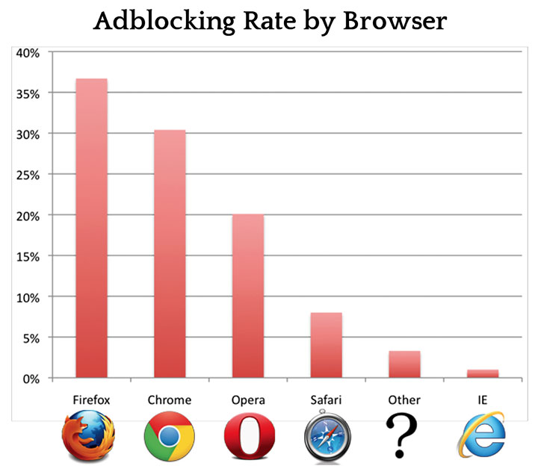
How does that relate with ad blocking?
http://downloads.pagefair.com/reports/the_rise_of_adblocking.pdf

Slide 39
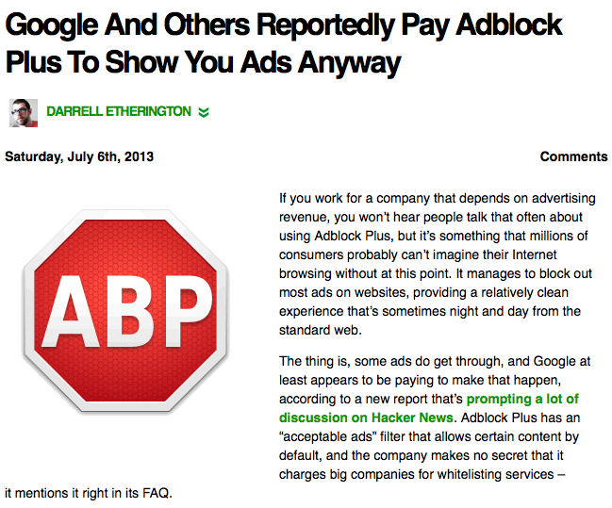
An “ad war?” Yes.
First there was annoying ads
ABP became the most downloaded add-on at 14.9M active users
Then ads companies pay off ABP
Then Congress got involved???

Slide 40
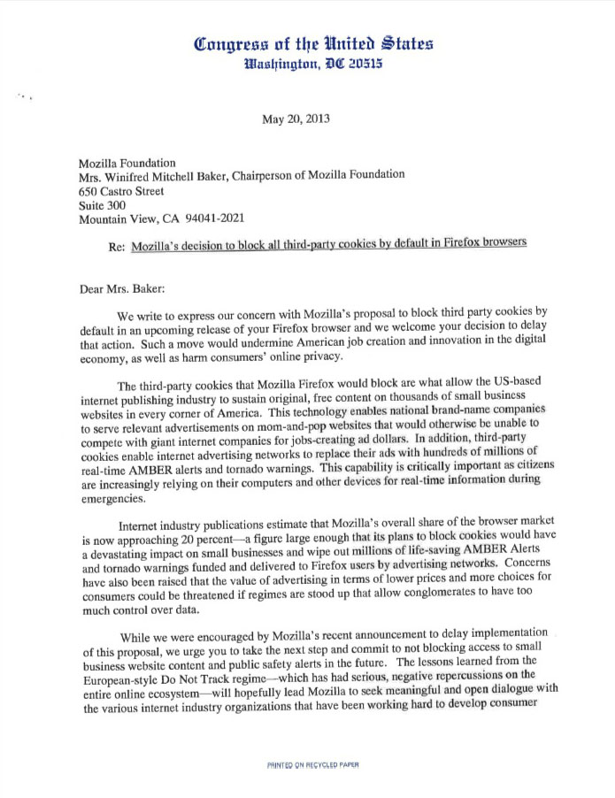
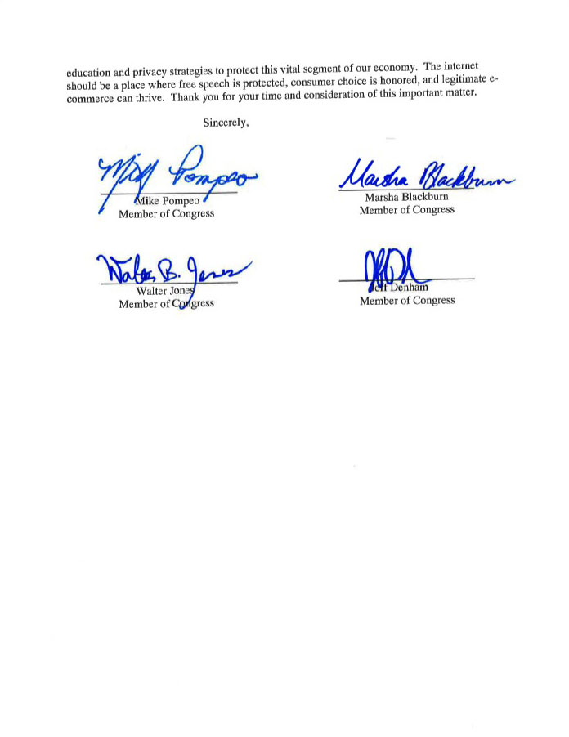
Say WHAAAAT? That’s right, Congress!
http://stanford.edu/~jmayer/content/Pompeo_Mozilla_Letter.pdf

Slide 41
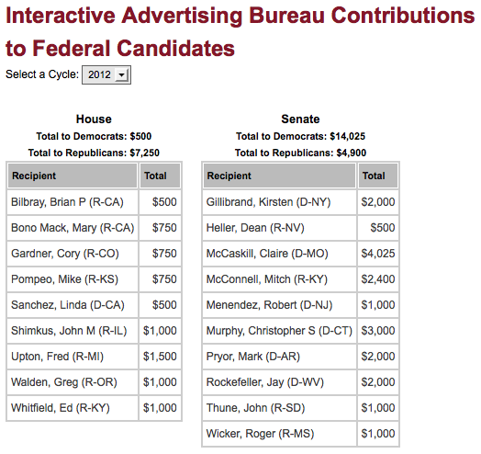
Payoffs? What payoffs?

Slide 42
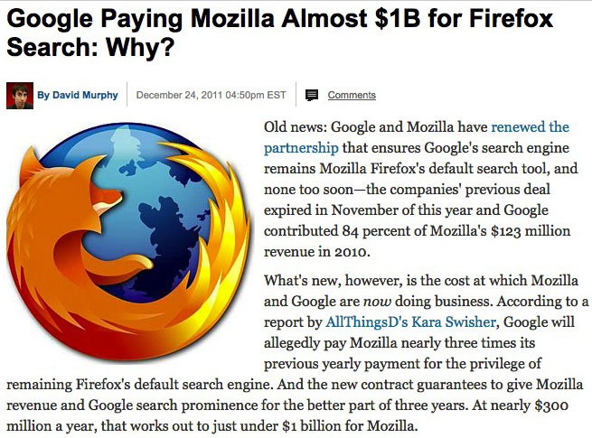
The battle lines are drawn
The Ad industry doesn’t believe in 3rd party cookie blocking because it hurts tracking and therefore revenue. Remember: $40 billion a year for Googe alone!
Browser companies do what the industry wants because they are paid by ads: Google: 96% of it’s revenues = ads* Firefox: 98% of it’s revenues = search deals, of which Google makes up ~80-90% of those deals*
http://www.investopedia.com/stock-analysis/2012/what-does-google-actually-make-money-from-goog1121.aspx
http://www.computerworld.com/s/article/9220695/Mozilla_relies_on_search_deals_for_98_of_revenues
http://www.pcmag.com/article2/0,2817,2398046,00.asp

Slide 43
Where are ads (probably) heading?
Logical conclusion is that derivatives of ad blocking (E.g. Disconnect) will win against most 3rd party JavaScript ads, sans virus evasion techniques: fast-flux.
However, advertisers will react by creating locally hosted/obfuscated ads.
Companies will increase blackmail tactics to force viewers to see ads.
Regulation. DNT via FTC. Consumers win, sorta. Google attacks Ad blockers.

Slide 44
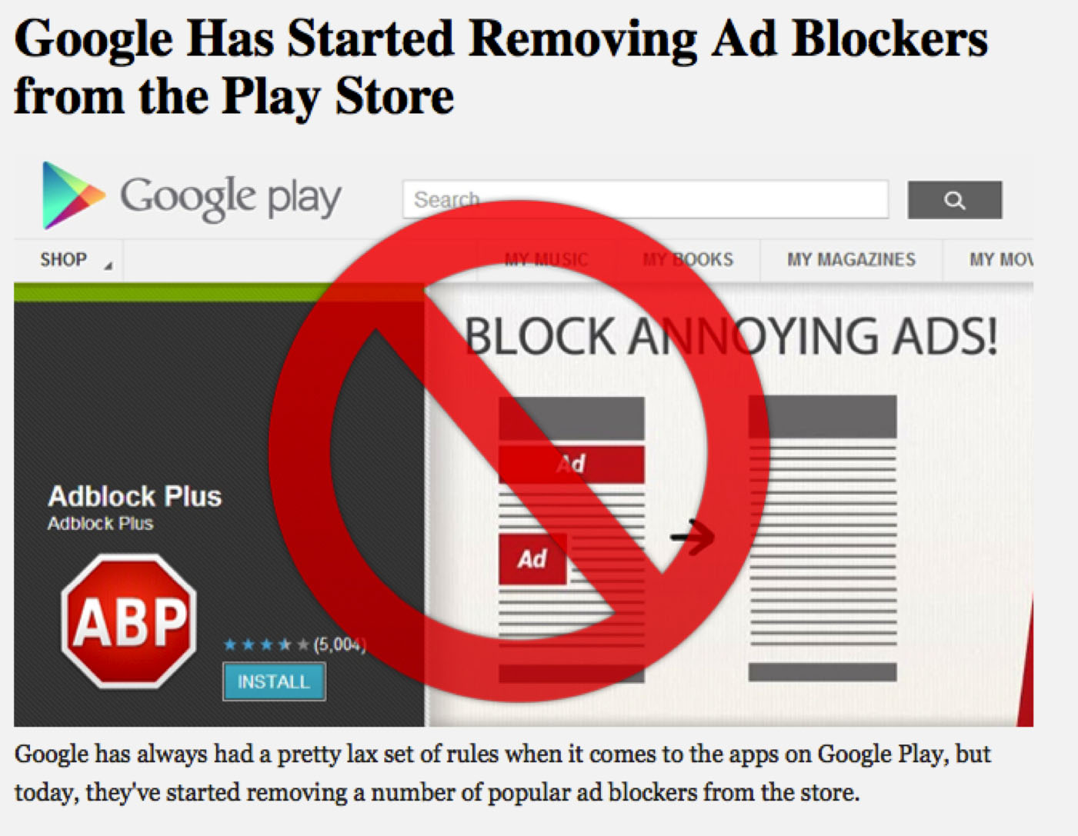
Where are ads (probably) heading?
What? Google attacking ad blockers? “No wayyyyy…” I can hear you saying….
“4.4 Prohibited Actions. You agree that you will not engage in any activity with the Market, including the development or distribution of Products, that interferes with, disrupts, damages, or accesses in an unauthorized manner the devices, servers, networks, or other properties or services of any third party including, but not limited to, Android users, Google or any mobile network operator…”

Slide 45
What’s the “so what?”
So yes, DNT may be a waste of time and as a result, IAB and advertisers ignore it. Numbers-wise it’s still great.
So let’s build technical controls to opt for what the consumer actually wants, not what the advertisers want.
Do-Not-Track < Can-Not-Track
Once the advertisers learn how to behave we can reconsider this approach.

Slide 46
What should we do?
Don’t recommend my setup to the masses – we need something better!
Socialize that most browser vendors probably want to do the right thing, but their $40BN/year business models (and fear of lawsuits) prohibit it.
Start tackling the problems one at a time: higher security and privacy to feature ratio.
Always side with the consumer, they are our families and they should always win. It’s ethical and good for our Internet.

Slide 47
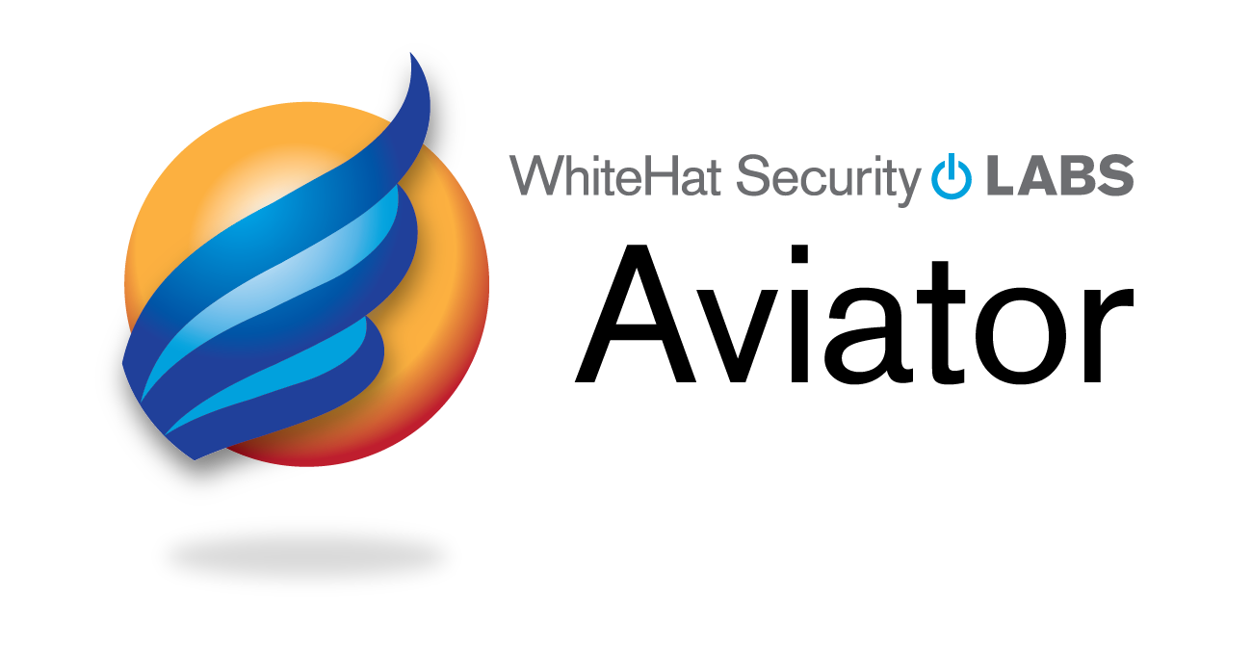
What is WhiteHat doing?
WhiteHat is in a unique position of zero conflict of interest with privacy/security.
We don’t believe in “Do-Not-Track”, we continue to embrace “Can-Not-Track”
Aviator will add in additional security and privacy features.

Slide 48
Thank You.
Robert Hansen
Director of Product Management
@RSnake

