Slide 1
Buried by time, dust and BeEF
Antisnatchor – OWASP AppSec USA 2013

Slide 2
Disclaimer
My views and opinions do not represent those of my employer
My employer has nothing to do with anything related to BeEF

Slide 3
Who am I ?
Co-author of Browser Hacker’s Handbook (pre-order from Amazon.com, available March 2014)
BeEF lead core developer
Application Security researcher
Ruby, Javascript, OpenBSD and BlackMetal fan

Slide 4
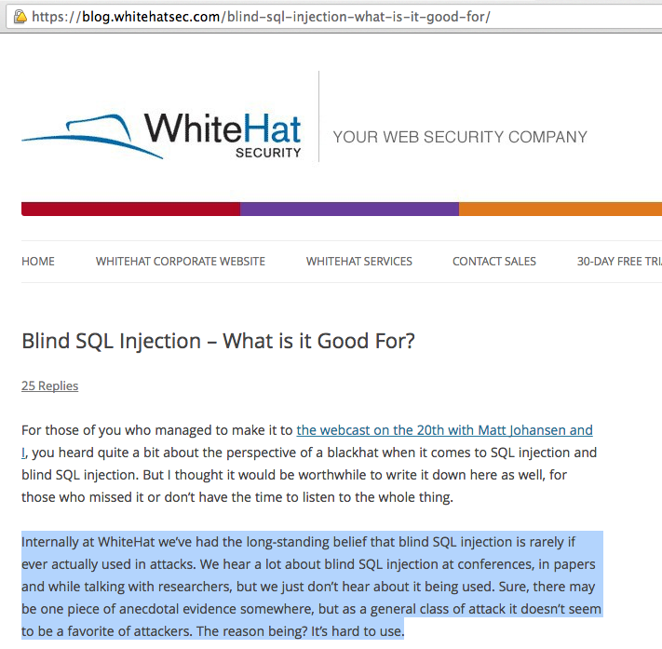
This made me LOL

Slide 5
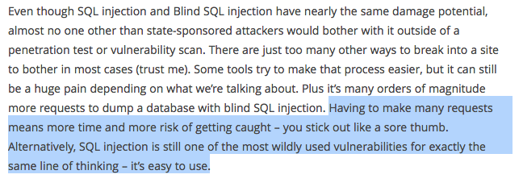
And this made me ROFL (same page, scroll down)

Slide 6
The issue
If the problem is getting caught:
  Spawn from 3 to X VPSs:
    1. Each of them has SQLmap
    2. Each of them dump a different data set
    3. Each of them uses a different chain of proxies
    4. When 1 data set is dumped, change the proxy chain.
    Restart from point 1
Downside: might not be cost-effective (depends on the data dumped :-). I don’t have enough money…

Slide 7

The issue

Slide 8

The issue
Solving the issue without paying for multiple VPSs/infrastructure….

Slide 9
Use BeEF
Exploit Time-Based Blind SQLi from multiple hooked browsers
It’s the hooked browser that (just through JavaScript) send requests and dump data
A forensic team will see a connection from multiple hooked browsers at the same time

Slide 10
Use BeEF
Install BeEF and OpenVPN on a VPS
VPN client -> TOR (or other proxies) -> VPS
Hook some browsers
Instruct the browsers to dump data for you
When finished, terminate the VPS

Slide 11
Some background
Same-Origin Policy and XHR
Why Time-based Blind SQLi?
The beautiful features of MSSQL
BeEF and putting all together

Slide 12
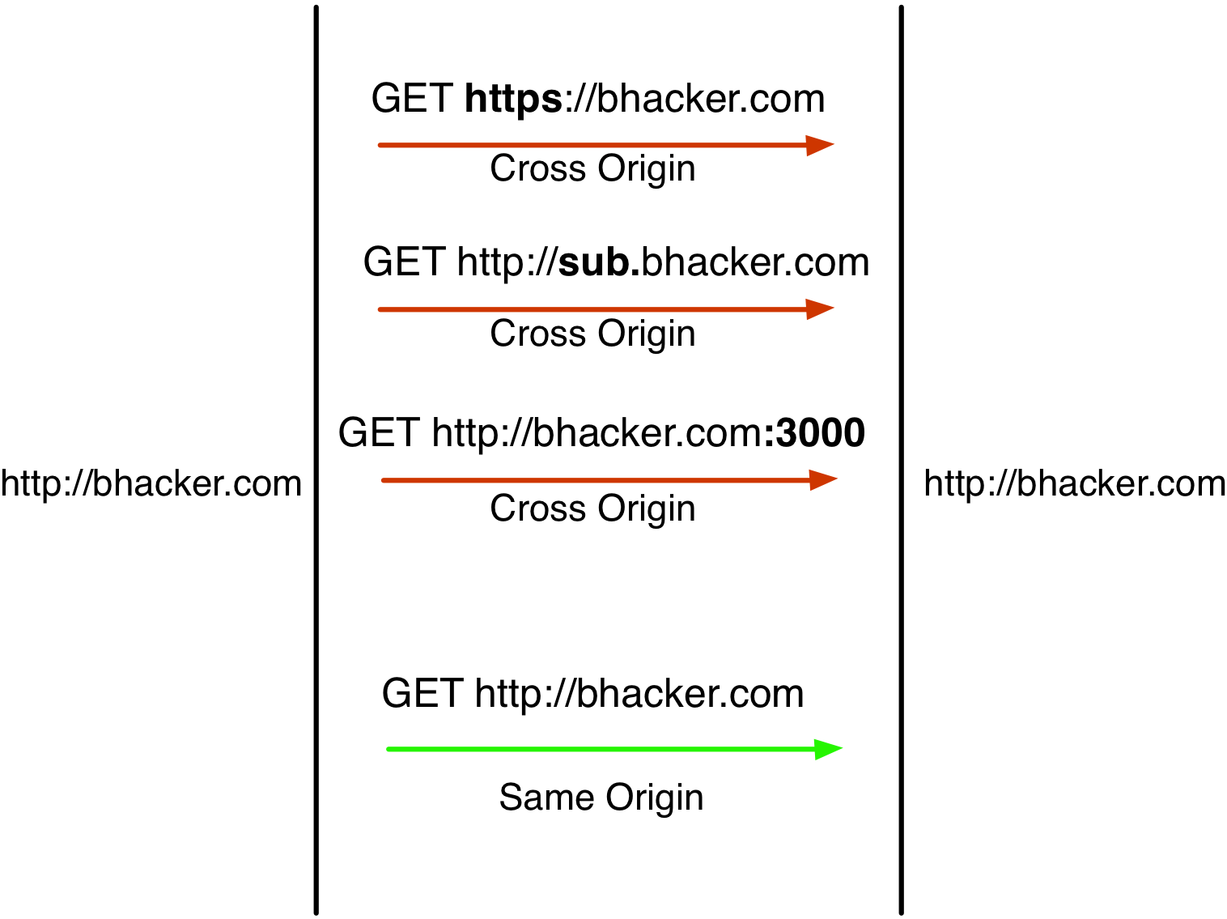
Same-Origin Policy and XHR

Slide 13
Same-Origin Policy and XHR
Cross-origin XmlHttpRequest
  You can’t read the HTTP Response (you need Access-Control-Allow-Origin, or a SOP bypass)
            But….
  You can still send the request
    The request arrives to the destination
  You can check the state of the request
    xhr.readyState

Slide 14
Same-Origin Policy and XHR: implications
Exploit RCE cross-origin from the browser
  See BeEF exploits on Jboss, GlassFish, and others
  You don’t need to read the response, just “blindly” send the attack vector
Exploit XSRF
Internal network attacks
  Ping sweeping, port scanning, and much more
  Inter-protocol communication and exploitation
    Wait for Browser Hacker’s Handbook :D

Slide 15
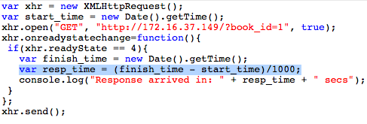
Same-Origin Policy and XHR: implications
If you can know if xhr.readyState == 4
  You can monitor the timing
  Just create 2 Date objects before and after sending the request, and do simple math :D

Slide 16
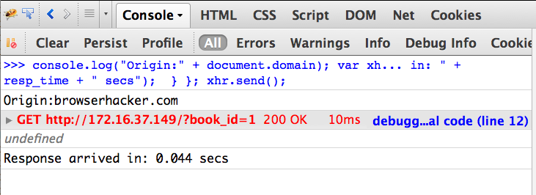
Same-Origin Policy and XHR: implications
Firefox 24

Slide 17
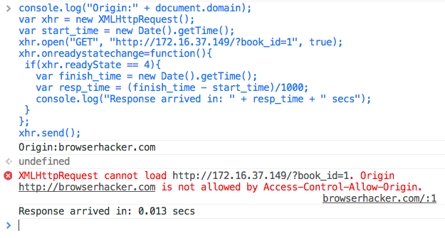
Same-Origin Policy and XHR: implications
Chrome 29

Slide 18
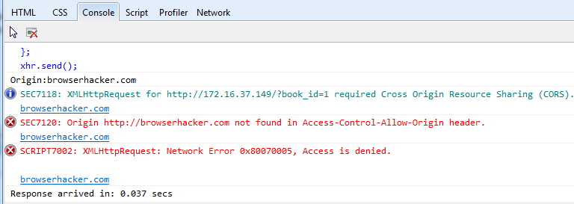
Same-Origin Policy and XHR: implications
Internet Explorer 10

Slide 19
Why Time-based Blind SQLi?
If we can infer the timing of the response, we can exploit Time-based blind SQLi cross-origin!
Actually any type of SQL injection flaw can be exploited with Time-based blind vectors
  Sometimes time-based blind is the only way to exploit an instance of SQLi
    Sometimes SQLmap (great tool, kudos Bernardo!) is able to exploit SQL injections only using time-based vectors

Slide 20
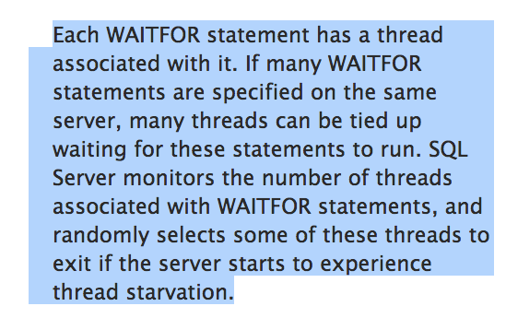
The beautiful features of MSSQL
http://msdn.microsoft.com/en-us/library/ms187331.aspx

Slide 21
The beautiful features of MSSQL
http://msdn.microsoft.com/en-us/library/ms187024.aspx
SQL Server 2008 R2 (<= 4 CPUs):
    256 thread pool (x86)
    512 thread pool (x86_64)
I did my tests on SQL Server Express (on Windows 7)
  Connection numbers/thread pools are much more limited

Slide 22
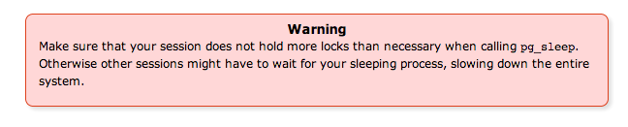
The beautiful features of MSSQL
MySQL and Postgres do not support this
  Postgres example: http://www.postgresql.org/docs/8.2/static/functions-datetime.html
Still, you could use BENCHMARK or other similar functions
  Excessive CPU load if parallelized? Probably

Slide 23
The beautiful features of MSSQL
With DBs != MSSQL you can still exploit SQLi using Time-based Blind vectors from the browser
  But you can’t parallelize requests
Most ASP/.NET applications uses MSSQL
MSSQL presence in the internet is widespread

Slide 24


The beautiful features of MSSQL

Slide 25
BeEF and putting all together
MSSQL only right now
  PoC retrieving DB and Table names
  Concurrent approach
  Multiple WebWorkers
  Multiple hooked browsers
  3 to 4 times faster than SQLmap
    They disabled multi-threading when using time-based blind vectors, with every database, even MSSQL
    Can be re-enabled hacking the source code

Slide 26
Concurrent approach: WebWorkers
Classic binary search inference
  IF ASCII(SUBSTRING((...),position,1)) > bin_value WAITFOR DELAY '00:00:02';--
  Position: byte position in the string to retrieve
  Bin_value: current mid value in the binary search
  Retrieving DB name (first request, first byte):
  http://172.16.37.149:8080/?book_id=1%20IF(UNICODE(SUBSTRING(
  (SELECT%20ISNULL(CAST(DB_NAME()%20AS%20NVARCHAR(4000)),
  CHAR(32))),1,1))%3E64)%20WAITFOR%20DELAY%20%270:0:2%27--

Slide 27
Concurrent approach: WebWorkers
If the response is delayed, the first byte of the DB name string is > 64 (Integer value)
If the response is NOT delayed, the first byte of the DB name string is <= 64 (Integer value)
Example with first byte == 115 (“s”)
Response delayed. Char is > 64
Response delayed. Char is > 96
Response delayed. Char is > 112
Response not delayed. Char is < 120
Response not delayed. Char is < 116
Response delayed. Char is > 114
Response not delayed. Char is == 115 -> s

Slide 28
Concurrent approach: WebWorkers
Given a pool of WebWorkers (controlled by a state-machine in JavaScript)
    Every WW manage one byte (7 requests each)
    You can retrieve up to <pool_size> bytes at the same time
    WW communicate with the “parent” state-machine with postMessage()
    Everything is happening from and in the browser

Slide 29
Concurrent approach: multiple browsers
As we can parallelize requests with WebWorkers, we could even distribute the data dumping process across multiple browser
  Reliability
    Minimize the impact of loosing an hooked browser
  Stealthiness (and piss-off forensic guys)
    The attack looks like coming from different sources
  Fun (and piss-off forensic guys)
    You want to target company X, which has company Y as competitor: hook some company Y browsers, and instrument them to exploit a SQLi in company X website :D
    Company X will think company Y is attacking them

Slide 30
BeEF and putting all together
Demo
  Video, as last year two live demos failed (Vmware Fusion issues, broken VM, porco dio!)
  https://vimeo.com/78055061

Slide 31
BeEF and putting all together
If you liked this talk, support BeEF buying:
  Pre-order on Amazon available, out March 2014
  50% of revenues will be used for the BeEF project (testing infrastructure, etc..)

Slide 32

Wrap-up
Thanks to Wade Alcorn for inspiration, research motivation, and for being awesome!
Thanks to Bernardo Damele (SQLmap)
Thanks Tom Brennan (semper fi)
Thanks Trustwave for paying my trip here
BeE(F)R time now!

