Slide 1
Passwords Breaches, Storage, Attacks
OWASP AppSec USA 2013

Slide 2
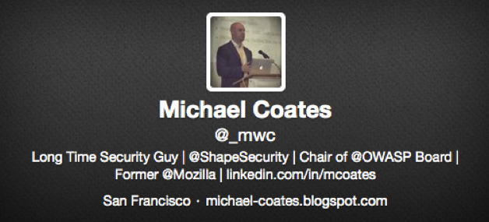
About Me
michael@ShapeSecurity.com

Slide 3
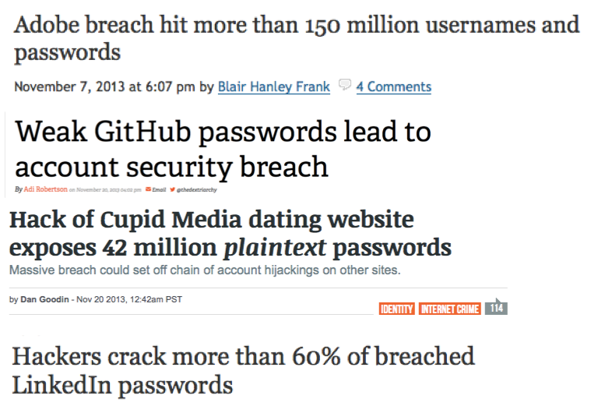
Password in the News

Slide 4
Understanding Password Threats

Slide 5
Online Attacks
^{Online Attacks}
Attackers interact with web interface via scripts & automation
Defenses Available: Account Lockout, Attacker Profiling, Anti-automation
^{Example Online Attacks}
Password Brute Force - 4 variations
Credential Stuffing - (Reuse of compromised passwords)
^{Account Lockout}

Slide 6
Offline Attacks
^{Offline Attacks}
Attackers have password hashes and are performing attacks against file
Defenses Available: Only the strong hashing algorithm you selected
^{Example Offline Attacks}
Hash brute force - dictionary or iterative
^{Rainbow tables}

Slide 7
Offline Password Storage

Slide 8
Password Storage
Bad Approaches
^{Your own algorithm}
^{md5}
^{sha1}
^{encryption}
^{base64 encoding}
^{rot 13}
Good Approach
^{Bcrypt}
^{Scrypt}
^{PBKDF2}
⁺ Per user salt

Slide 9
Additional Attacks

Slide 10
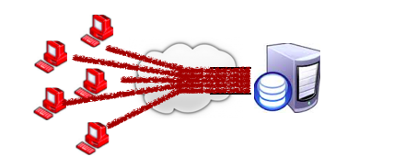
Denial of Service
Denial of Service (DOS)
Distributed Denial of Service (DDOS)

Slide 11
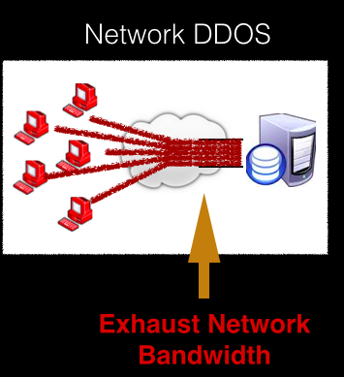
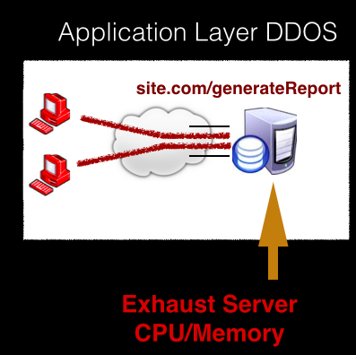
Denial of Service

Slide 12
DDOS Comparisons
Traditional Network DDOS
^{overwhelms target with volume}
exhausts bandwidth / capacity of network devices
Requires large number of machines
Defenses: CDN, anti-DDOS services
Application Abuse DOS
invokes computationally intense application functions
exhausts CPU / memory of web servers
^{Requires few machines}
Defenses: Few available, must customize

Slide 13
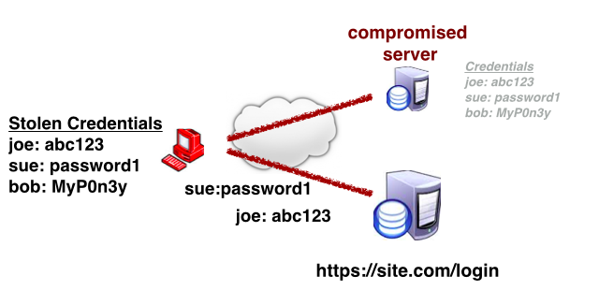
Credential Stuffing
Account Take Over - Credential Stuffing

Slide 14
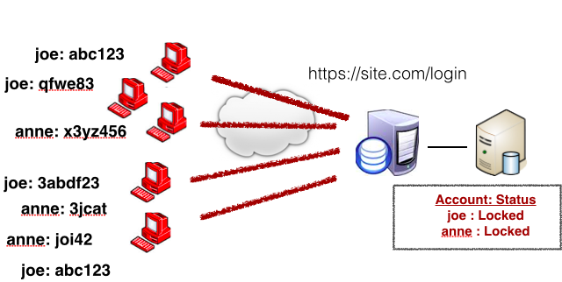
Distributed App Lock Out
Distributed App Lock Out

Slide 15
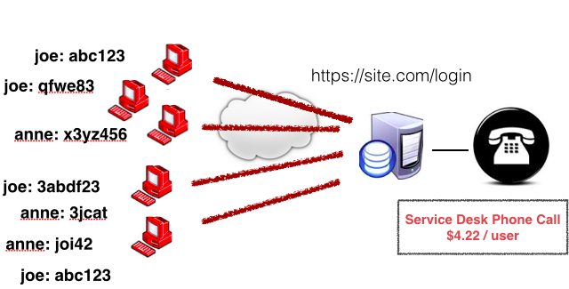
Service Desk Overload
Service Desk Overload

Slide 16
Take Aways
Password Hashing
Don’t get breached - Defense in depth
Don’t exacerbate breach – use correct hashing
Online Attacks
Prepare for automated attacks
Different attacks and motivation from Criminal Enterprises, Hacktivism, Nation State, etc

Slide 17
Thanks!
michael@shapesecurity.com
http://michael-coates.blogspot.com
@_mwc

