Slide 1
Wassup MoM? Owning the Message Oriented Middleware
By:
Gursev Singh Kalra – Senior Principal
McAfee Foundstone Practice

Slide 2
Agenda
Messaging 101
Introduction to JMSDigger
Attacking the Message Broker – ActiveMQ Case Study
Attacking a Messaging Application
Several demonstrations along the presentation
Q&A

Slide 3
About me
Written several security tools (JMSDigger, Oyedata, Clipcaptcha, TesserCap & SSLSmart) and whitepapers
Wear multiple hats (Java security, web application security, mobile etc…)
Research voted among top ten web hacking techniques of 2011 and 2012
gursev.kalra@foundstone.com , (@igursev)
Blog http://gursevkalra.blogspot.com

Slide 4
Messaging 101

Slide 5
Enterprise Messaging
Notes:
NOTE: Enterprise messaging is not same as messaging. It is not Skype/communicator

Slide 6
Enterprise Messaging
Enables communication between enterprise systems written in disparate technologies via messages
Provides
Heterogeneous Integration
High Scalability and Reliability
Asynchronous Operation
Forms the transactional backbone for a very large number of organizations worldwide
Notes:
NOTE: Enterprise messaging is not same as messaging. It is not Skype/communicator

Slide 7
An Enterprise Messaging Application (Simplified)
Message Broker (Queues, Topics and custom code)
Messages
Messages
Client A
Client N

Slide 8
What is a Message?
An object that transfers data between JMS clients
Made up of Headers, Properties and a Body
May contain financial information, PII, business critical information etc…
Something of value
Headers
Properties
Body

Slide 9
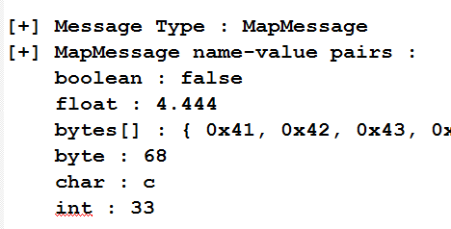
Types of Messages

Slide 10
Queues and Topics (Destinations)
Virtual channels to transmit messages
Live on a message broker
Transmit messages
Message
Message
Sender
Queue
Receiver
Acknowledgement
Message
Subscriber
Message
Topic
Publisher
Message
Subscriber

Slide 11
Message Broker
Core of Enterprise Messaging
Allow message transformation, message routing etc…
Host JMS destinations
ActiveMQ, WebsphereMQ, RabbitMQ etc… are a few message broker examples
Most message brokers support Java Messaging Service(JMS) API
Notes:
Message broker serves as an intermediary between messaging clients. They host JMS destinations
Most of the message brokers support JMS API.
A few example messaging APIs are ActiveMQ, Microsoft BizTalk

Slide 12
JMS API
Java Messaging Services
An Enterprise Messaging API supported by large number of Messaging Products
Write once, run everywhere (well, almost)
A potent attack tool
JMSDigger is written using JMS API
Notes:
JMS API can be seen as a the glue which binds all of these together.
It is used by clients to communicated with the broker.

Slide 13
An Enterprise Messaging Application (Again)
Message Broker (Queues, Topics and custom code)
Messages
Messages
Client A
Client N

Slide 14
An Attackers View (Items of value)
Message Broker (Queues, Topics and custom code)
Messages
Messages
Client A
Client N

Slide 15
Why Bother?
Enterprise messaging hasn’t been extensively explored for security issues
A lot (business, reputation etc…) rides on it
Notes:
Enterprise messaging domain hasn’t been extensively explored in terms of security. It is therefore important to give the domain a serious thought because a lot rides on it.

Slide 16
Introduction to jmsdigger
Notes:
We will briefly visit JMSDigger as it will be extensively used during the demos.

Slide 17
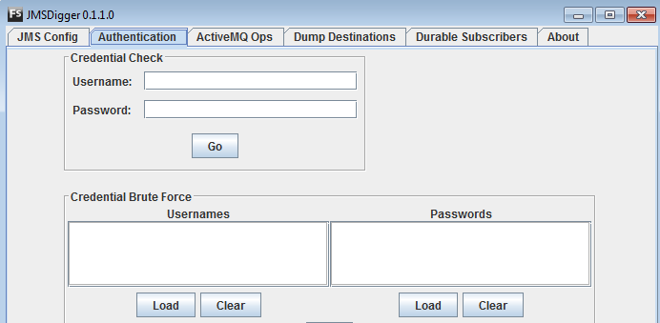
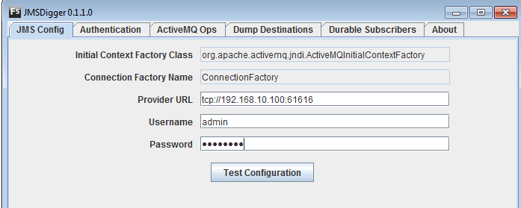
Notes:
The current version is 0.1.1.0 but it packs a lot of punch as we will see in the demos.
You can see the landing tab and the authentication tab screenshots here.

Slide 18
JMSDigger - Enterprise Messaging Application Assessment Tool
Authentication testing and credential brute force
Dump messages from Queues, Topics and Durable Subscribers
Manipulate durable subscribers
ActiveMQ specific operations
Password decryption, query broker statistics etc…
More
Notes:
It has pre and post exploitation modules. The pre exploitation module allows you to test authentication, and bruteforce authentication
It allows you to place hooks on JMS destination like queues, topics and durable subscribers and retrieve messages.
You can also manipulate durable subscribers
It has several activemq specific operations that we will see
And then, it has more

Slide 19
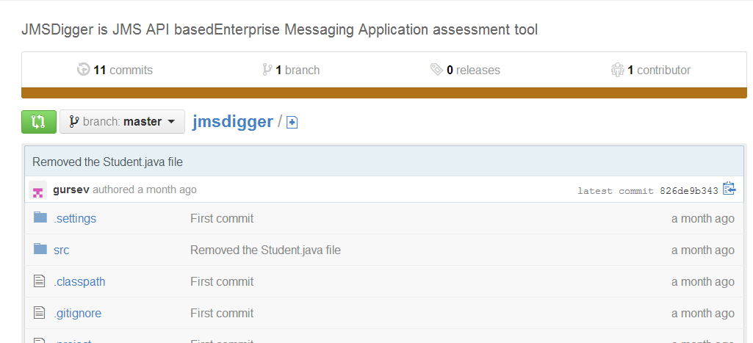
Open Source
Actively maintained
https://github.com/OpenSecurityResearch/jmsdigger
Notes:
JMSdigger is open source and is hosted on github. if you come across any bugs, please let me know.

Slide 20
ActiveMQ Case Study
Attacking the Message Broker

Slide 21
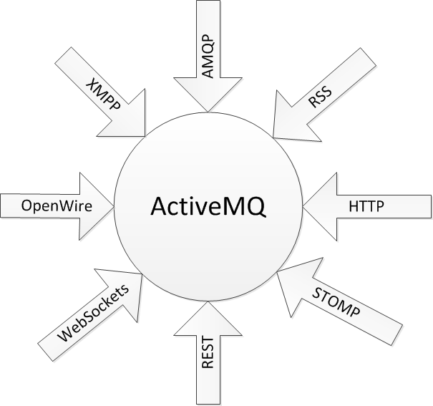
ActiveMQ Protocol Attack Surface
Notes:
Here we look at only the protocols that ActiveMQ supports. Imagine the attack surface if we start going into dependencies and components used.

Slide 22
ActiveMQ Web Admin Interface
Manage Broker
Create/Delete Destinations
View Message Content (for TextMessage)
Unprotected until 5.8.0 – Now protected by basic authentication
Listens on 0.0.0.0
Notes:
Can you imagine a production website with its message broker

Slide 23
CVE-2013-3060
Notes:
Here is the result of an unprotected admin interface listening on the internet

Slide 24
CVE-2013-3060
Notes:
Another example

Slide 25
0.0.0.0 is evil
Open ActiveMQ production instances available on the internet
Notes:
As an extension of HTML interface, I expected ActiveMQ to be listening on the internet.
I did not take the route of scanning all internet hosts for ActiveMQ. Only some where admin interface was available on 8161.

Slide 26
CVE-2013-1879 – XSS
Vulnerable cron string
* * * * *<script>alert(1)</script>

Slide 27
CVE-2012-6092 – XSS
Multiple XSS in Web Demos

Slide 28
More CVE’s
CVE-2012-6551 – Denial of service (broker resource consumption) via HTTP requests
CVE-2012-5784 – SSL MiTM because X.509 CN is not verified against the hostname
…

Slide 29
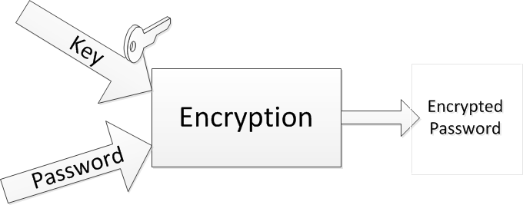
ActiveMQ Encrypted Passwords (1/2)
ActiveMQ passwords can be optionally encrypted before storage

Slide 30
ActiveMQ Encrypted Passwords (2/2)
Can be subjected to offline brute force decryption
Password brute force demo with JMSDigger
Speed with a single thread on my machine → 1 million decryption attempts in 240 seconds

Slide 31
Default ActiveMQ Configuration
No Authentication
No Encryption
There’s more…

Slide 32
ActiveMQ Authentication Schemes
None (Default)
Simple Authentication Plugin
JAAS Authentication Plugin

Slide 33
ActiveMQ Simple Authentication Plugin
No account lockout
Susceptible to credential brute force
Authentication brute force demo with JMSDigger

Slide 34
JMS and Encryption
No API Support
Must rely on Broker Configuration
Changes with Every Broker – No Portability

Slide 35
Attacking A messaging application

Slide 36
Attacking Authentication
Custom authentication code with jaasAuthenticationPlugin
Can be vulnerable to SQL Injection, LDAP injection etc…
SQL injection + authentication bypass demo with JMSDigger

Slide 37
Evaluating Authorization
Custom authorization code or inadequate controls
Dump messages from destinations (Queues and Topics)
Leverages QueueBrowser to dump Queue contents
Message dump demo with JMSDigger
Notes:
Either your rules are incomplete or

Slide 38
Manipulating Durable Subscribers
Create durable subscribers
Erase durable subscribers
Leverage durable subscribers to cause disk space usage DoS
Manipulating durable subscribers with JMSDigger

Slide 39
Doing More With JMS API
Messaging Brokers may talk to C/C++/.Net … clients
Attack other clients
Attack the broker
Your imagination

Slide 40
References
Java Message Service by Mark Richards, Richard Monson-Haefel and David A. Chappell
ActiveMQ in Action
JMS API Specification – http://www.jcp.org/en/jsr/detail?id=914
ActiveMQ @ Apache http://activemq.apache.com

Slide 41
Conclusion
Enterprise messaging applications can be insecure when secure coding practices are not followed
Harden your Messaging Brokers
Perform a security audit before deployment
Maintain your guard

Slide 42
?
gursev.kalra@foundstone.com
@igursev

Slide 43
Thank you

