Slide 1
BASHing iOS Applications
dirty, s*xy, cmdline tools for mobile auditors

Slide 2
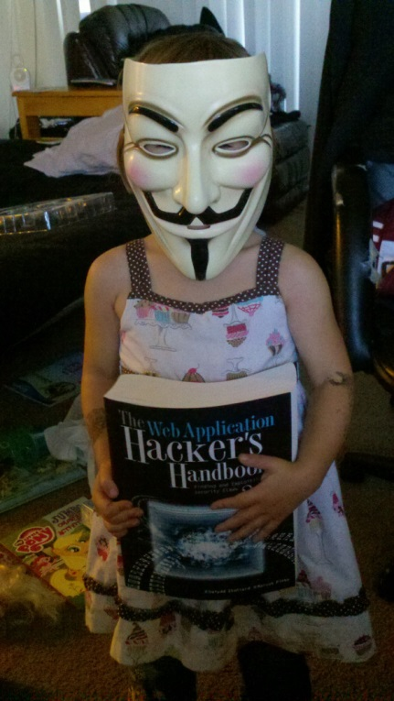
Whoami?
Director of Pentesting – Fortify on Demand
Leader of ShadowLabs group
iOS application Hacker
OWASP Mobile Top Ten Leader
OWASP iOS assessment Cheat Sheet leader
OWASP SB Leader
Proud husband and father!
Notes:
In the information economy, applications are everywhere. You have:
Applications that are being designed and conceptualized by your business leaders
Applications that are being coded and developed by your engineers and IT analysts
Applications that are running and supported in the Production environment. These legacy applications can be developed in-house or procured from 3rd party sources

Slide 3
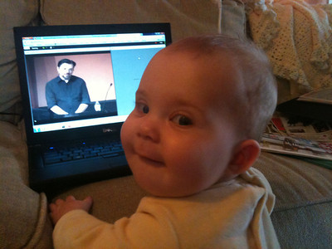
Whoami?
Mobile Security Consultant – Fortify on Demand
Python coder
Hunter of bugs
Ninja crafter
Herder of extremely well-behaved hackers-in-training
Notes:
In the information economy, applications are everywhere. You have:
Applications that are being designed and conceptualized by your business leaders
Applications that are being coded and developed by your engineers and IT analysts
Applications that are running and supported in the Production environment. These legacy applications can be developed in-house or procured from 3rd party sources

Slide 4
What are we doing here?
Mobile app testing tools are fragmented!
Notes:
In the information economy, applications are everywhere. You have:
Applications that are being designed and conceptualized by your business leaders
Applications that are being coded and developed by your engineers and IT analysts
Applications that are running and supported in the Production environment. These legacy applications can be developed in-house or procured from 3rd party sources

Slide 5
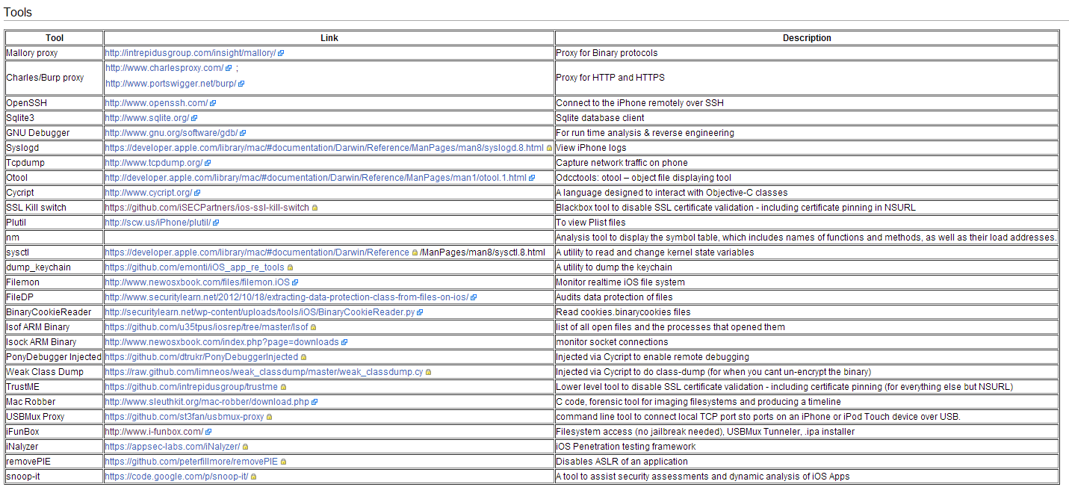
Mobile App testing tools are fragmented!
Notes:
In the information economy, applications are everywhere. You have:
Applications that are being designed and conceptualized by your business leaders
Applications that are being coded and developed by your engineers and IT analysts
Applications that are running and supported in the Production environment. These legacy applications can be developed in-house or procured from 3rd party sources

Slide 6
What are we looking for?
Notes:
In the information economy, applications are everywhere. You have:
Applications that are being designed and conceptualized by your business leaders
Applications that are being coded and developed by your engineers and IT analysts
Applications that are running and supported in the Production environment. These legacy applications can be developed in-house or procured from 3rd party sources

Slide 7
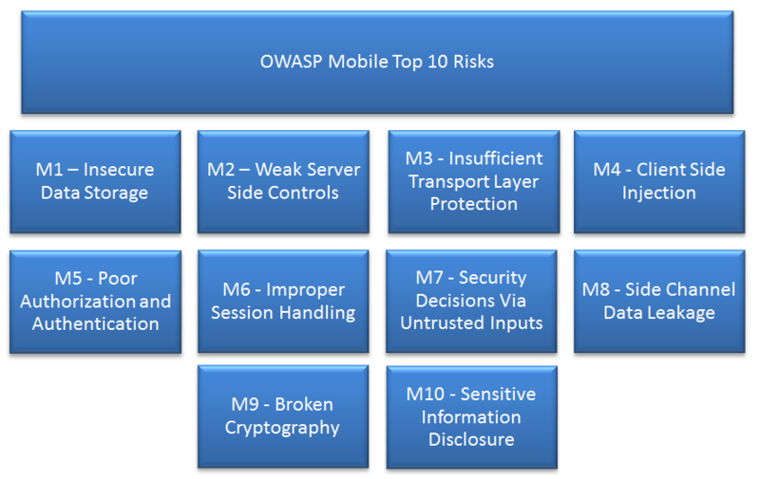
Notes:
In the information economy, applications are everywhere. You have:
Applications that are being designed and conceptualized by your business leaders
Applications that are being coded and developed by your engineers and IT analysts
Applications that are running and supported in the Production environment. These legacy applications can be developed in-house or procured from 3rd party sources

Slide 8
TLDR; expertise needed to assess a mobile app in-depth is high. Testers need better solutions: faster, more cost-effective.
Notes:
In the information economy, applications are everywhere. You have:
Applications that are being designed and conceptualized by your business leaders
Applications that are being coded and developed by your engineers and IT analysts
Applications that are running and supported in the Production environment. These legacy applications can be developed in-house or procured from 3rd party sources

Slide 9
Is this you?
Do one of these categories describe you?
New to mobile
Large enterprise with LOTS of mobile apps
Worried about impact of BYOD
You need a better solution too.

Slide 10
Anatomy of a better solution
Quick
Blackbox capable - no source required
Good coverage with low effort/expertise
Automatable
Manageable learning curve

Slide 11
Let’s make some buckets…
Tool Domains and Purpose
Source
Holistic Scanners
Greppers (search)
Binary
Crackers
Binary Analysis
Client
File System
Runtime Tools
Network/Server
Reversing
Pretty well documented already.
Scanners (taint)
RE and Code Quality
Artifact Inspections
Hooking
Dynamic Analysis
Notes:
You need to start testing all your applications immediately. However, this can be an overwhelming endeavor. You need large upfront capital and human investments:
Hardware to procure, setup and maintain for the test/ staging environment
Software to procure, install and maintain to automate the testing
People with the right expertise and experience in security to hire, train and retain
Process to define and refine so that everything is standardized and efficient

Slide 12
Where does this lead us?
Source scanners limit our scope
Reversing and runtime tools have steep learning curve
We already know how to do network/server
What’s left?

Slide 13
What’s left?
Binary analysis
No source required
Doesn’t SOUND easy/quick
Automatable?
File system
No source required
Probably automatable
Easy? Quick?

Slide 14
What’s in YOUR binary?
Mobile Top 10 Category | Look for…
M1: Insecure Data Storage | Data Protection API Storage to plist files Storage to client database
M3: Insufficient Transport Layer Protection | Insecure SSL configuration Web service calls over HTTP
M4: Client-Side Injection | Vulnerable SQL Web views
M8: Side-Channel Data Leakage | Backgrounding screenshot
M9: Broken Cryptography | Weak algorithms
M10: Sensitive Information Disclosure | Sensitive info over HTTP Logging URL schemes

Slide 15
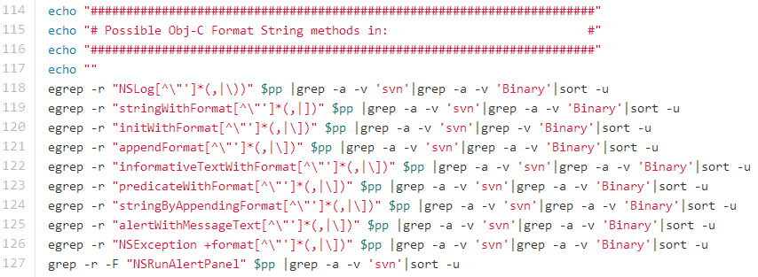
iOS.sh
https://github.com/jhaddix/ios_sh

Slide 16
BINARY TOOLS (mostly non-runtime & require a JB device)
Notes:
In the information economy, applications are everywhere. You have:
Applications that are being designed and conceptualized by your business leaders
Applications that are being coded and developed by your engineers and IT analysts
Applications that are running and supported in the Production environment. These legacy applications can be developed in-house or procured from 3rd party sources

Slide 17
Cracking Apps
Remove Apple’s encryption!
Clutch
https://code.google.com/p/iphone-clutch/downloads/list
Rasticrac
Has some built-in magic to detect different versions of ARM and anti-cracking code.
https://twitter.com/iRastignac
Uses GDB

Slide 18
Binary *Disassembly* and Parsing
otool
https://developer.apple.com/library/mac/documentation/Darwin/Reference/ManPages/man1/otool.1.html
Good for parsing out:
Architectures
Frameworks
Binary protection usage (PIE, Stack Smashing)
Code Quality (ARC)
Also important: most of the above is unencrypted strings data. This means that strings, grep, sed, and awk are magical!

Slide 19
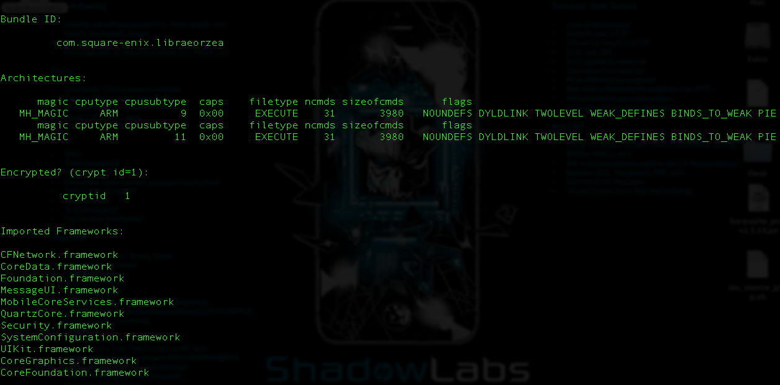

Slide 20
Poor Man’s Disassembly
Application binaries contain LOTS of relevant strings
The “strings” command can be revealing
Method names
Web service URLs
SQL query strings
API secrets, crypto keys, passwords

Slide 21
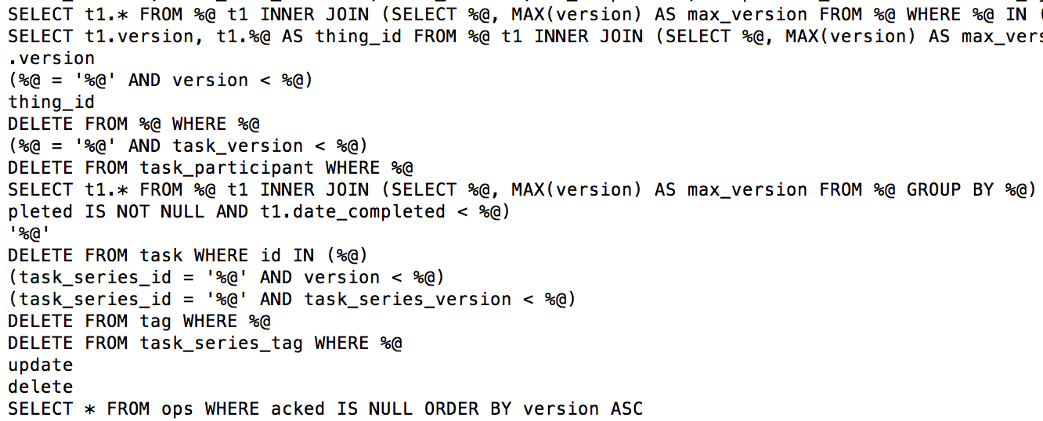

Slide 22
Vulnerability Detection with grep
Use strings from binary to zero in on issues
Presence of deprecated/known vulnerable methods
Vulnerable coding practices (SQL injection)
Pro: Fast, easy to code
Con: Without source, confidence level may vary – no context

Slide 23
Putting it all together
Install app
Crack app
Extract headers, symbols, and frameworks (otool)
Extract binary strings (strings)
Search for known patterns (grep)
This can all be wrapped in a scripting language of your choice!

Slide 24
Binary Analysis
Quick
No source required
Covers six Mobile Top 10 categories
Very easy to automate
Low technical learning curve

Slide 25
But wait, there’s more! (we didn’t actually run the app yet)
Notes:
In the information economy, applications are everywhere. You have:
Applications that are being designed and conceptualized by your business leaders
Applications that are being coded and developed by your engineers and IT analysts
Applications that are running and supported in the Production environment. These legacy applications can be developed in-house or procured from 3rd party sources

Slide 26
Plists and DBs and caches, oh my!
Mobile Top 10 Category | Look for…
M1: Insecure Data Storage | Data protection classes Credential/sensitive data in plists and databases Sensitive image storage
M4: Client-Side Injection | Loading from shared storage
M6: Improper Session Handling | Cookie/session ID storage “Remember me” persistence
M8: Side-Channel Data Leakage | Cached background image Autocorrect cache URL caches
M10: Sensitive Information Disclosure | Logging

Slide 27
Artifact Inspection
Cookie Reader:
http://www.securitylearn.net/2012/10/27/cookies-binarycookies-reader/
File monitor:
http://bit.ly/16TeiqJ (or binutils)
Keychain dumper:
https://github.com/ptoomey3/Keychain-Dumper
Log reader:
iPhone Configuration Utility or http://www.libimobiledevice.org/ API
Data Protection Class Parser:
http://www.securitylearn.net/2012/10/18/extracting-data-protection-class-from-files-on-ios/

Slide 28
Putting it all together
Install app
Crack app
Extract headers, symbols, and frameworks (otool)
Extract binary strings (strings)
Search for known patterns (grep)
Launch app
Parse/search artifacts (more grep)
This can all be wrapped in a scripting language of your choice!

Slide 29
DIY Mobile Assessment
Manual process = tedious
Tool fragmentation creates a learning curve
If each individual tool is a module in a larger assessment process, then what we really need is a framework.

Slide 30
That’s too much stuff. I just don’t have the resources.
Notes:
In the information economy, applications are everywhere. You have:
Applications that are being designed and conceptualized by your business leaders
Applications that are being coded and developed by your engineers and IT analysts
Applications that are running and supported in the Production environment. These legacy applications can be developed in-house or procured from 3rd party sources

Slide 31
DEMO Risker ENGINE DEMO RISKER Frontend
Notes:
In the information economy, applications are everywhere. You have:
Applications that are being designed and conceptualized by your business leaders
Applications that are being coded and developed by your engineers and IT analysts
Applications that are running and supported in the Production environment. These legacy applications can be developed in-house or procured from 3rd party sources

Slide 32
Risker is eating a lot of Apples
Risker (ENGINE) is used in our Mobile Express offering
With this methodology and toolset , you can create your own Risker!
Frontend just launched
Currently crunching all the Apples

Slide 33
Thanks! jason.haddix@hp.com dawn@hp.com
Notes:
In the information economy, applications are everywhere. You have:
Applications that are being designed and conceptualized by your business leaders
Applications that are being coded and developed by your engineers and IT analysts
Applications that are running and supported in the Production environment. These legacy applications can be developed in-house or procured from 3rd party sources

