Slide 1
WELCOME
Notes:
Welcome to NYC Welcome to OWASP Welcome to AppSec USA 2013!
Introductions

Slide 2
Hosted by OWASP & the NYC Chapter
Notes:
A bit of fun….

Slide 3
Hosted by OWASP & the NYC Chapter
Notes:
...and a serious problem...“I own you.”
OWASP is about building awareness of the problem in software security and being part of the solution…

Slide 4
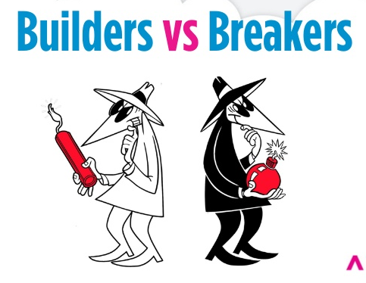
Defenders
Hosted by OWASP & the NYC Chapter

Slide 5
Hosted by OWASP & the NYC Chapter
Notes:
The amazing thing about OWASP Conferences is the community –
Attend to see amazing talks, support the mission of the OWASP Foundation – The Open Web Application Security Project (OWASP) is a 501(c)(3) worldwide not-for-profit charitable organization focused on improving the security of software. Our mission is to make software security visible, so that individuals and organizations worldwide can make informed decisions about true software security risks.
This event is a fundraiser for our GLOBAL Foundation and we hope to raise over a quarter of a million dollars to support our operation and mission outreach.

Slide 6
Hosted by OWASP & the NYC Chapter
Notes:
Why is OWASP Special?
Over 40,000 community members worldwide, in over 100 countries
Rapid growth over the 12+ years since OWASP’s inception. Demonstrative of our growth as an organization is our revenue which is comes primarily from global conferences such as this as well as memberships. In the last year our revenue grew from just under a million dollars in 2012 to an estimated 1.8 million for the current year.
Different from other organizations and conferences because
The community
Incubator for Ideas and OWASP Projects – Open Source Documentation, Tools, Code Libraries

Slide 7
OWASP Project Summit
16th Floor Skylobby
PCI Toolkit
ZAP Hackathon
ESAPI 3.0 & Hackathon
OpenSAMM Working Session
OWASP Media Project
OWASP Project Reviews & Assessments
Application Security Guide for CISOs and CISO Survey
Project Talks in Edison Room Wed & Thurs
- AppSensor and Security Principals (swap)
Hosted by OWASP & the NYC Chapter

Slide 8
Open Mic Sessions
Community Energy Boards
CTF x 2
Lockpick Village
Waspy Awards
OWASP Jeopardy
The Great OWASP Bug Bash of 2013
Hosted by OWASP & the NYC Chapter

Slide 9
Hosted by OWASP & the NYC Chapter

