Slide 1
Pushing CSP to PROD
Case Study of a Real-World Content-Security Policy Implementation
Notes:
Brian talks

Slide 2
What is Content-Security Policy?
Controls where content is loaded from
Controls what content can do
Extremely useful for thwarting content injection attacks!
XSS

Slide 3
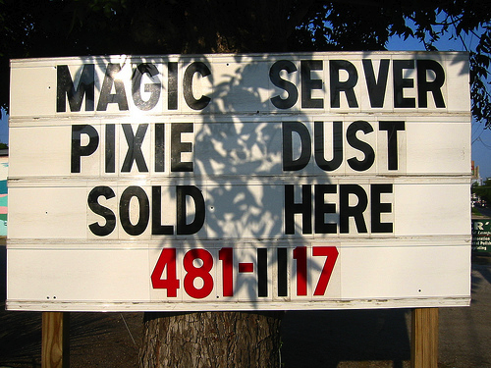
What Content-Security Policy IS NOT
A silver bullet for addressing Cross-Site Scripting
Think of it as a safety belt in case you mess up

Slide 4
History of Content Security Policy
Started at Mozilla, and has since grown into its own W3C specification
v1.0 – Release Candidate
Support is pretty good across most major browsers
v1.1 – Draft
Browser support is lacking / spotty
What we will be talking about today.

Slide 5
Browser Support for CSP
DESKTOP
v14+
v6+
v4+
N/A
v15+

Slide 6
Who’s using CSP?
Only 191 out of Alexa top 1,000,000 sites
Source: Veracode - http://www.veracode.com/blog/2013/03/security-headers-on-the-top-1000000-websites-march-2013-report/
List includes some high-profile websites
Facebook, Twitter, GitHub

Slide 7
What types of content can be restricted?
Content Type | CSP Attribute
JavaScript | script-src
CSS | style-src
Connections (XHR, WebSockets, etc) | connect-src
iFrame | frame-src
Images | img-src
Web Fonts | font-src
Video and Audio Sources | media-src
Embedded elements, applets and plug-ins | object-src

Slide 8
How is content restricted?
By Source (per directive)
'none', 'self', specific hostnames, *
By Category
unsafe-inline (script-src & style-src only)
unsafe-eval (script-src only)
Missing directives inherit from default-src
Assumed to be * if missing (open by default)

Slide 9
About the Application

Slide 10
Objectives of our CSP Implementation
Be as Strict as Possible
Deny everything by default, only allow what is needed
Monitor Attempts to Bypass
Leverage built in CSP error reporting
Maximize Coverage Across Browsers
Handle browser-specific nuances

Slide 11
Objectives of our CSP Implementation
Be as Strict as Possible
Deny everything by default, only allow what is needed
Monitor Attempts to Bypass
Leverage built in CSP error reporting
Maximize Coverage Across Browsers
Handle browser-specific nuances
Notes:
Erik takes over
When creating a policy you have two ways to go. Either you allow everything and block off the parts you don’t want. Or you block everything and allow the things you need.

Slide 12
Dedicated Site for Authorized Scripts
BEFORE
+
https://www.sendsafely.com
Notes:
We used to host the HTML and JavaScript on the same server. By doing this we were forced to open up the ‘self’ attribute. We wanted to keep our policy as tight as possible so we wanted to avoid this.

Slide 13
We want to be as strict as possible
Our policy uses a “Deny by Default” model
default-src= "none"
Allow JavaScript only from our static server
static.sendsafely.com
No string-to-code functions or in-line scripts
No use of unsafe-eval or unsafe-inline
Notes:
We deny everything and will only open up what we need. All our JavaScript will load from our own static server.
Additionally, all string to code functions like eval are blocked.

Slide 14
Dedicated Site for Authorized Scripts
AFTER
<html>
<head>
<script src="https://static.sendsafely.com/main.js"/>
</head>
https://www.sendsafely.com
https://static.sendsafely.com
Notes:
So instead of hosting the javascript code with the web server we have created a separate server which only hosts JS. We can now remove the ‘self’ attribute and only allow this server.

Slide 15
And now for the harder part…
Removal of patterns banned by unsafe-eval
Covers text-to-Javascript functions like eval()
Luckily we had already banned these
Removal of all in-line JavaScript
This was pervasive within our code
Most of your code will likely look like our examples
Notes:
We had an existing code base we wanted to migrate to be compliant. Luckily we weren’t using eval already.
We did however have a bunch of javascript. Our code had a couple of similar patterns. Once we figured out a way to solve those it went pretty smoothly from there.
If you guys are interested in implementing a csp you are likely to run into the same scenarios.

Slide 16
Eliminating In-line Scripting (Example #1)
Before (HTML w/ In-line JavaScript)
<a href="javascript:doSomething()">Do something</a>
Find the link based on it’s ID
After (HTML without JavaScript)
<a id="my-link">Do something</a>
After (JavaScript loaded from static.sendsafely.com)
var link = document.getElementById("my-link");
link.addEventListener("click", doSomething, false);
Notes:
The first one is pretty simple really. We have a link or a button, when it’s clicked we will call a JavaScript function.
Of course we can’t do it like this since it would violate the inline scripting rule.
Instead we assign the link with a unique ID. From JavaScript we can then register a click handler reacting when that ID is clicked.

Slide 17
Eliminating In-line Scripting (Example #1)
Before (HTML w/ In-line JavaScript)
<a href="javascript:doSomething()">Do something</a>
Wire up the “click” event to “doSomething()”
After (HTML without JavaScript)
<a id="my-link">Do something</a>
After (JavaScript loaded from static.sendsafely.com)
var link = document.getElementById("my-link");
link.addEventListener("click", doSomething, false);

Slide 18
Eliminating In-line Scripting (Example #2)
Before (HTML w/ In-line JavaScript)
<type="text" name="email" onkeyup="doSomethingElse(arg1, arg2)">
Embed argument values within the HTML as data-vars
After (HTML without JavaScript)
<type="text" id="my-email-field" name="email"
data-arg-one="arg1" data-arg-two="arg2">
After (JavaScript loaded from static.sendsafely.com)
$(“#my-email-field”).keyup(function() { doSomethingElse(this.getAttribute(“data-arg-one”), this.getAttribute(“data-arg-two”)); });
Notes:
Our second example is similar. Again, it’s a button. This time the function will take two parameters.
Just as before we will create a ID for the link. The arguments can be put in data attributes.
Data attributes is a new thing in HTML5. Luckily it’s been out for a while and is supported by all browsers and has been so for a while..
Anyhow, once the data args are in place, we can yet again register a click handler. The data attributes can then be read from the click handler and used.

Slide 19
Eliminating In-line Scripting (Example #2)
Before (HTML w/ In-line JavaScript)
<type="text" name="email" onkeyup="doSomethingElse(arg1, arg2)">
Use JQuery to wireup event and pass data-args to function
After (HTML without JavaScript)
<type="text" id="my-email-field" name="email"
data-arg-one="arg1" data-arg-two="arg2">
After (JavaScript loaded from static.sendsafely.com)
$(“#my-email-field”).keyup(function() { doSomethingElse(this.getAttribute(“data-arg-one”), this.getAttribute(“data-arg-two”)); });

Slide 20
Working with Third Party Scripts
We try to minimize reliance on third party scripts
Occasionally the cost/benefit is worth using them
Examples: JQuery, reCAPTCHA
Our policy is to host all JavaScript on our servers
Re-factoring to make CSP compliant is not desirable
Notes:
So we’ve talked about our own code. What about third party code?
Although we try to minimize their impact it might just be to expensive to replace them all.
jQuery is one, reCAPTCHA is another.
We try to host them on our own server.
We will however try to avoid having to refactor the code to make it CSP compliant

Slide 21
Working with Third Party Scripts (reCAPTCHA)
Required unsafe-inline
Inline Event Handler Definitions
Inline Script within HREF Attributes
Required unsafe-eval
Use of String-to-Code in Function Calls
Fixed by
Google
this Summer
Notes:
jQuery was easier to move. ReCAPTCHA caused a bigger headache. The recaptcha implementation required both unsafe-inline and unsafe-eval to be enabled.
We wasn’t very willing to lighten up our csp just for this.
So what could we do instead?

Slide 22
Refactoring reCAPTCHA (Example #1)
Before (Inline Event Handler Definitions)
Recaptcha.timer_id = setInterval('Recaptcha.reload("t");', a);
After (Eliminate Inline Event Handler)
Recaptcha.timer_id = setInterval(function(){Recaptcha.reload("t")}, a);
Notes:
Although we didn’t like it we decided to take a look at refactoring the recaptcha source.
It turned out to be pretty simple. We had to make three changes.
Luckily they followed the pattern we described before.
We had to convert one link to use an identifier instead.
Additionally we had to convert a timer to use a function instead of a string which would be converted to a function by timer.

Slide 23
What about Web Workers?
HTML5 Web Workers enforce Same-Origin Policy
You cannot create a Web Worker using a JavaScript file that's on a different domain.
Our workaround:
Relaxed CSP on the two pages that use Web Workers
script-src='self'
Notes:
Brian takes over

Slide 24
Content Type | Directive
Default | default-src
JavaScript | script-src
Stylesheets | style-src
Connections | connect-src
iFrame | frame-src
Images | img-src
Web Fonts | font-src
Video and Audio | media-src
Embedded Objects | object-src

Slide 25
Content Type | Directive
Default | default-src
JavaScript | script-src
Stylesheets | style-src
Connections | connect-src
iFrame | frame-src
Images | img-src
Web Fonts | font-src
Video and Audio | media-src
Embedded Objects | object-src
CSP
default-src 'none';

Slide 26
Content Type | Directive
Default | default-src
JavaScript | script-src
Stylesheets | style-src
Connections | connect-src
iFrame | frame-src
Images | img-src
Web Fonts | font-src
Video and Audio | media-src
Embedded Objects | object-src
CSP
default-src 'none'; script-src https://static.sendsafely.com https://www.google.com;

Slide 27
Embedded Stylesheet Resources
We have in-line CSS across most of our pages
Significantly more effort that removing our in-line script

Slide 28
Embedded Stylesheet Resources
We have in-line CSS across most of our pages
Significantly more effort that removing our in-line script
What our code needs to run:
style-src='self' 'unsafe-inline'

Slide 29
Allowing un-safe inline for StyleSheets
Threat of CSS injection is lower than that of direct script injection (but still a valid threat)
We do not rely on CSP as a primary defense
Robust encoding APIs used throughout the site
Decision: Cost/Benefit of refactoring effort was not worth it
Long term goal (in next UI overhaul) will attempt to fix

Slide 30
Content Type | Directive
Default | default-src
JavaScript | script-src
Stylesheets | style-src
Connections | connect-src
iFrame | frame-src
Images | img-src
Web Fonts | font-src
Video and Audio | media-src
Embedded Objects | object-src
CSP
default-src 'none'; script-src https://static.sendsafely.com https://www.google.com; style-src 'self' 'unsafe-inline';

Slide 31
Content Type | Directive
Default | default-src
JavaScript | script-src
Stylesheets | style-src
Connections | connect-src
iFrame | frame-src
Images | img-src
Web Fonts | font-src
Video and Audio | media-src
Embedded Objects | object-src
CSP
default-src 'none'; script-src https://static.sendsafely.com https://www.google.com; style-src 'self' 'unsafe-inline'; connect-src 'self';

Slide 32
Content Type | Directive
Default | default-src
JavaScript | script-src
Stylesheets | style-src
Connections | connect-src
iFrame | frame-src
Images | img-src
Web Fonts | font-src
Video and Audio | media-src
Embedded Objects | object-src
CSP
default-src 'none'; script-src https://static.sendsafely.com https://www.google.com; style-src 'self' 'unsafe-inline'; connect-src 'self'; frame-src 'self';

Slide 33
Content Type | Directive
Default | default-src
JavaScript | script-src
Stylesheets | style-src
Connections | connect-src
iFrame | frame-src
Images | img-src
Web Fonts | font-src
Video and Audio | media-src
Embedded Objects | object-src
CSP
default-src 'none'; script-src https://static.sendsafely.com https://www.google.com; style-src 'self' 'unsafe-inline'; connect-src 'self'; frame-src 'self'; img-src 'self' https://www.google.com

Slide 34
Content Type | Directive
Default | default-src
JavaScript | script-src
Stylesheets | style-src
Connections | connect-src
iFrame | frame-src
Images | img-src
Web Fonts | font-src | N/A
Video and Audio | media-src
Embedded Objects | object-src
CSP
default-src 'none'; script-src https://static.sendsafely.com https://www.google.com; style-src 'self' 'unsafe-inline'; connect-src 'self'; frame-src 'self'; img-src 'self' https://www.google.com

Slide 35
Content Type | Directive
Default | default-src
JavaScript | script-src
Stylesheets | style-src
Connections | connect-src
iFrame | frame-src
Images | img-src
Web Fonts | font-src | N/A
Video and Audio | media-src | N/A
Embedded Objects | object-src
CSP
default-src 'none'; script-src https://static.sendsafely.com https://www.google.com; style-src 'self' 'unsafe-inline'; connect-src 'self'; frame-src 'self'; img-src 'self' https://www.google.com

Slide 36
Allowing Java Applets
The same pages that use Web Workers use a Java Applet when using a browser without HTML5
Initially we planned for an object-src directive to allow

Slide 37
As it turns out…
None of the browsers we tested block the <applet> tag (even with object-src: 'none')
Chrome, FireFox, Safari
Were we missing something?
Thread started on
public-webappsec@w3.org
???

Slide 38
Content Type | Directive
Default | default-src
JavaScript | script-src
Stylesheets | style-src
Connections | connect-src
iFrame | frame-src
Images | img-src
Web Fonts | font-src | N/A
Video and Audio | media-src | N/A
Embedded Objects | object-src | N/A
CSP
default-src 'none'; script-src https://static.sendsafely.com https://www.google.com; style-src 'self' 'unsafe-inline'; connect-src 'self'; frame-src 'self'; img-src 'self' https://www.google.com

Slide 39
Objectives of our CSP Implementation
Be as Strict as Possible
Deny everything by default, only allow what is needed
Monitor Attempts to Bypass
Leverage built in CSP error reporting
Maximize Coverage Across Browsers
Handle browser-specific nuances

Slide 40
Objectives of our CSP Implementation
Be as Strict as Possible
Deny everything by default, only allow what is needed
Monitor Attempts to Bypass
Leverage built in CSP error reporting
Maximize Coverage Across Browsers
Handle browser-specific nuances
Notes:
Erik takes over
Ok, so now we’ve talked about how we implemented our policy.
Lets move on and discuss how to monitor any potential breaches.

Slide 41
CSP Error Reporting
Built-in feature of CSP, used to report violations
Browser sends error reports when a directive is violated
Source URL, offending directive and code fragment
If CSP kicks in for a user, you will know
Great for development and testing
CSP also works in report-only mode
Notes:
CSP has a feature out of the box to report violations when they occur.
A JSON formatted message will be sent to our server when there is a breach.
It shows us what directive was violated and by what. It also tells us on what page it happened.
This is a great tool to have during development. If you’re doing something wrong, you can find out right away.
If there’s a true breach in your production environment you will hopefully be notified about it.
CSP can also be configured to work in a report-only mode where violations are recorded but not prevented.

Slide 42
Example CSP Error Report
Report
document-uri: https://mysite.com/vulnerable/
referrer: https://evil.com/attack
blocked-uri: self
violated-directive: inline script base restriction
source-file: https://mysite.com/vulnerable/
script-sample: alert(document.cookie)
The URI of the page where the error occurred
Notes:
The page where the error occurred.

Slide 43
Example CSP Error Report
Report
document-uri: https://mysite.com/vulnerable/
referrer: https://evil.com/attack
blocked-uri: self
violated-directive: inline script base restriction
source-file: https://mysite.com/vulnerable/
script-sample: alert(document.cookie)
The page that the user came from to get there
Notes:
The regular referrer header displaying where they user came from.

Slide 44
Example CSP Error Report
Report
document-uri: https://mysite.com/vulnerable/
referrer: https://evil.com/attack
blocked-uri: self
violated-directive: inline script base restriction
source-file: https://mysite.com/vulnerable/
script-sample: alert(document.cookie)
Blocked URI shows that the content resides on the same page
Notes:
Blocked uri will tell you if the attacker tried to load content from a different server.
In this case it shows you that the content resides on this page.

Slide 45
Example CSP Error Report
Report
document-uri: https://mysite.com/vulnerable/
referrer: https://evil.com/attack
blocked-uri: self
violated-directive: inline script base restriction
source-file: https://mysite.com/vulnerable/
script-sample: alert(document.cookie)
Violated Directive tells us what happened.
Notes:
The violated directive will tell us what happened. In this case it seems like we have some inline scripts on our page.
This may be an indication of a XSS vulnerability.

Slide 46
Example CSP Error Report
Report
document-uri: https://mysite.com/vulnerable/
referrer: https://evil.com/attack
blocked-uri: self
violated-directive: inline script base restriction
source-file: https://mysite.com/vulnerable/
script-sample: alert(document.cookie)
Source File tells us the page where the breach happened.
Notes:
Will tell us where the breach happened.

Slide 47
Example CSP Error Report
Report
document-uri: https://mysite.com/vulnerable/
referrer: https://evil.com/attack
blocked-uri: self
violated-directive: inline script base restriction
source-file: https://mysite.com/vulnerable/
script-sample: alert(document.cookie)
Script Sample shows us an example of the injected code.
Notes:
The script sample might show us an example of the injected code.

Slide 48
Real CSP Error Report from Production
Report
document-uri: https://www.sendsafely.com/auth/
referrer: http://www.google.com/search
blocked-uri: self
violated-directive: inline script base restriction
source-file: chrome-extension://hdokiejnpimakedhajhdlcegeplioahd
script-sample: var a=function(){},_gaq={pus...
Does this look like a valid exploit attempt?
Notes:
But now when we’ve gone through this, does this look like a real exploit?
UrchinTracker is a Google library used by google analytics.

Slide 49
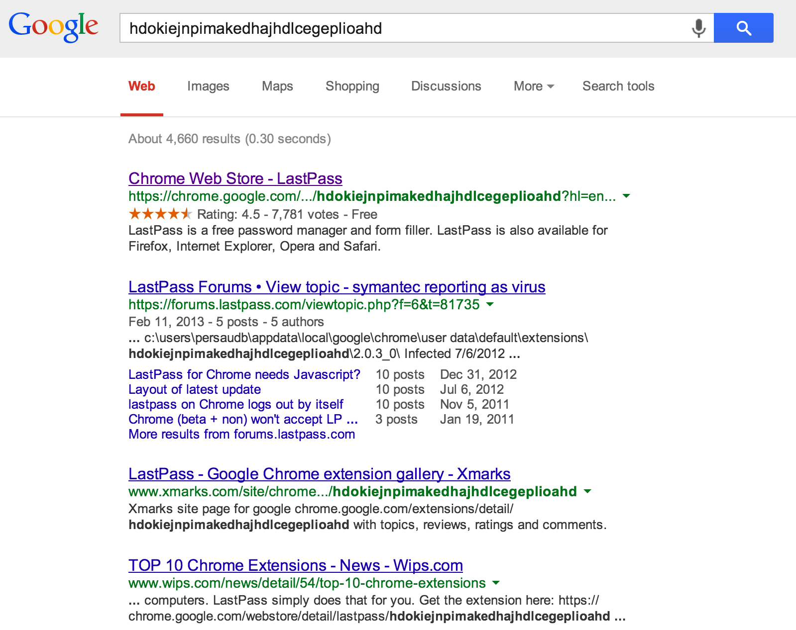
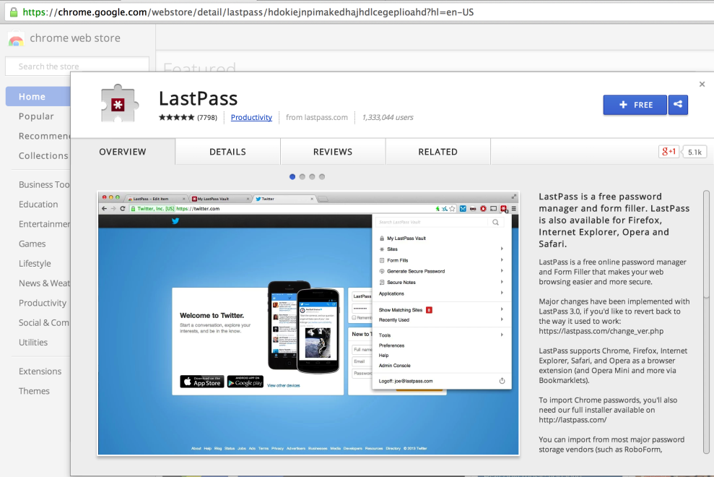

Slide 50
Notes:
So let’s talk about those false positives. Since we enrolled our policy we have received thousands of reports.
All of them has been false positives.
So lets take a look at what’s causing these and what we can do about it.
After all, false positives can be crucial since it will help the attacker hide the real attack.

Slide 51
The (big) problem with False Positives
Several popular browser plug-ins /extensions inject JavaScript code into pages
The most common sources we’ve seen:
LastPass
Norton Identity Protection
Urchin Tracker
JSShell
Notes:
Most of the false positives we’ve seen are coming from various chrome and safari extensions.
The most common ones are lastpass, norton, jsshell and urchin tracker.
These are not malicious scripts.
Clearly we would love if they didn’t show up in our logs.

Slide 52
Seeing Through the Noise
Need to filter out the noise while being careful not to cover real exploit attempts
We started analyzing reports to identify signatures could be safely ignored
Signature = Keyword or Pattern + Violated CSP Directive
Notes:
We would like to filter out the noise while still being confident that we are not covering real exploits.
So we went through the reports we had and tried to see some patterns. We figured out that we could build signatures that contained a keyword + the violated directive.

Slide 53
Violations from Common Chrome Extensions
Extension | Violated Directive (per Report) | Source File (per Report)
LastPass | Source-file | chrome-extension://hdokiejnpimakedhajhdlcegeplioahd
Buffer | Source-file | chrome-extension://noojglkidnpfjbincgijbaiedldjfbhh
Firebug | Source-file | chrome://firebug/content/console/commandLineExposed.js
AutoFill | Source-file | chrome-extension://nlmmgnhgdeffjkdckmikfpnddkbbfkkk
DoNotTrackMe | Source-file | chrome-extension://epanfjkfahimkgomnigadpkobaefekcd
Notes:
So these are a few signatures we came up with. As you can see they are all chrome extensions.

Slide 54
Filtering out extensions will go a long way
Extensions wont hide real attacks, unless its coming from the extension itself
If a user installs an evil extension, we can’t help them
Notes:
Filtering out extensions will remove a lot of the noise.
You might think it’s to wide to remove all extensions.
But if a user installs an evil extension we can unfortunately not do that much to help them.
Besides from that, Chrome and Safari both support CSP so the injected code wont execute here anyways.

Slide 55
Signature for Ignoring Chrome Extensions
Chrome loads extensions via URL calls
Shows up as source-file
Report Signature (Chrome Extensions)
document-uri: *
referrer: *
blocked-uri: *
violated-directive: *
source-file: ^(chrome-extension://|chrome://)
script-sample: *

Slide 56
Signature for Ignoring Safari Extensions
Similar to chrome, loads extensions via URL calls
Shows up as source-file
Report Signature (Safari Extensions)
document-uri: *
referrer: *
blocked-uri: *
violated-directive: *
source-file: ^(safari-extension://)
script-sample: *

Slide 57
What about Firefox?
Firefox doesn’t load extensions the same way
Filtering based on code snippets is dangerous
LastPass on Firefox
document-uri: https://www.sendsafely.com/auth/
referrer: www.sendsafely.com/
blocked-uri: self
violated-directive: inline script base restriction
source-file: https://www.sendsafely.com/auth/
script-sample: try { for(var lastpass_iter=0; lastpass...

Slide 58
Objectives of our CSP Implementation
Be as Strict as Possible
Deny everything by default, only allow what is needed
Monitor Attempts to Bypass
Leverage built in CSP error reporting
Maximize Coverage Across Browsers
Handle browser-specific nuances

Slide 59
Objectives of our CSP Implementation
Be as Strict as Possible
Deny everything by default, only allow what is needed
Monitor Attempts to Bypass
Leverage built in CSP error reporting
Maximize Coverage Across Browsers
Handle browser-specific nuances
Notes:
Brian takes over

Slide 60
Maximizing Browser Coverage
v14+
v6+
N/A
v4+
v15+

Slide 61
Maximizing Browser Coverage
???
Content-Security-Policy: default-src 'none';scri...

Slide 62
Maximizing Browser Coverage
X-WebKit-CSP: default-src 'none';scri...
Content-Security-Policy: default-src 'none';scri...

Slide 63
Handling different CSP Header Names
Detect browser and send the correct header?
Alternatively we could just set both headers every time
Older versions of Safari 5.1x
Botched CSP support (breaks pages)

Slide 64
Setting the CSP Header
vs.
Apache mod_header mod_header covers ALL HTTP requests, not just those that make it to the application Needed to chain mod_rewrite rules for browser detection |  | Tomcat Servlet Filter Context-aware Authenticated vs Anonymous Allows much more complex logic for a more granular CSP policy

Slide 65
Other Notable Differences
Safari posts CSP Error Reports
Sends HTTP name/value pairs instead of JSON
Chrome and Firefox Headers
Was X-Content-Security-Policy until recently
Firefox Connection Source Directive
Was previously xhr-src (fixed)

Slide 66
Apple Ad Campaign Circa 1990

Slide 67
Objectives of our CSP Implementation
Be as Strict as Possible
Deny everything by default, only allow what is needed
Monitor Attempts to Bypass
Leverage built in CSP error reporting
Maximize Coverage Across Browsers
Handle browser-specific nuances

Slide 68
Concluding Thoughts
CSP works, especially with regards to XSS
But you will likely not end up with a bullet proof CSP
Error Reporting causes A LOT of noise
Mainly due to browser add-ons
Browser support currently useable for 1.0 only
1.0 features are fairly stable, not much coverage for 1.1

