Slide 1
Making the Future Secure with Java
Milton Smith
Sr. Principal Security PM, Oracle
Java Platform Group
Twitter, @spoofzu

Slide 2
About Me
Role, Java platform strategy, vision, features, security communications
Background, 20+ years of programming and specializing in security
Former Employer, Yahoo! Lead security for the User Data Analytics property. Run enterprise triage program
Hosted by OWASP & the NYC Chapter

Slide 3
Session Agenda
A Brief Java Primer
Security at Oracle
Security Remediation
Security Feature Highlights
Industry & Java Community Outreach
Call to Action
Hosted by OWASP & the NYC Chapter

Slide 4
A Brief Java Primer
Java is useful in many ways…
Hosted by OWASP & the NYC Chapter

Slide 5
Java is an Open Ecosystem
An application platform but what’s that?
Specifications, Java Community Process (JCP) defines rules defining Java
Implementations, transforming Java specifications into code like Java.exe, utility libraries (e.g. java.lang.String), etc
Open Source, Java source code available to the public via OpenJDK project. Contributors like IBM, Apple, and individuals.
Hosted by OWASP & the NYC Chapter

Slide 6
Where is Java?
The Java Ecosystem…
 | Facts
Desktops | Java deployed on 97 Percent desktops
Devices | Java deployed on 80 percent of mobile platforms Java deployed on 125 million television sets
Community | 1 billion Java downloads per year 9 million developers worldwide
Hosted by OWASP & the NYC Chapter
Notes:
- TIOBE language survey

Slide 7
Security at Oracle
Securing the worlds largest application platform
Hosted by OWASP & the NYC Chapter

Slide 8
Security Policies
Larger policy areas…
Remediation
CPU
Security Alerts
Communications
SA/CPU RSS Feeds
Security Assurance Blog
eBlasts
Java.com Security
Java PM Blog (security)
Development Lifecycle
Architecture Review
Peer Review
Security Testing
Post Mortems
Hosted by OWASP & the NYC Chapter

Slide 9
Security Policies – Communications
News communicated via several channels…
Security Alerts (RSS feed)
Critical Patch Update Advisories (Oracle security patch)
eBlasts
Blogs (Security Assurance, Java PM Blog)
Hosted by OWASP & the NYC Chapter

Slide 10
Security Policies – Communications (cont’d)
Why we don’t respond to alleged security vulnerabilities?
Correcting or corroborating articles in media provides more information to adversaries
Most articles don’t provide engineering details necessary for verification
Responding to individual reports forces Java communities to track social media for Oracle news
Information Oracle releases is precise, actionable, and everyone receives it at the same time
Hosted by OWASP & the NYC Chapter

Slide 11
Security Policies – Remediation
Managing vulnerabilities…
Common Vulnerability Scoring System (CVSS)
Vulnerability submissions reviewed (triage) and CVSS scores assigned
Remediate according to risk and influenced by CVSS score
Hosted by OWASP & the NYC Chapter

Slide 12
Security Policies – Remediation
Software delivery…
Critical Patch Update (CPU), security patches. Regular patching process. Applicable for all Oracle products (and now include Java). Published one year in advance.
Security Alerts (SA), emergency security patches. Issued as a last resort and only if absolutely necessary
Hosted by OWASP & the NYC Chapter

Slide 13
Security Throughout Development Lifecycle
Security applied to generalized development methodology…
Concept
Analysis
Coding
Testing
Delivery
Risk Factors
Less Scrutiny
More Scrutiny
Project Review
Architecture
Compliance
Peer Review
Manual
Automated
Security Tests
Static Analysis
Fuzzing
Java.com
* Java team uses various development methodologies (e.g., waterfall and agile) depending upon platform area
Hosted by OWASP & the NYC Chapter

Slide 14
Security Throughout Development Lifecycle (cont’d)
Some areas of security working outside the development lifecycle…
Throughout Development
Cycle
Global Product Security
Ethical Hacking
Security Training
Tech Talks
…and more.
Hosted by OWASP & the NYC Chapter

Slide 15
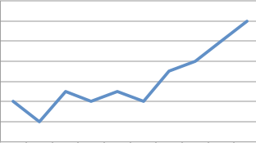
Security Remediation
Progress on security vulnerabilities over the last year
Hosted by OWASP & the NYC Chapter

Slide 16
What is Oracle’s Position on Java Security?
Java is a strategic platform
Safety and security of the Java community is a top priority
Focus remediation effort in process with top executive oversight
Hosted by OWASP & the NYC Chapter

Slide 17
What is Oracle Doing in Java Security?
Defending Java Applets, limit ability of attackers to use malicious applets as a means of attack
Accelerate Remediation, accelerate production of security fixes
New Security Features, new security countermeasures to strengthen Java
Hosted by OWASP & the NYC Chapter

Slide 18
How Serious is Oracle on Java Security?
Java 8: Secure the train (Apr 18, 2013) – Mark Reinhold, Java Chief Architect
"...As a consequence of this renewed focus on security the Java 8 schedule, with a GA release in early September, is no longer achievable."
Hosted by OWASP & the NYC Chapter

Slide 19
Remediated Vulnerabilities
7u15
7u21
7u25
7u9
7u5
* Analysis source, information provided by publicly available Oracle Java Critical Patch Updates
Hosted by OWASP & the NYC Chapter

Slide 20
Remediated Vulnerabilities by Component Subtype
* Analysis source, information provided by publicly available Oracle Java Critical Patch Updates
Hosted by OWASP & the NYC Chapter

Slide 21
Critical Patch Update Process
CPUs are Oracle security patches…
Java Included, Java on Oracle’s regular patch schedule (4 CPUs/yr). Scheduled one year in advance
Customer Benefits, Easier to schedule. Less data center outages
Hosted by OWASP & the NYC Chapter

Slide 22
Security Feature Highlights
Recent security features delivered…
Hosted by OWASP & the NYC Chapter

Slide 23
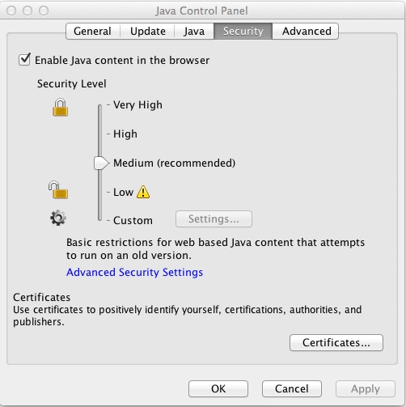
Enable/Disable Java in Web Browsers (Java 7 Update 10)
Feature: Easy way to disable Java on different platforms
Concern: Instructions to disable Java are different on each platform
Hosted by OWASP & the NYC Chapter

Slide 24
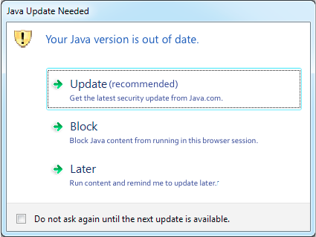
Hardcoded best before date in JRE (Java 7 Update 10)
Feature: Java should function differently when it’s operating insecurely, encourage upgrade
Concern: Older versions of Java are insecure
Hosted by OWASP & the NYC Chapter

Slide 25
Java Security Slider (Java 7 Update 10)
Feature: End-user adjustable plugin security levels
Concern: Let end-users balance operational vs. security concerns in accordance with risk preferences or IT policies.
Hosted by OWASP & the NYC Chapter

Slide 26
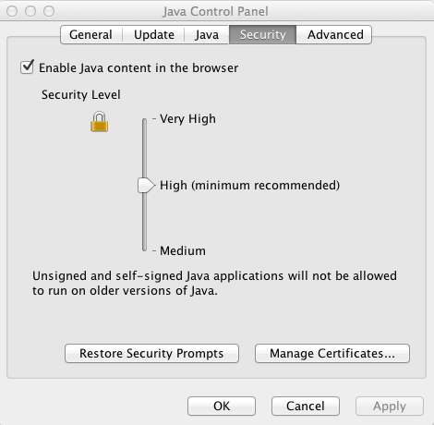
Remove “Low” and “Custom” from Slider (Java 7 Update 21)
Feature: Remove “low” and “custom” levels
Concern: End-users side stepping security controls. End result, more exploitation. Readjust minimum baseline security
Hosted by OWASP & the NYC Chapter

Slide 27
Dynamic Blacklisting Expanded (Java 7 Update 21)
Feature: Expanded to include, JARs, code-signing certificates, and subsidiary CA certificates
Concern: Need capabilities to blacklist critical files for vendors
Hosted by OWASP & the NYC Chapter

Slide 28
Signing for sandboxed applications (Java 7 Update 21)
Feature: Signing for sandboxed applications. Separated code-signing from assigning privileges
Concern: Establish accountability standards for software authors. Open up new enforcement options to the Java community
Hosted by OWASP & the NYC Chapter

Slide 29
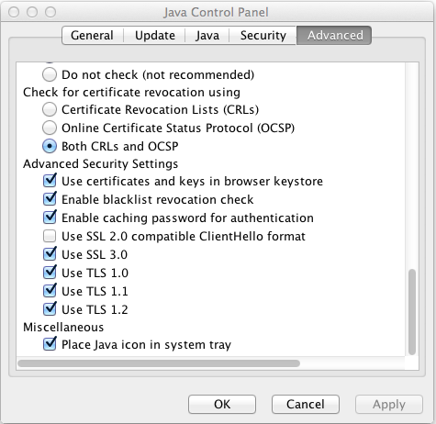
Enable Standardized Revocation Services (Java 7 Update 25)
Feature: Enable standardized revocation services by default like CRL and OCSP
Concern: Stolen digital certificates and impersonation
Hosted by OWASP & the NYC Chapter

Slide 30
Lock JARs (Java 7 Update 25)
Feature: Lock JARs to specific servers or domains
Concern: Deter applet code repurposing
Hosted by OWASP & the NYC Chapter
Notes:
- CERT

Slide 31
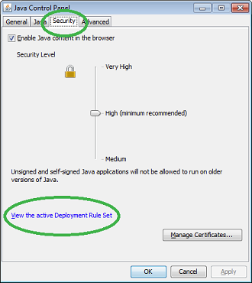
Deployment Rule Set (Java 7 Update 40)
Feature: Add whitelisting for enterprise and partner assets
Concern: Exploitation from Java used in 3rd party ads and spearfishing
…
<rule>
<id location="http://payroll.example.org" />
<action permission="run" />
</rule>
<rule>
<id location="http://knownvendor.example.com/program" />
<action permission="run" version="SECURE-1.6" />
<!-- Application is known not to work on Java 1.7 -->
</rule>
…
Hosted by OWASP & the NYC Chapter

Slide 32
Old JRE Warning (Java 7 Update 40)
X
Feature: Disable JRE out of date warning
Concern: Most businesses desire to manage their own update process. Balance operational vs. security concerns
Hosted by OWASP & the NYC Chapter

Slide 33
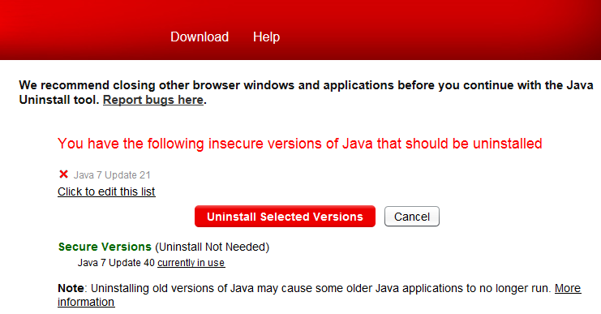
Java Uninstaller (Ongoing)
Feature: Java Uninstaller
Concern: Adversaries target old versions of Java
Hosted by OWASP & the NYC Chapter

Slide 34
JAXP (Java 7 Update 40)
Feature: JAXP security improvements
Concern: Fetching of external resources
Hosted by OWASP & the NYC Chapter

Slide 35
Industry & Java Community Outreach
Where can you find us?
Hosted by OWASP & the NYC Chapter

Slide 36
Outreach Highlights for Milton
JavaOne September, 2012 (presentation)
Java Spotlight Episode 106: Java Security Update Oct, 2012 (podcast)
Java Spotlight Episode 142: Milton Smith on JavaOne Security Track Aug, 2013 (podcast)
Evans Data Corp, March, 2013 (presentation)
Devoxx UK 2013, March, 2013 (presentation + interview)
Black Hat Executive Summit, July 2013 (presentation)
Hosted by OWASP & the NYC Chapter

Slide 37
Outreach Highlights for Milton
OWASP AppSec EU, Hamburg Germany, Aug, 2013 (presentation)
OWASP AppSec USA, NYC, Nov, 2013 (TODO),
MaryAnn Davidson CSO (keynote),
Milton Smith (presentation)
JavaOne 2013, SFO – track opening presentation, application industry experts panel, Sep, 2013 (presentations)
JUG Leaders Call, Jan, 2013,
Milton Smith (call)
Hosted by OWASP & the NYC Chapter

Slide 38
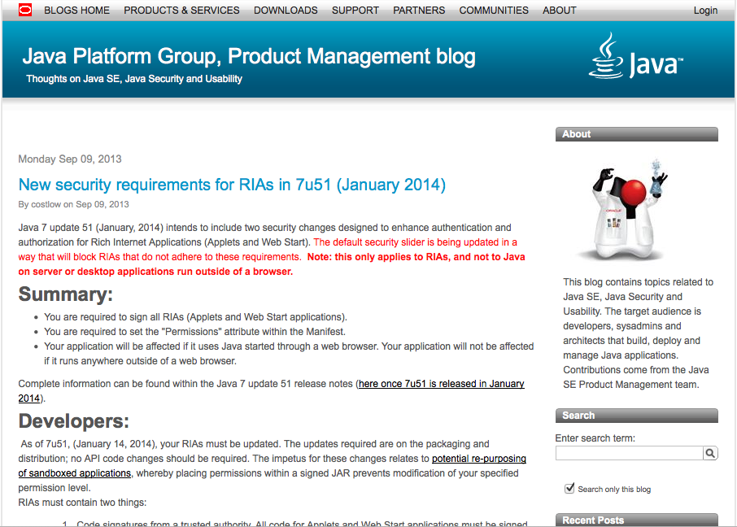
PM Blog
Java platform security news…
Unique, security best practices, timely information, etc.
Follow us, prepare for changes you need to make
Erik Costlow, joins us from HP’s Fortify team. Authored recent security articles
Hosted by OWASP & the NYC Chapter

Slide 39
JavaOne Developer Conference
New security track at Oracle’s flagship conference…
Problem, many developers will never have an opportunity to attend a security conference
Solution, bring security conference to developers
Hosted by OWASP & the NYC Chapter

Slide 40
JavaOne Developer Conference
Securing Java, bringing security to developers…
More content, twice the content over 2012
Defensive, detective and defensive techniques
Success, Surpassed expectations for a first year
Program Committee – Securing Java
Sean Mullen (@seanjmullan)
Michael Coates (@_mwc)
Jim Manico (@manicode)
Jeff Nisewanger
And of course me, Milton ;o)
Hosted by OWASP & the NYC Chapter

Slide 41
Call to Action
Something we can all do…
Hosted by OWASP & the NYC Chapter

Slide 42
Deprecation of Self-Signed and Unsigned Applets
January 7u51, self-signed/unsigned blocked by default
Block self-signed and unsigned at High (default)
Manifest “permissions” attribute required on High (default) security level
All applets written before 7u25 will no longer run by default
Self-signed for a known community is acceptable
* See Java PM Blog, “New security requirements for RIAs in 7u51 (January 2014)”
Hosted by OWASP & the NYC Chapter
Notes:
- Self-signed for a known community acceptable

Slide 43
Vulnerability Report & Feature Suggestions
Reporting Vulnerabilities, Under support (My Oracle Support), all others secalert_us@oracle.com
New Features, http://bugreport.sun.com/bugreport/
Hosted by OWASP & the NYC Chapter

Slide 44
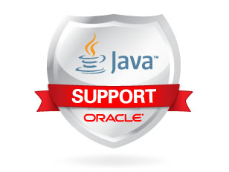
Java Platform Support
3 Options
Premier, 5 years from GA,
Extended, Premier + 3 years,
Sustaining, “as long as you own your Oracle products”
Hosted by OWASP & the NYC Chapter

Slide 45
Java Root Certificate Program
Like web browsers…
Java ships with root certificates
Roots establish intrinsic “trust” for Java users
Anyone can apply to the program
Hosted by OWASP & the NYC Chapter

Slide 46
Future CPUs
January 14, 2014
April 15, 2014
July 15, 2014
October 14, 2014
Hosted by OWASP & the NYC Chapter

Slide 47
Help Us Keep You Secure
To End-Users
Keep your JREs updated (auto-update on)
Practice defense-in-depth: harden OS, virus scanner, firewall
To Developers
Support current JREs so end-users can upgrade
Sign your applications (use timestamp)
Review OWASP Top 10
Follow Secure Coding Guidelines for Java Language
Hosted by OWASP & the NYC Chapter

Slide 48
Additional References
Where can I find more information about Java security?
Java PM Blog (includes security)
https://blogs.oracle.com/java-platform-group/
New security requirements for RIAs in 7u51 (January 2014)
https://blogs.oracle.com/java-platform-group/entry/new_security_requirements_for_rias
Secure Coding Guidelines for the Java Language
http://www.oracle.com/technetwork/java/seccodeguide-139067.html
Oracle CPU and Security Alerts (including RSS Feed)
http://www.oracle.com/technetwork/topics/security/alerts-086861.html
Hosted by OWASP & the NYC Chapter

Slide 49
"THE PRECEEDING IS INTENDED TO OUTLINE OUR GENERAL PRODUCT DIRECTION. IT IS INTENDED FOR INFORMATION PURPOSES ONLY, AND MAY NOT BE INCORPORATED INTO ANY CONTRACT. IT IS NOT A COMMITMENT TO DELIVER ANY MATERIAL, CODE, OR FUNCTIONALITY, AND SHOULD NOT BE RELIED UPON IN MAKING PURCHASING DECISION. THE DEVELOPMENT, RELEASE, AND TIMING OF ANY FEATURES OR FUNCTIONALITY DESCRIBED FOR ORACLE'S PRODUCTS REMAINS AT THE SOLE DISCRETION OF ORACLE."
Hosted by OWASP & the NYC Chapter

Slide 50
Questions?
Java Primer, how Java is used
Security at Oracle, security policy and development life cycle
Security Remediation, vulnerability remediation activities
Security Feature Highlights, delivery of recent security features
Industry & Java Community Outreach, where do we participate
Call to Action, what you can do and additional resources
Milton Smith
Sr. Principal Security PM, Oracle
Java Platform Group
Twitter, @spoofzu
Hosted by OWASP & the NYC Chapter

