Slide 1
THE REAL STATE OF WEBSITE SECURITY and THE TRUTH ABOUT ACCOUNTABILITY and “BEST-PRACTICES.”
OWASP AppSEC, 2013
Jeremiah Grossman
  Founder and CTO
    @jeremiahg

Slide 2
BIO
Jeremiah Grossman
Founder & CTO of WhiteHat Security
Practicing Web security since 2000
International speaker (6-continents)
InfoWorld Top 25 CTO
Co-founder of the WASC
Co-author: XSS Attacks
Former Yahoo! information security officer
Brazilian Jiu-Jitsu Black Belt

Slide 3



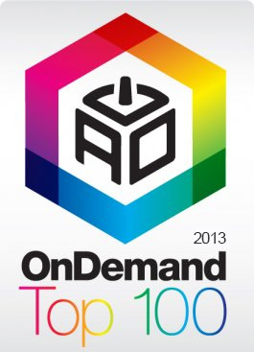




WhiteHat Security, Inc.
THE COMPANY
Founded 2001
Head quartered in Santa Clara, CA
Employees: 300+
WhiteHat Sentinel: SaaS end-to-end website risk management platform (static and dynamic analysis)
Customers: Banking, retail, healthcare, etc.

Slide 4
Why is
Web Security
Important?
(It touches everyone’s lives)

Slide 5
Total Number of Websites:
767,234,152
SSL Websites:
~1,800,000
(producing more code than we’re testing for vulnerabilities)

Slide 7
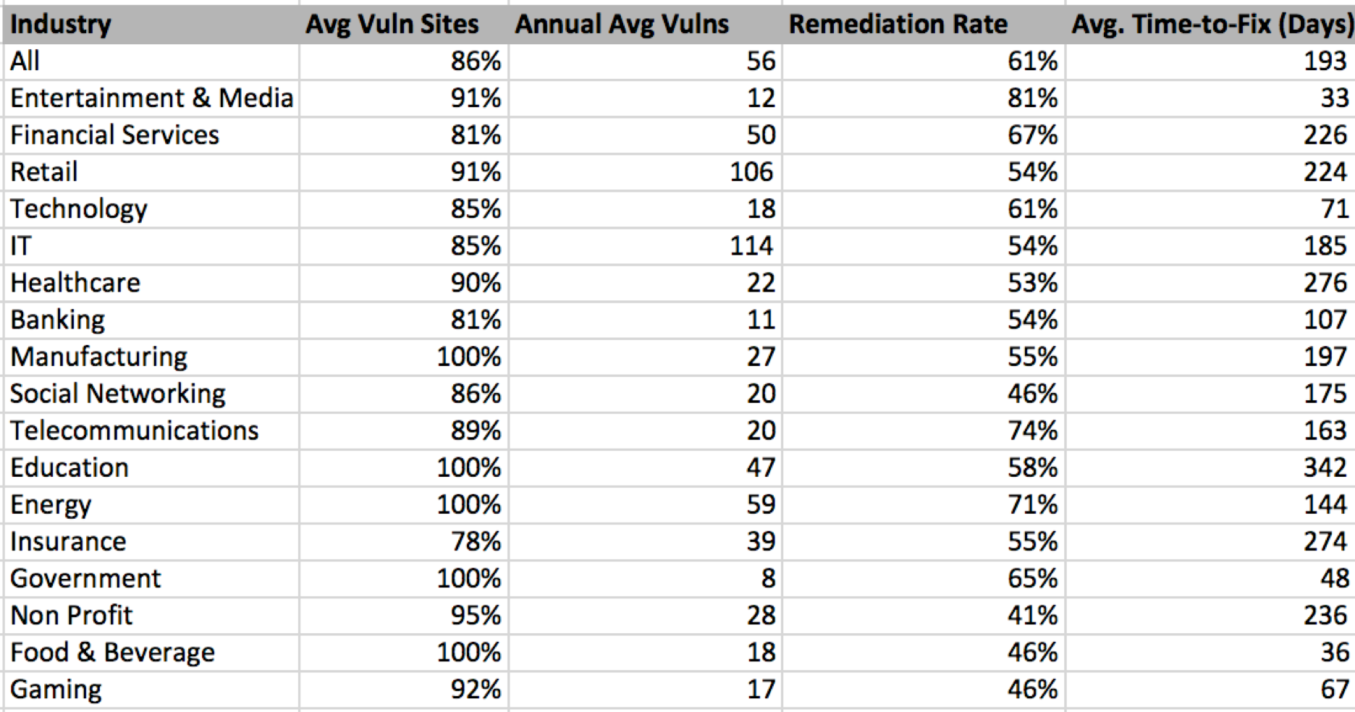
2012
AT A GLANCE: INDUSTRY

Slide 8
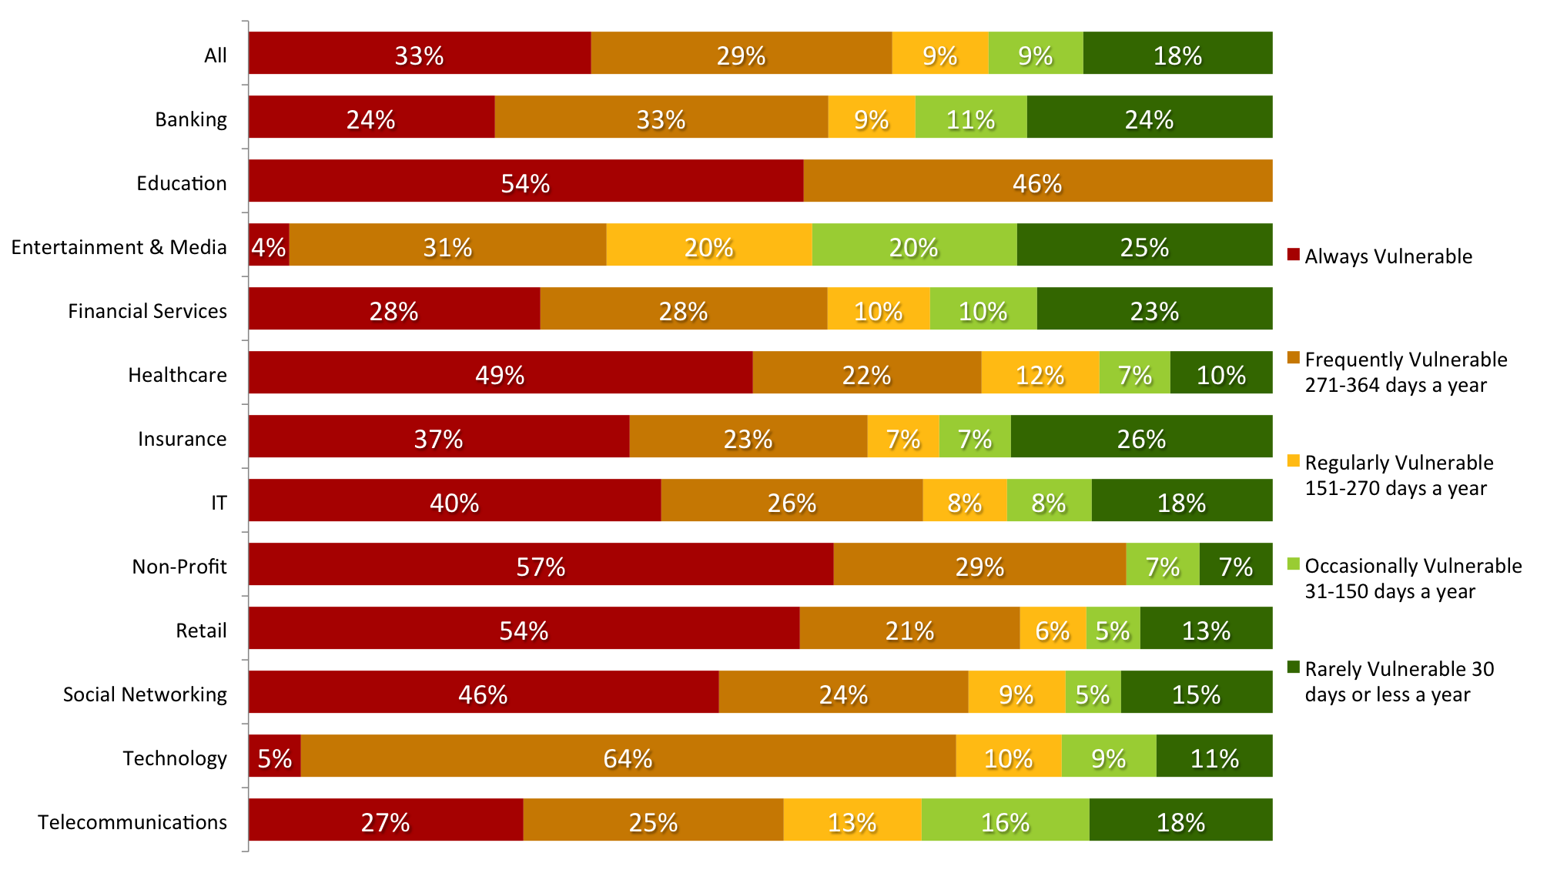
The average number of days in a year a website is exposed to at least one serious* vulnerability.
Window of EXPOSURE

Slide 9
Top 15 Vulnerability Classes (2012)
Percentage likelihood that at least one serious* vulnerability will appear in a website
MOST COMMON VULNS

Slide 10
1.8 million websites x
56 vulnerabilities per year =
100,800,000
Undiscovered serious* vulnerabilities on just the SSL websites.

Slide 11
What we knew going in to 2012...
How Hacks Happen
“Web applications abound in many larger companies, and remain a popular (54% of breaches) and successful (39% of records) attack vector.” –Verizon Data Breach Investigations Report (2012)
“SQL injection was the means used to extract 83 percent of the total records stolen in successful hacking-related data breaches from 2005 to 2011.” –Privacyrights.org

Slide 12
Who’s BEEn HACKED?

Slide 13
WASC: Web Hacking Incident Database
ATTACKS IN-THE-WILD
http://projects.webappsec.org/w/page/13246995/Web-Hacking-Incident-Database

Slide 14
The Bad Guys

Slide 15
HACK
YOURSELF
FIRST

Slide 16
WhiteHat Sentinel
100+ Web security experts
World’s largest web security army
650+ Customers
24x7 vulnerability monitoring for Start-ups to Fortune 500
10,000’s of Assessments
concurrently run at any moment
7,000,000
vulnerabilities processed per week

Slide 19
SURVEY: APPLICATION SECURITY IN THE SDLC
(76 Organizations)
Notes:
The connections from various software security controls and SDLC behaviors to vulnerability outcomes and breaches is far more complicated than we ever imagined.

Slide 20
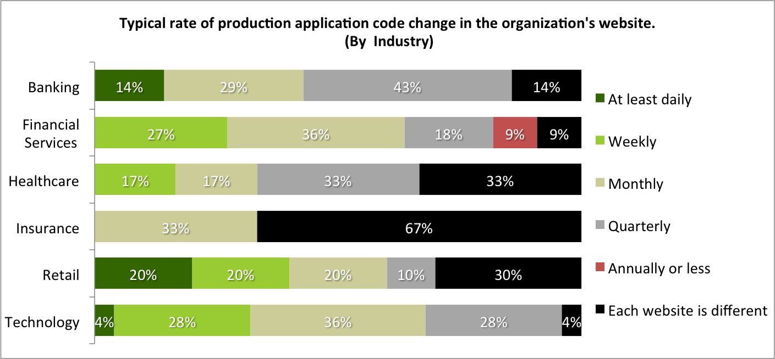
INDUSTRY CORRELATION

Slide 21
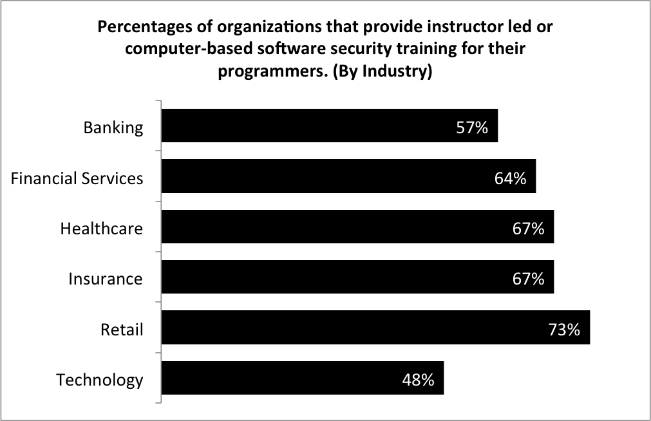
INDUSTRY CORRELATION
http://projects.webappsec.org/w/page/13246995/Web-Hacking-Incident-Database

Slide 22
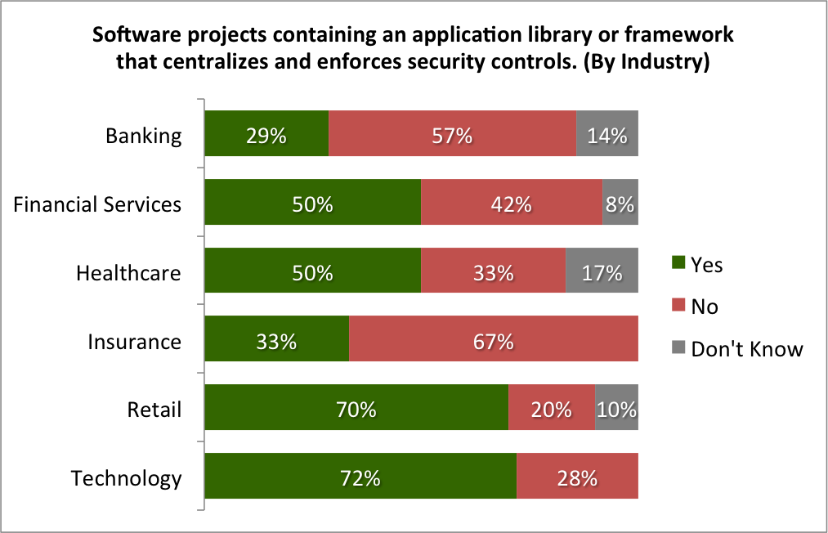
INDUSTRY CORRELATION
http://projects.webappsec.org/w/page/13246995/Web-Hacking-Incident-Database

Slide 23
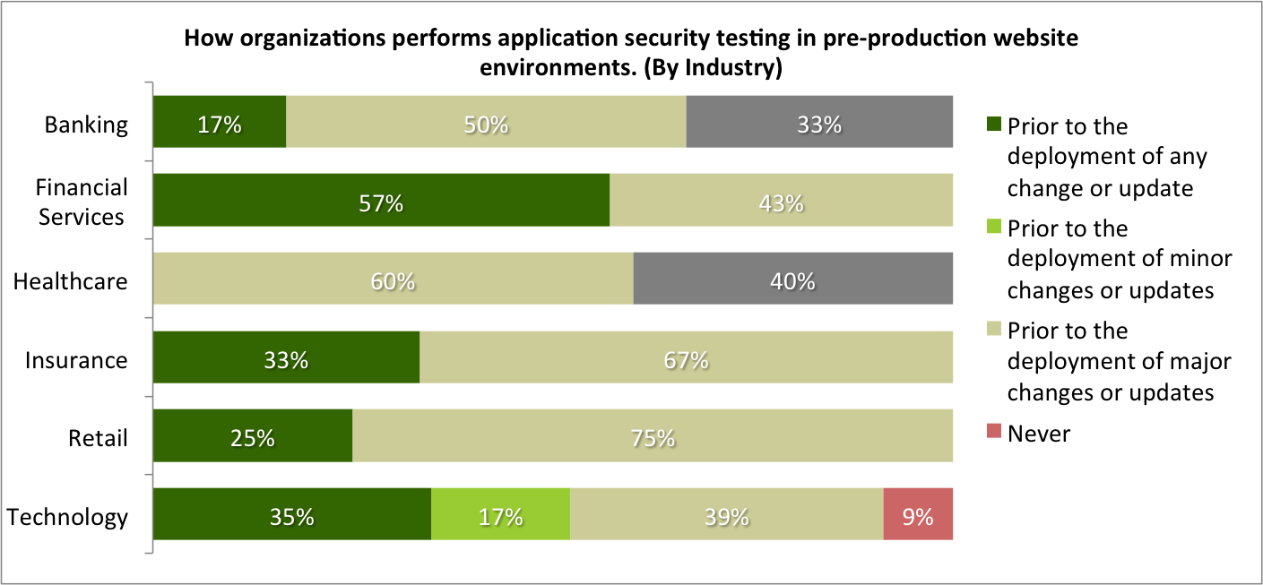
INDUSTRY CORRELATION

Slide 24
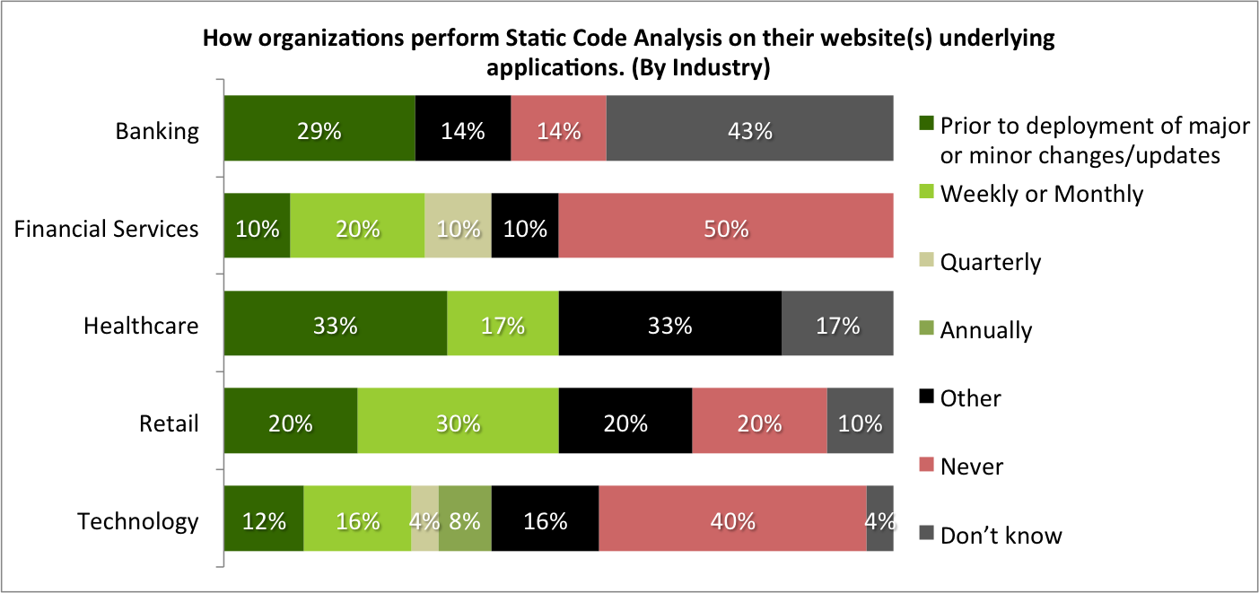
INDUSTRY CORRELATION

Slide 25
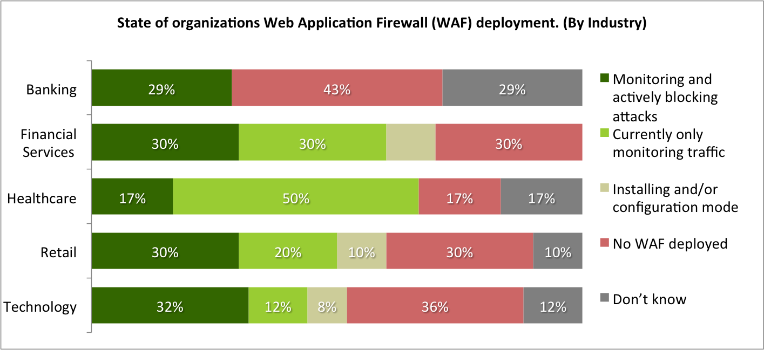
INDUSTRY CORRELATION

Slide 26
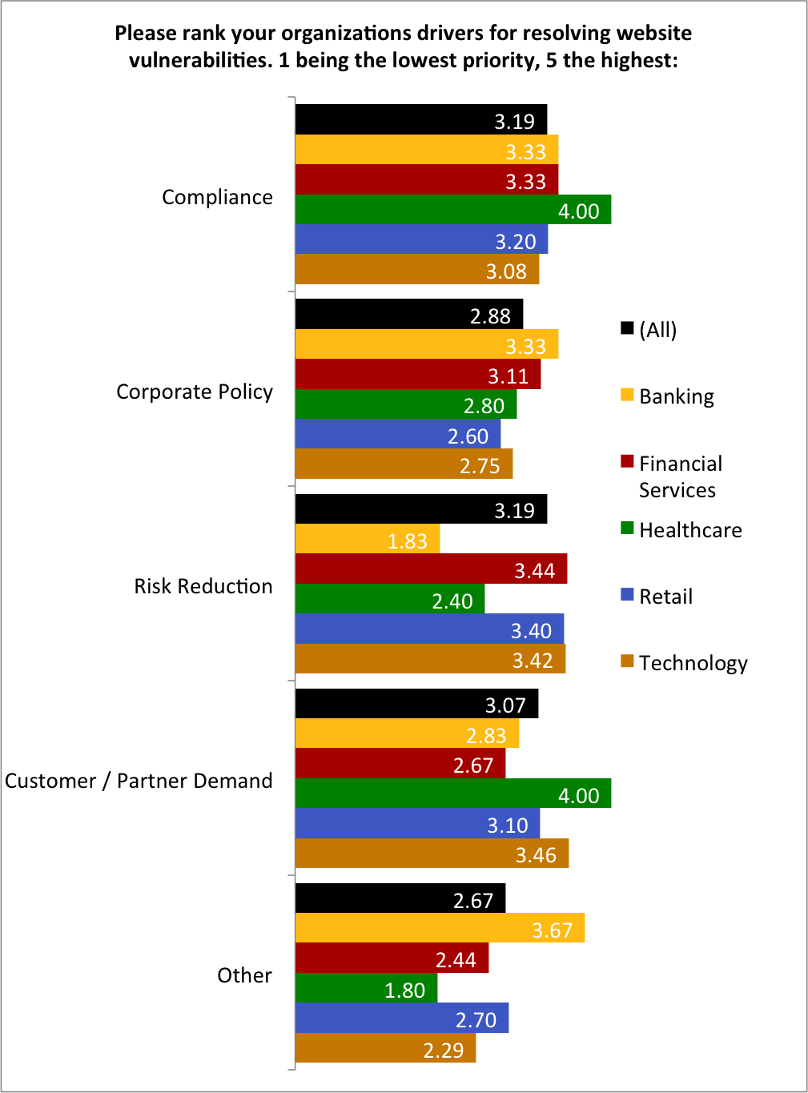

Slide 27
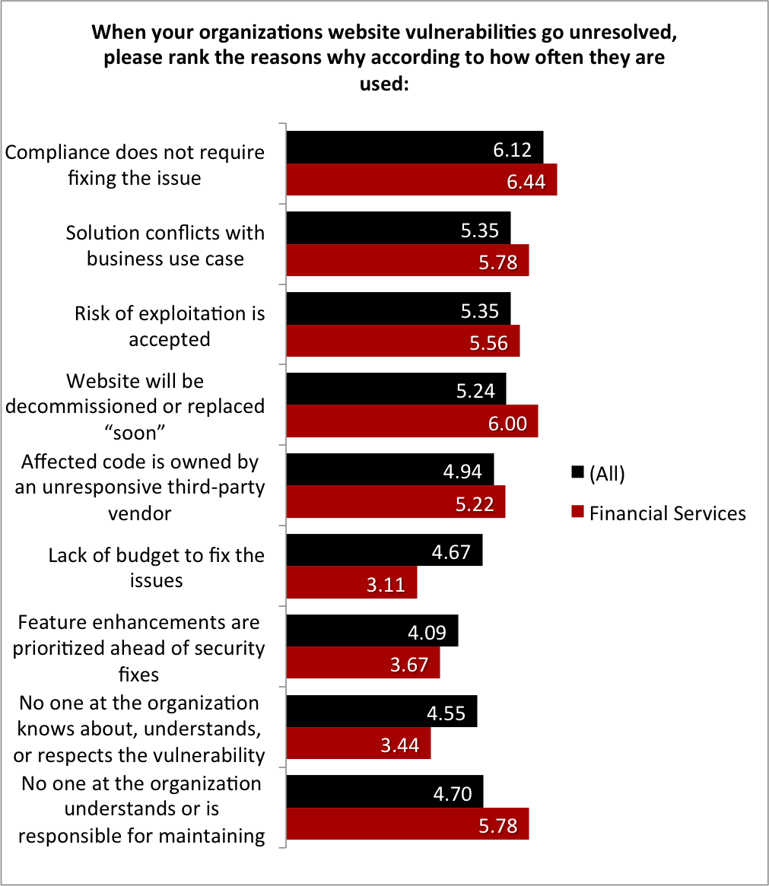
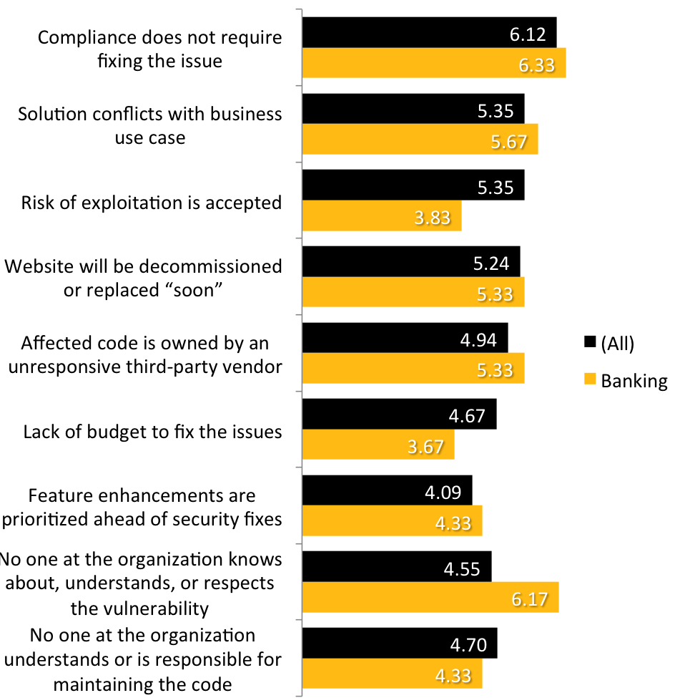

Slide 28
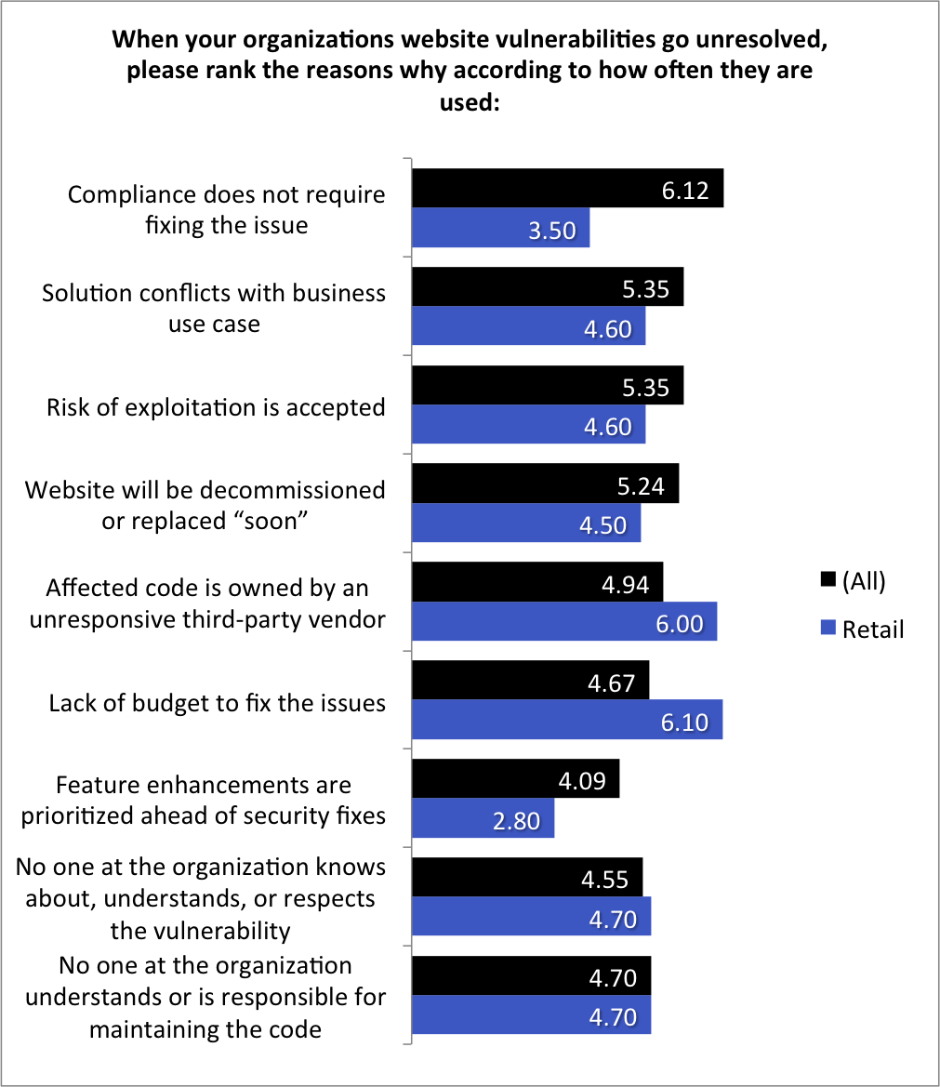
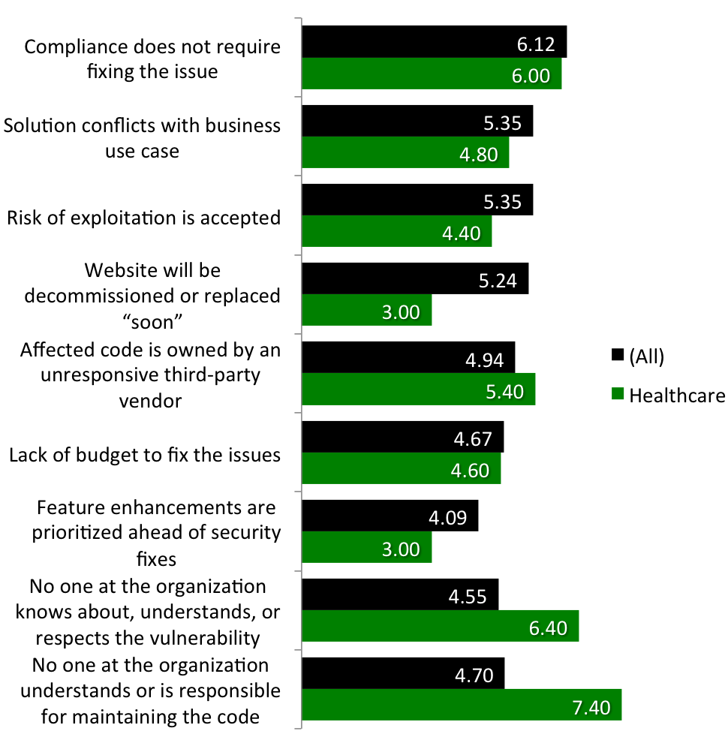

Slide 29
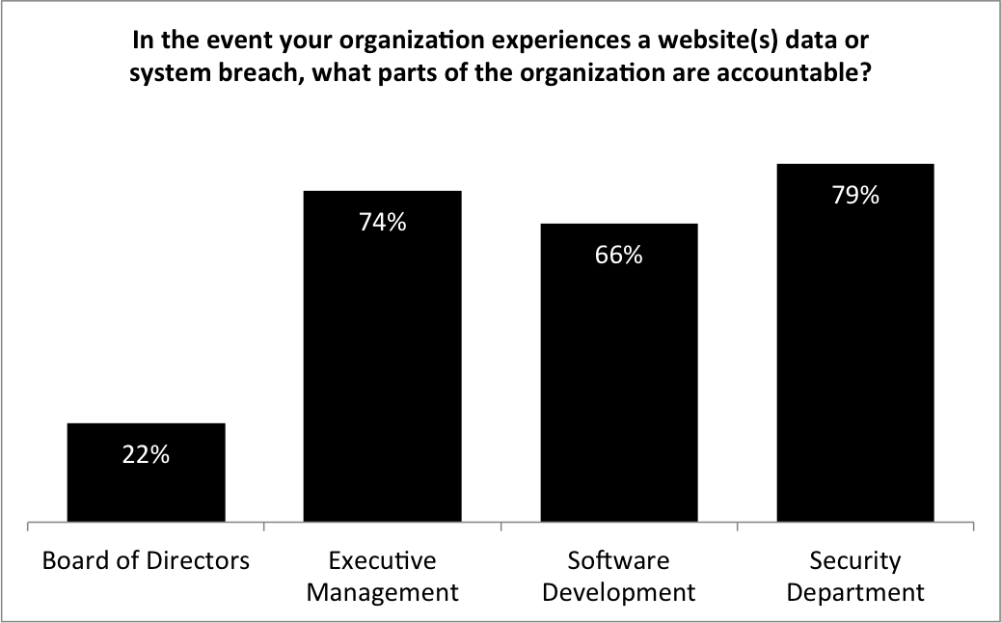
SDLC SURVEY
http://projects.webappsec.org/w/page/13246995/Web-Hacking-Incident-Database

Slide 30
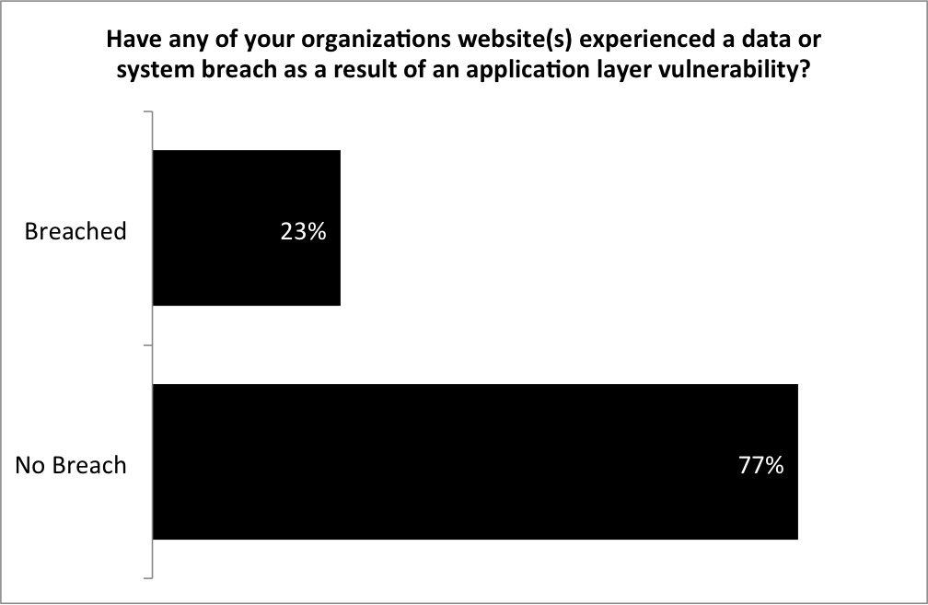
SDLC SURVEY
http://projects.webappsec.org/w/page/13246995/Web-Hacking-Incident-Database

Slide 31
SURVEY: BREACH CORRELATION

Slide 32
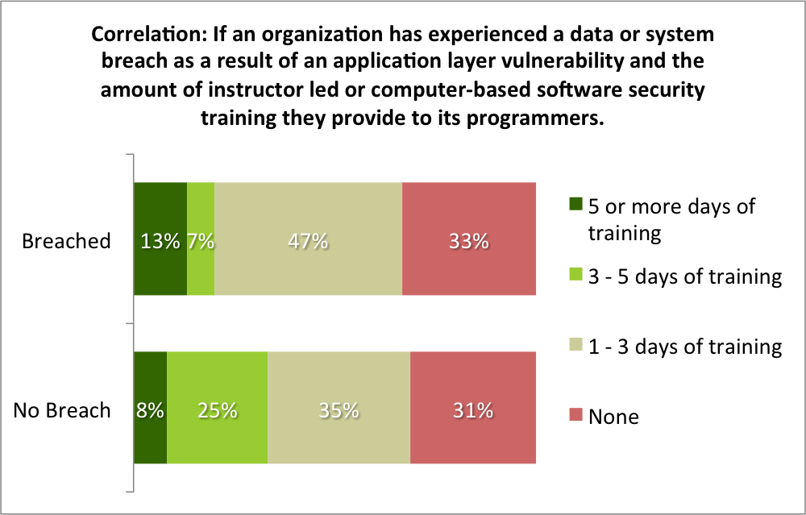
BREACH CORRELATION
Organizations that provided instructor-led or computer-based software security training for their programmers had 40% fewer vulnerabilities, resolved them 59% faster, but exhibited a 12% lower remediation rate.

Slide 33
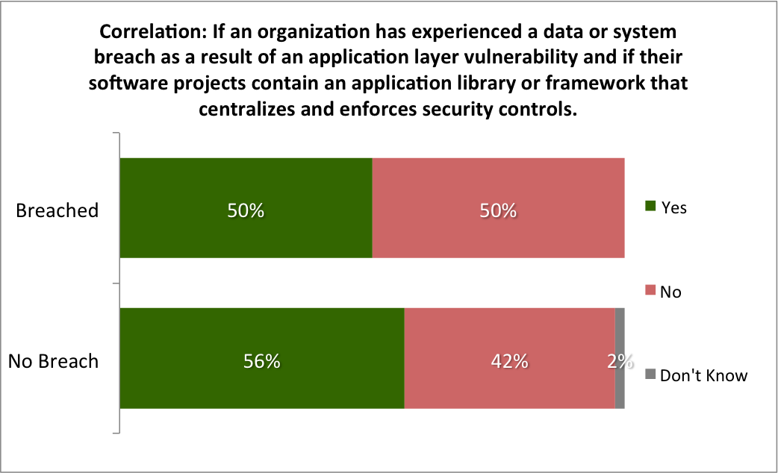
BREACH CORRELATION
Organizations with software projects containing an application library or framework that centralizes and enforces security controls had 64% more vulnerabilities, resolved them 27% slower, but demonstrated a 9% higher remediation rate.

Slide 34
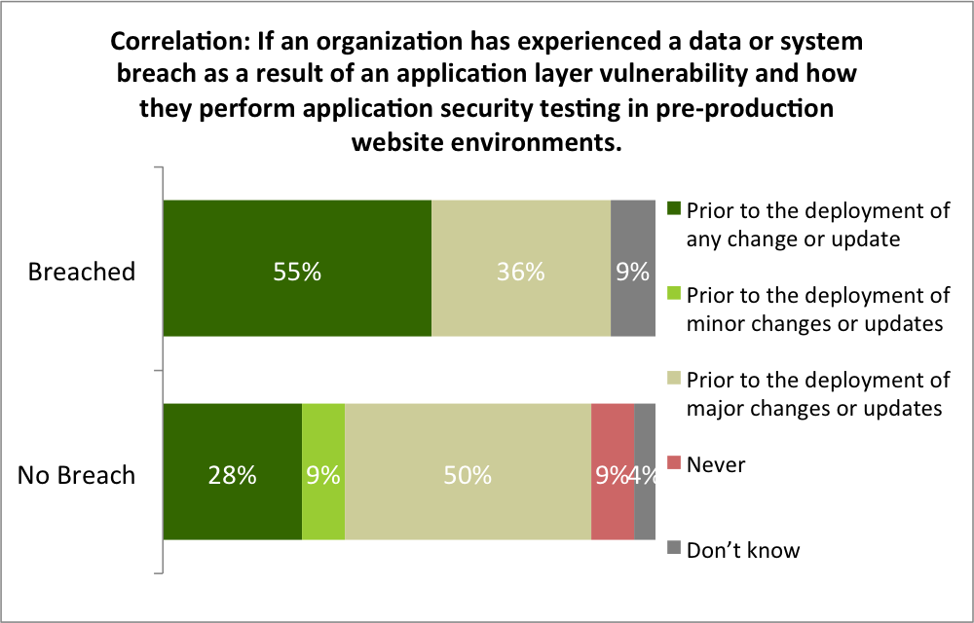
BREACH CORRELATION
http://projects.webappsec.org/w/page/13246995/Web-Hacking-Incident-Database

Slide 35
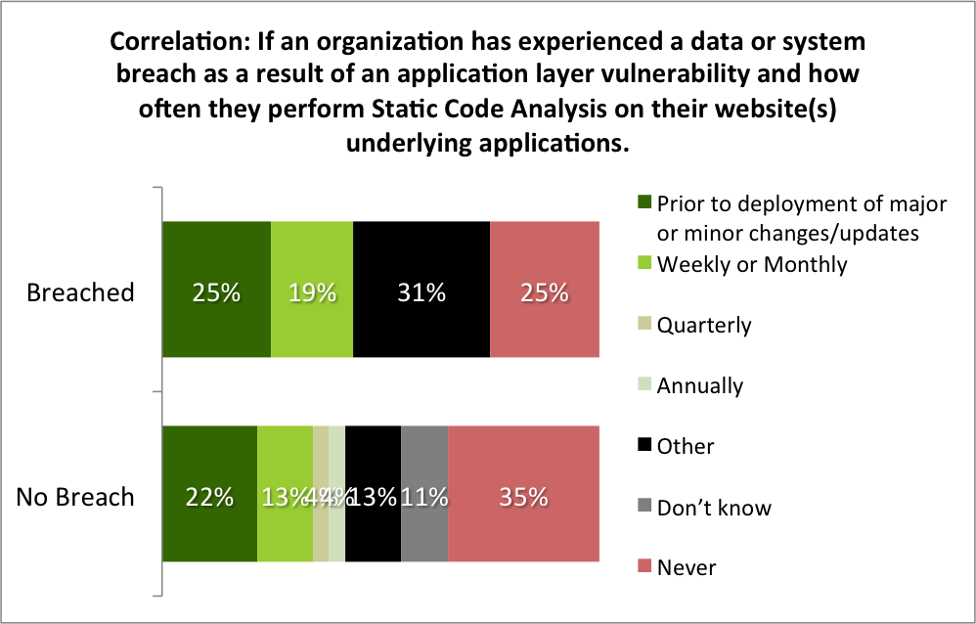
BREACH CORRELATION
Organizations that performed Static Code Analysis on their website(s) underlying applications had 15% more vulnerabilities, resolved them 26% slower, and had a 4% lower remediation rate.

Slide 36
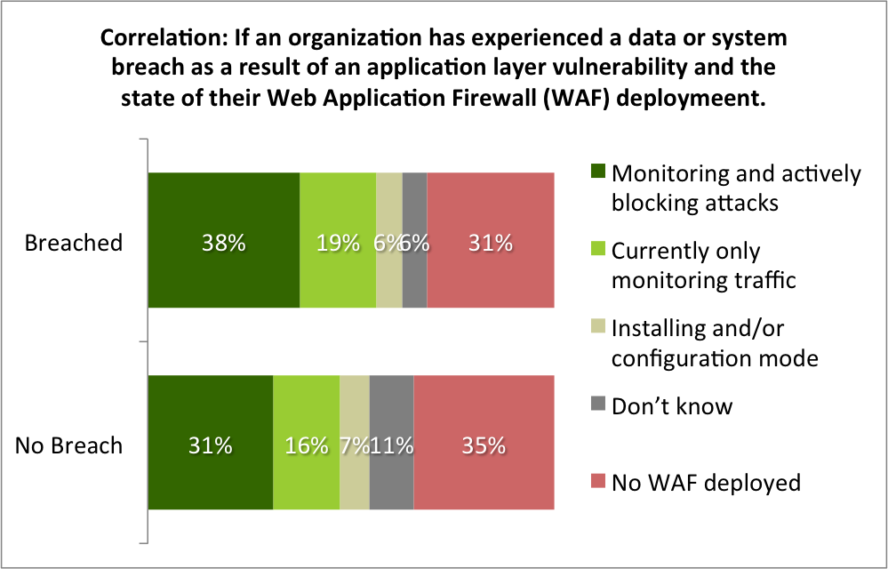
BREACH CORRELATION
Organizations with a Web Application Firewall deployment had 11% more vulnerabilities, resolved them 8% slower, and had a 7% lower remediation rate.

Slide 37
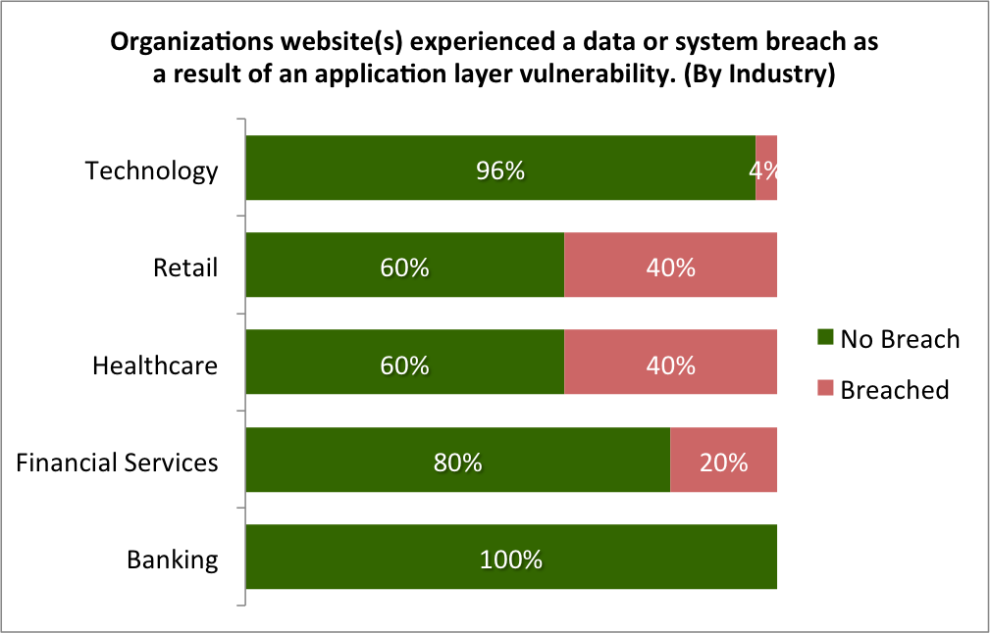
BREACH CORRELATION
Organizations whose website(s) experienced a data or system breach as a result of an application layer vulnerability had 51% fewer vulnerabilities, resolved them 18% faster, and had a 4% higher remediation rate.

Slide 38
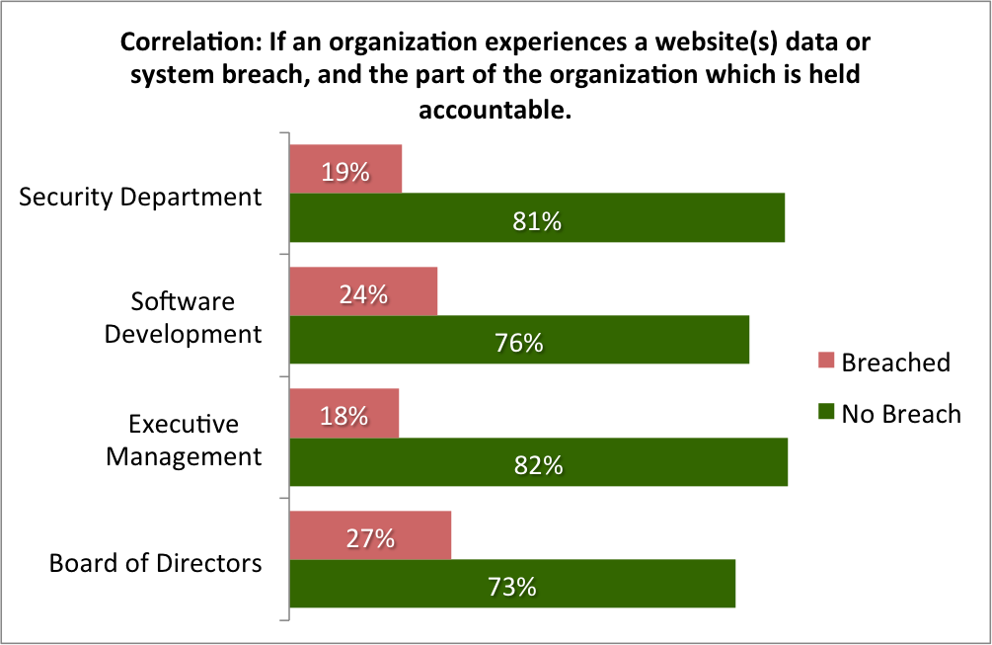
ACCOUNTABILITY
http://projects.webappsec.org/w/page/13246995/Web-Hacking-Incident-Database

Slide 39
LESSONS
“Best-Practices”─there aren’t any!
Assign an individual or group that is accountable for website security
Find your websites – all of them – and prioritize
Measure your current security posture from an attacker’s perspective
Trend and track the lifecycle of vulnerabilities
Fast detection and response

