Slide 1
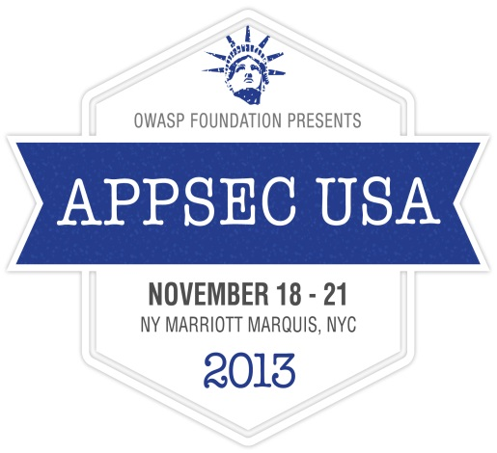
Verify Your Software
for Security Bugs
AppSecUSA
New York City 2013

Slide 2
ME?
Simón Roses Femerling
Founder & CEO, VULNEX www.vulnex.com
Blog: www.simonroses.com
Twitter: @simonroses
Former Microsoft, PwC, @Stake
DARPA Cyber Fast Track award on software security project
Black Hat, RSA, OWASP, SOURCE, AppSec, DeepSec, TECHNET

Slide 3

BIG THANKS!
DARPA Cyber Fast Track (CFT)
Mudge
The fine folks at BIT SYSTEMS

Slide 4
TALK OBJECTIVES
Secure development
Verification technologies
Assess software security posture
Notes:
4

Slide 5
AGENDA
Secure Development: Verification
BinSecSweeper
Case Studies & Demos
Conclusions
Notes:
5

Slide 6
1. Secure Development: Verification
Notes:
6

Slide 7
1. Secure DEVELOPMENT: VERIFICATION
MS SDL
  “This phase involves a comprehensive effort to ensure that the code meets the security and privacy tenets established in the previous phases.”
Software Assurance Maturity Model (SAMM)
  “Verification is focused on the processes and activities related to how an organization checks and tests artifacts produced throughout software development. This typically includes quality assurance work such as testing, but it can also include other review and evaluation activities.”
Notes:
7

Slide 8
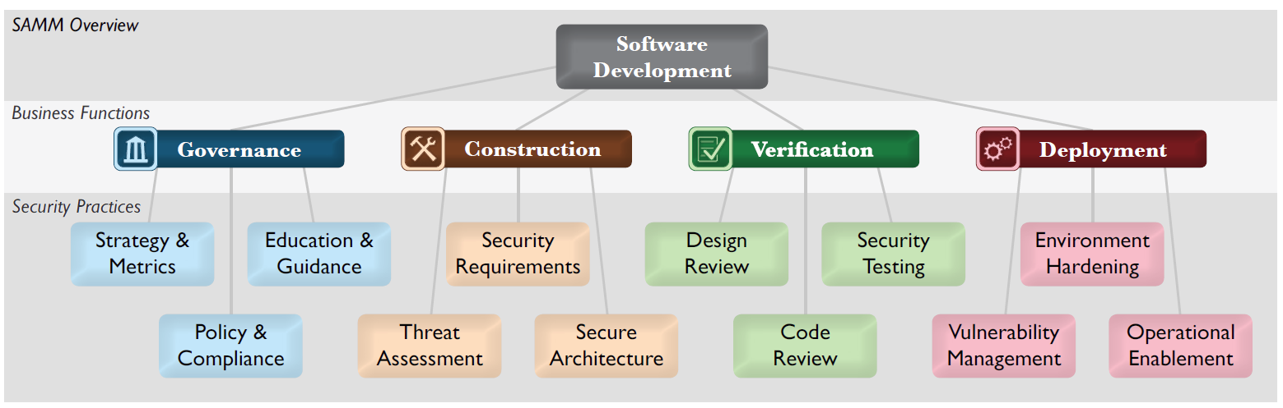
1. Opensamm
Notes:
8

Slide 9
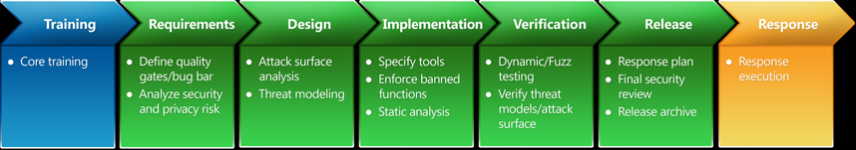
1. Microsoft sdl
Notes:
9

Slide 10
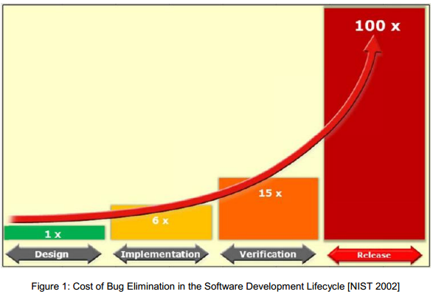
1. IT’s about saving money!
Notes:
10

Slide 11
1. OTHER VERIFICATION TOOLS
Microsoft BinScope
http://www.microsoft.com/en-us/download/details.aspx?id=11910
RECX Binary Assurance for Windows
http://www.recx.co.uk/products/exeaudit.php
ErrataSec Looking Glass
http://blog.erratasec.com/search/label/LookingGlass#.UodWXJ2DN9A
Notes:
11

Slide 12
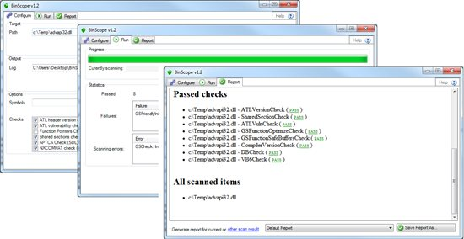
1. BinScope
Notes:
12

Slide 13
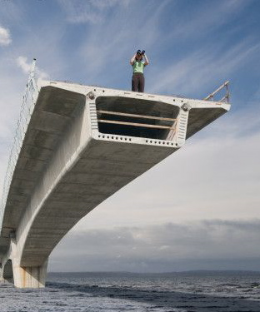
1. CURRENT VERIFICATION TOOLS
Platform specific
  Windows: BinScope, Looking Glass & Binary Assurance
  Linux: checksec.sh and custom scripts
Limited set of checks
  Check for defenses but what about:
    Compiler used
    External libs used
    Malware
    You name it…
Not easy to extend
Notes:
13

Slide 14

1. BINARY INTELLIGENCE
File Information
Compiler
Size
Hash
Timestamp
Name
Version
Security Mitigations
Vulnerabilities
DEP
ASLR
Stack Cookies
Unsafe API
Weak Crypto
Notes:
14

Slide 15
2. BinSecSweeper
Notes:
15

Slide 16
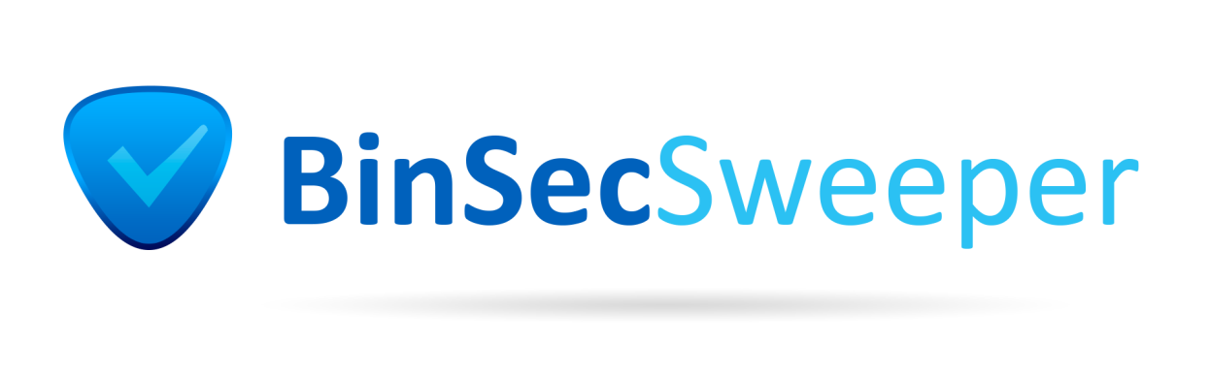

2. WHY BINSECSWEEPER?
BinSecSweeper is VULNEX binary security verification tool to ensure applications have been built in compliance with Application Assurance best practices
The goal for BinSecSweeper is a tool:
  Developers can use to verify their output binaries are safe after compilation and before releasing their products
  IT security pros to scan their infrastructure to identify binaries with weak security defenses or vulnerabilities.
BinSecSweeper is a cross platform tool (works on Windows and Linux) and can scan different file formats: PE and ELF.
Notes:
16

Slide 17
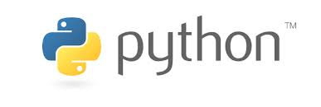
2. features
100% open source
Easy to use
Cross-platform works on Windows & Linux
Scans Windows (PE) and Unix (ELF) files for security checks
Configurable
Extensible by plugins
Reporting
Notes:
17

Slide 18
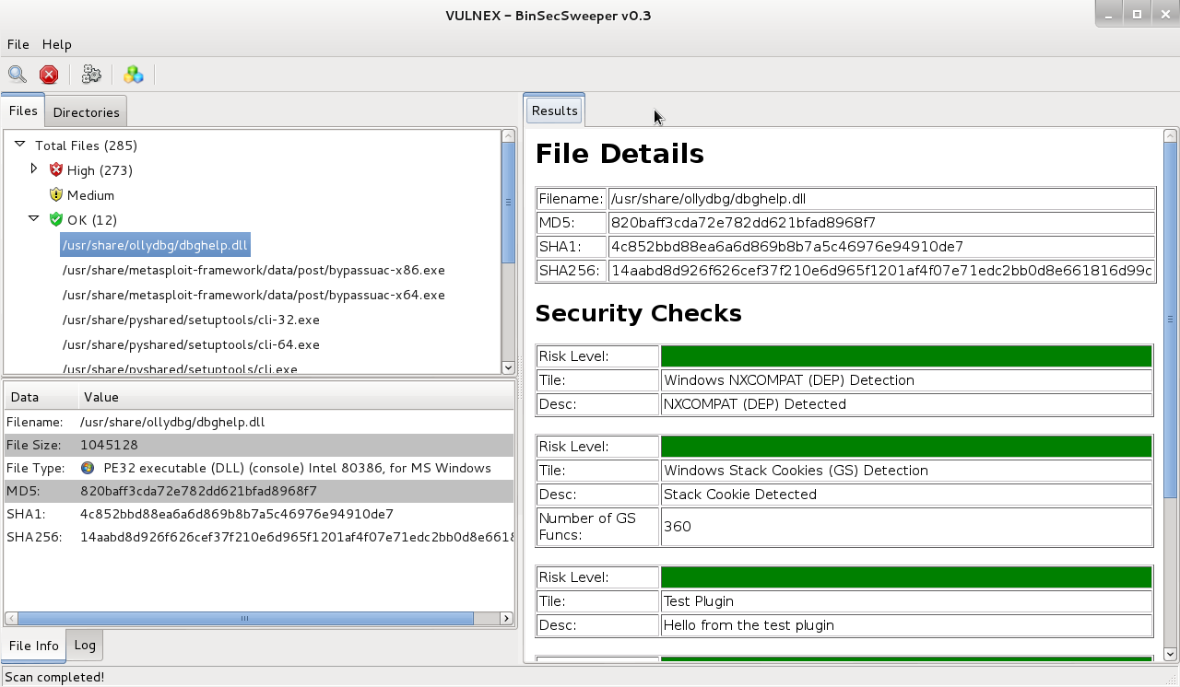
2. BINSECSWEEPER IN ACTION (I)
Notes:
18

Slide 19
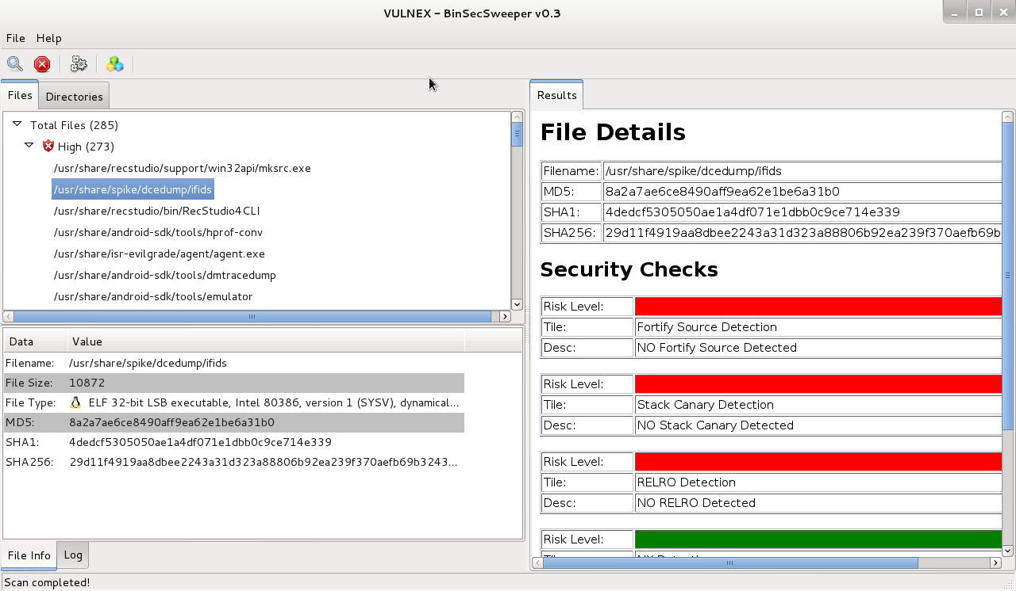
2. BINSECSWEEPER IN ACTION (II)
Notes:
19

Slide 20
2. CURRENT WINDOWS CHECKS
CHECK | DESCRIPTION
Address space layout randomization (ASLR) | Checks if binary has opted the ASLR. Link with /DYNAMICBASE
Stack Cookies (GS) | Verifies if binary was compiled with Stack Cookies protection. Compile with /GS
HotPatch | Checks if binary is prepared for hot patching. Compile with /hotpatch
Compatible with Data Execution Prevention (NXCOMPAT) | Validates if binary has opted hardware Data Execution Prevention (DEP). Link with /NXCOMPAT
Structured Exception Handling (SEH) | Checks if binary was linked with SafeSEH. Link with /SAFESEH
Abobe Malware Classifier | Analyzes binary for malware behavior using machine learning algorithms
Visual Studio Compiler Fingerprinting | Identifies if binary was compiled with Visual Studio and version (2008, 2010 & 2012)
Notes:
20

Slide 21
2. CURRENT LINUX CHECKS
CHECK | DESCRIPTION
Fortify Source | Checks if binary was compiled with buffer overflow protection (bounds checking). Compile with –D_FORTIFY_SOURCE=X
Never eXecute (NX) | Verifies if binary was compiled with NX to reduce the area an attacker can use to perform arbitrary code execution.
Position Independent Code (PIE) | Checks if binary was compiled with PIE to protects against "return-to-text" and generally frustrates memory corruption attacks. Compile with –fPIE -pie
RELocation Read-Only (RELRO) | Validates if binary was compiled with RELRO (partial/full) to harden data sections. Compile with –z,relro,-z,now
Stack Canary | Checks if binary was compiled with stack protector to protect against stack overflows. Compile with –fstack-protector
Notes:
21

Slide 22
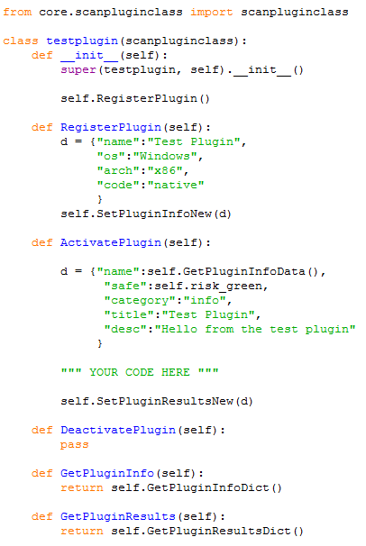
2. PLUGIN EXAMPLE: TEST PLUGIN
Notes:
22

Slide 23
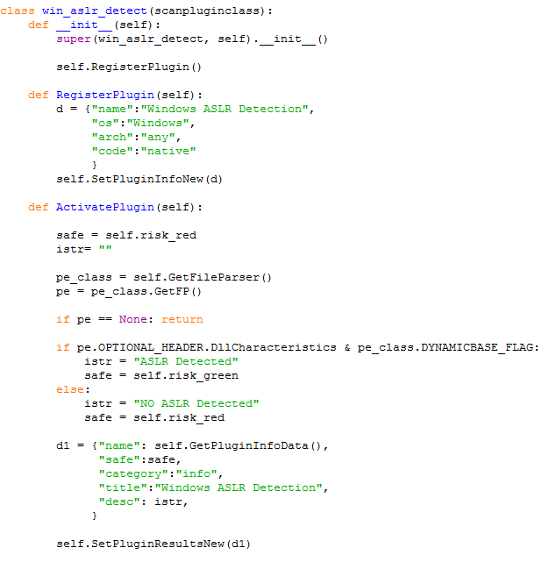
2. PLUGIN EXAMPLE: WINDOWS ASLR
Notes:
23

Slide 24
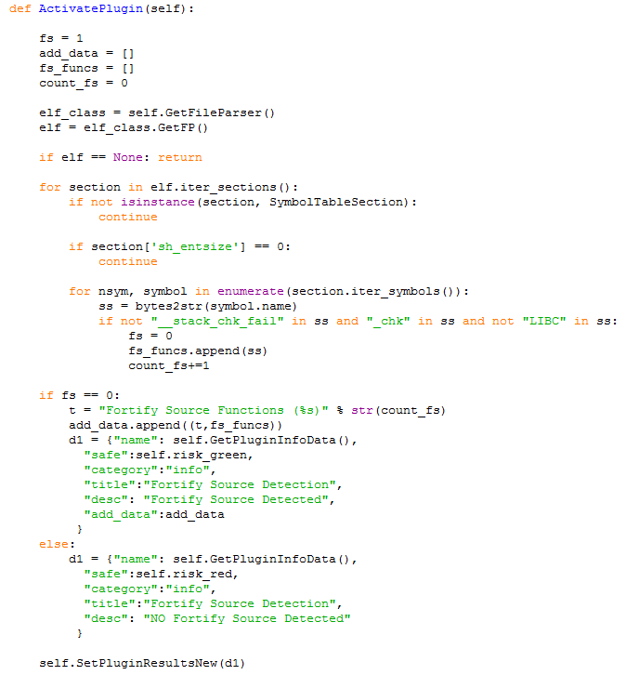
2. PLUGIN EXAMPLE: LINUX FORTIFY_SOURCE
Notes:
24

Slide 25
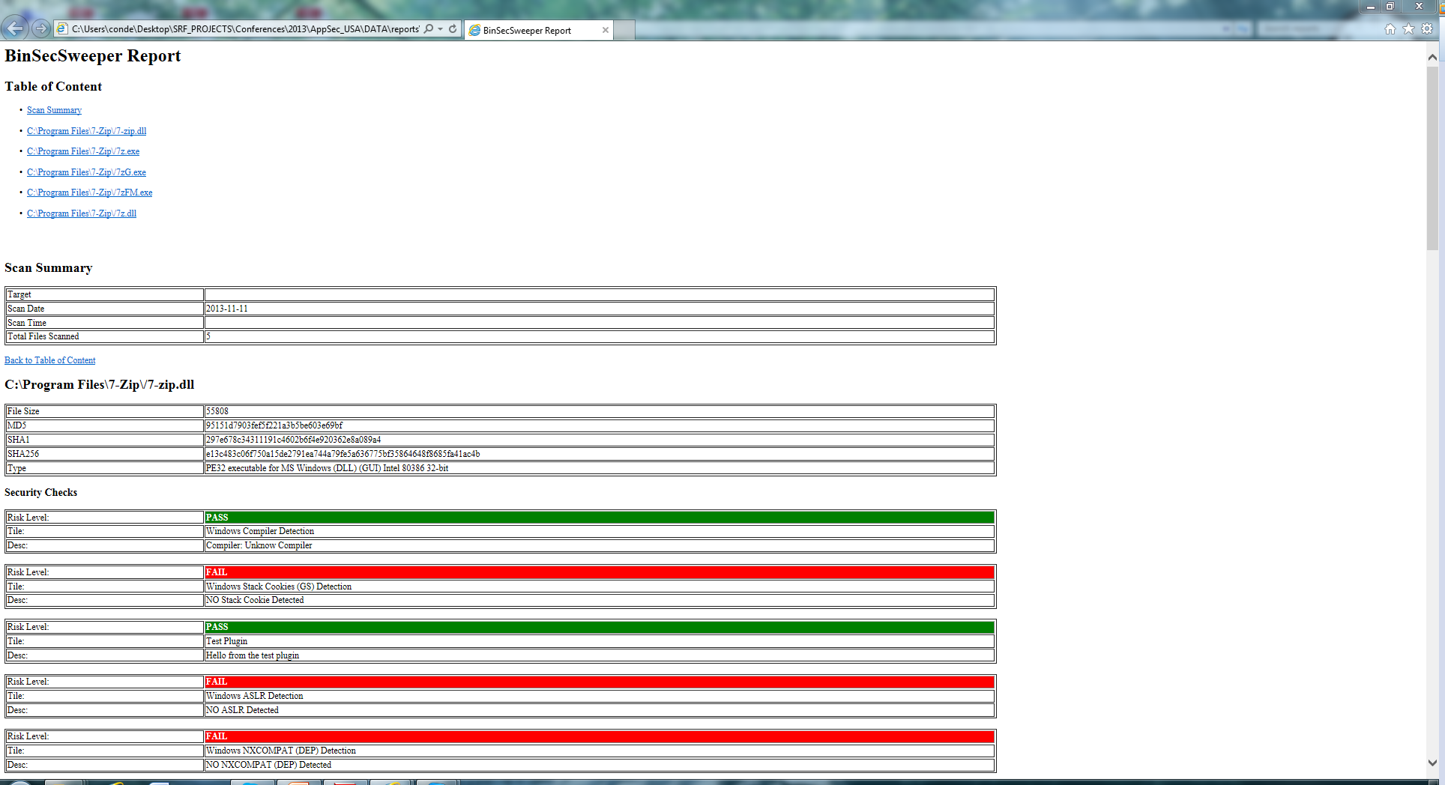
2. REPORTING
Notes:
25

Slide 26
2. BINSECSWEEPER: WHAT’S NEXT
More plugins:
  Windows, Linux, etc.
  Mobile
  Malware
  Backdoors
  Compilers
  Packers
Metrics panel
Diff across product / versions
Notes:
26

Slide 27
2. BINSECSWEEPER: Where?
Download BinSecSweeper software from www.vulnex.com
Notes:
27

Slide 28
3. Case Studies & Demos
Notes:
28

Slide 29

3. Time for some action
Case Study I: Verify your own software
Case Study II: Software Security Posture, ACME inc
Case Study III: Browser Security Comparison
Notes:
29

Slide 30
3. Case study i: Verify your own software
Is your in-house software following a secure development framework?
Is your software being checked for:
  Compiled with a modern compiler?
  Security defenses enabled for Windows or Linux?
  No malware included in product?
  Using external libraries (DLL, etc.) and what is their security?
Notes:
30

Slide 31
3. Case study i: Verify your own software
BinSecSweeper can verify that product (used by development teams):
  What Visual Studio version has been used? (Windows Only) (MS SDL)
  What defenses have been enabled?:
  Will audit all files in the project?
Program security posture: will it Pass / Fail?
Windows | Linux
Stack Cookies | Stack Canary
ASLR | NX
DEP | Fortify Source
SAFESEH | PIE
HotPacthing | RELRO
Notes:
31

Slide 32

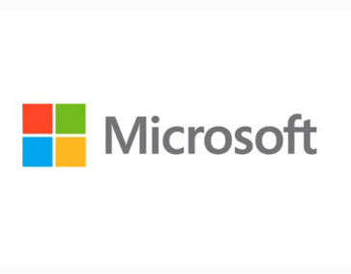



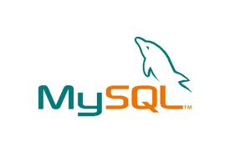

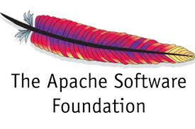

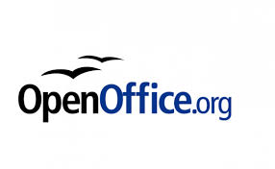
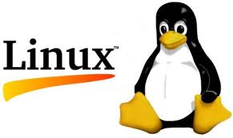
3. Case study ii: Software security posture, amce inc
Do IT know the security posture of all software? You can assess your vendors…
Now you know where EMET is needed!
Notes:
32

Slide 33
3. Case study ii: Software security posture, amce inc
VLC
SKYPE
iTunes
Dropbox
Notes:
33

Slide 34

3. Case STUDY III: BROWSER SECURITY
COMPARISON
Let’s assess browser security posture
  Chrome
  Firefox
  Internet Explorer
  Opera
  Safari
Only checked on Windows, but will be interesting to do same exercise in other OS
Notes:
34

Slide 35
3. Case STUDY III: BROWSER SECURITY
COMPARISON
BROWSER | AUDIT FILES | FILE | Compiler | GS | ASLR | DEP | SAFESEH | HotPatch
Chrome | 75 | chrome.exe | VS 2010 | / 360
Firefox | 28 | firefox.exe | VS 2010 | / 11
Internet Explorer | 18 | iexplore.exe | ¿? | / 5
Opera | 14 | opera.exe | VS 2010 | / 16099
Safari | 48 | safari.exe | VS 2008 | / 2
Notes:
35

Slide 36
4. Conclusions
Notes:
36

Slide 37
4. VERIFYING Software security posture matters!
Binaries contain a lot of information!
The security posture of the software developed by you is important:
  Security improves Quality
  Branding (show you care about security)
How is the security posture of software vendors you use?
Notes:
37

Slide 38

4. BinSECSWEEPER: CALL TO ARMS
  How can the software be improved?
  What checks do you need?
  What metrics do you need?
  Contact: research@vulnex.com
Notes:
38

Slide 39
4. REFERENCES
Linux Security Features (Ubuntu)
https://wiki.ubuntu.com/Security/Features
Visual Studio Compiling Options
http://msdn.microsoft.com/en-us/library/9s7c9wdw.aspx
Notes:
39

Slide 40
4. Q&A
Thanks!
@simonroses / @vulnexsl
www.vulnex.com
Notes:
40

