Slide 1
Web Security – Everything we know is wrong

Slide 2
Eoin Keary
CTO BCCRISKADVISORY.COM
OWASP GLOBAL BOARD MEMBER
OWASP Reboot & Code Review Project Lead

Slide 3
HACKED

Slide 4
Last Week (11th November):
“Loyaltybuild” BREACH
1,100,000
30
$$$

Slide 5
Globally, every second, 18 adults become victims of cybercrime
- Symantec
“One hundred BILLION dollars” - Dr Evil
2012 Cyber Crime
US $20.7 billion in direct losses
Global $110 billion in direct losses
Global $338 billion + downtime
“The loss of industrial information and intellectual property through cyber espionage constitutes the greatest transfer of wealth in history” - Keith Alexander
Almost 1 trillion USD was spent in 2012 protecting against cybercrime
Eoin, I didn’t click it – My Grandma
“556 million adults across the world have first-hand experience of cybercrime -- more than the entire population of the European Union.”

Slide 6
Its (not) the $$$$
Information security spend
Security incidents (business impact)

Slide 7
……we are approaching this problem
[software <in>Security] completely wrong and have been for years…..

Slide 8
Asymmetric Arms Race

Slide 9
A traditional end of cycle / Annual pentest only gives minimal security…..

Slide 10
There are too many variables and too little time to ensure “real security”.

Slide 11
An inconvenient truth
Two weeks of ethical hacking
Business Logic Flaws
Code Flaws
Security Errors
Ten man-years of development

Slide 12
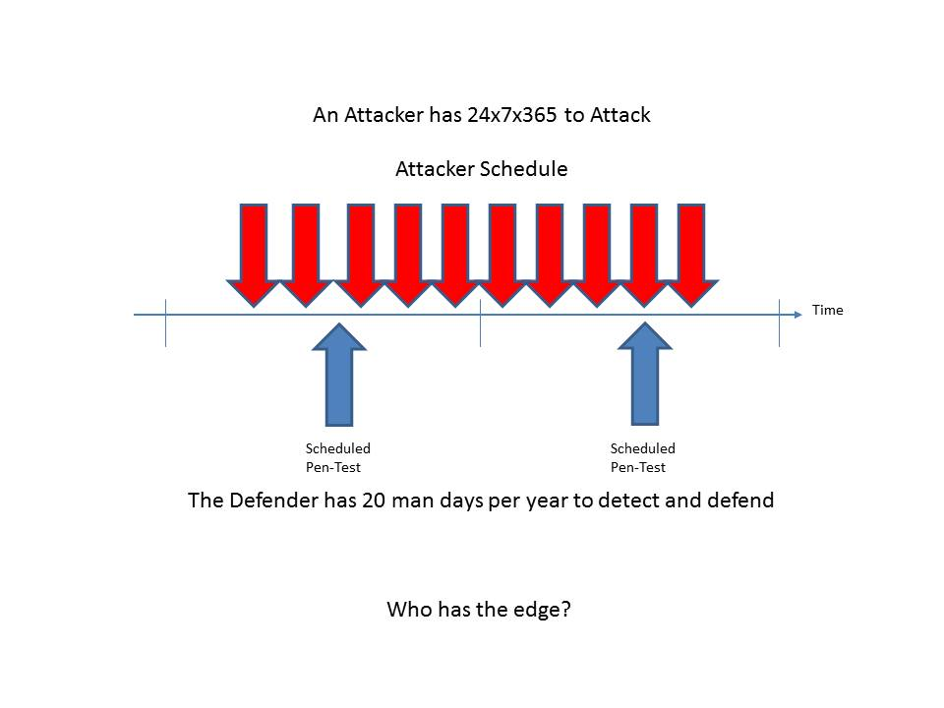
Make this more difficult: Lets change the application code once a month.

Slide 13
"Risk comes from not knowing what you're doing." - Warren Buffet

Slide 14
Time Limited:
Consultant “tune tools”
Use multiple tools – verify issues
Customize Attack Vectors to technology stack
Achieve 80-90 application functionality coverage
Experience
As good as the bad guys?
Code may be pushed frequently:
Erosion of Penetration test?
Window of Exploitation?
SECURE NOW
A fool with a tool, is still a fool”…..?
HACK NOW

Slide 15
Tools with Tunnel Vision:
Problem has moved (back) to the client.
Some “Client Side” vulnerabilities can’t be tested via HTTP parameter testing.
AJAX
Flex/Flash/Air
Native Mobile Web Apps – Data Storage, leakage, malware.
DOM XSS – Sinks & Sources in client script -> no HTTP required
Scanning in not enough anymore.
We need DOM security assessment.
- Javascript parsing/ Taint analysis/ String analysis
http://code.google.com/p/domxsswiki/

Slide 16
“We need an Onion”
SDL Design review
Threat Modeling
Code review/SAST
Negative use/abuse cases/Fuzzing/DAST
Live/ Continuous/Frequent monitoring / Testing
Ongoing Manual Validation
Vulnerability management & Priority
Dependency Management ….
“Robots are good at detecting known unknowns”
“Humans are good at detecting unknown unknowns”
Notes:
If you don’t understand the business, you cant see the flaws in the business logic

Slide 17
You are what you eat

Slide 18
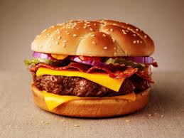
Cheeseburger Security
Cheese Burger Security
We know they are bad for us, but who cares, right?
If we eat too many we may get a heart attack? …sound familiar
We also write [in]secure code until we get hacked
The Cheeseburger approach: “Cheeseburger risk’ is the kind of risk you
deliberately take even knowing the consequences, until those consequences
actually come to pass.”

Slide 19
Software food chain
Outsourced development
Sub-Contractors
COTS (Commercial off the shelf
Third Party API’s
Application Code
Bespoke outsourced development
Third Party Components & Systems
Bespoke Internal development
More
Degrees of trust
Less
You may not let some of the people who have developed your code into your offices!!

Slide 20
2012- Study of 31 popular open source libraries.
19.8 million (26%) of the library downloads have known vulnerabilities.
Today's applications may use up to 30 or more libraries - 80% of the codebase

Slide 21
Spring - application development framework : downloaded 18 million times by over 43,000 organizations in the last year. – Vulnerability: Information leakage CVE-2011-2730
http://support.springsource.com/security/cve-2011-2730
In Apache CXF– application framework: 4.2 million downloads.- Vulnerability: high risk CVE-2010-2076 & CVE 2012-0803
http://svn.apache.org/repos/asf/cxf/trunk/security/CVE-2010-2076.pdf
http://cxf.apache.org/cve-2012-0803.html

Slide 22
Do we test for "dependency“ issues?
NO
Does your patch management policy cover application dependencies?
Check out: https://github.com/jeremylong/DependencyCheck

Slide 23
Bite off more than we chew

Slide 24
“We can’t improve what we can’t measure”

Slide 25
How can we manage vulnerabilities on a large scale….

Slide 26
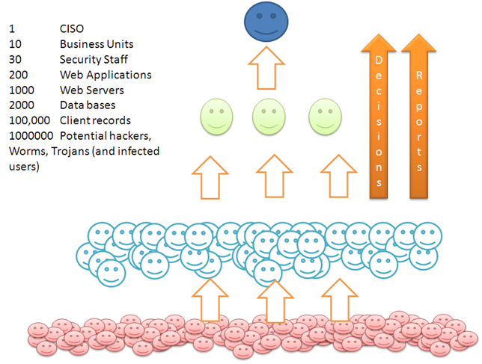

Slide 27
Say 300 web applications:
300 Annual Penetration tests
10’s of different penetration testers?
300 reports
How do we consume this Data?

Slide 28
Enterprise Security Intelligence:
Consolidation of vulnerability data.
Continuous active monitoring
Vulnerability Management solutions
Delta Analysis is Key: Initial testing is most work. Subsequent testing is easier we focus on delta/change.

Slide 29
Metrics: We can measure what problems we have
Measure: We cant improve what we cant measure
Priority: If we can measure we can prioritise
Delta: If we can measure we can detect change
Apply: We can apply our (limited) budget on the right things
Improve: We can improve where it matters……
Value: Demonstrate value to our business
Answer the question: “Are we secure?” <- a little better
Vulnerability Management:

Slide 30
Information flooding
(Melting a developers brain, White noise and “compliance”)

Slide 31
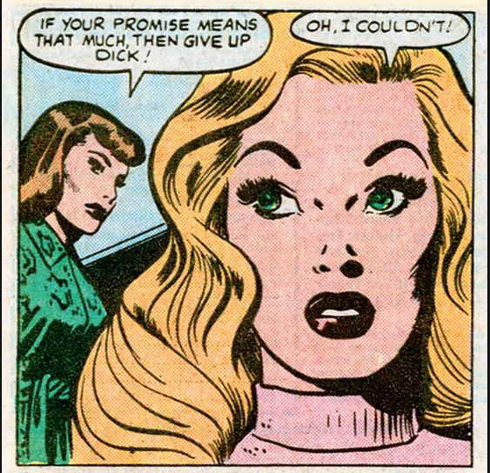
Doing things right != Doing the right things.
“Not all bugs/vulnerabilities are equal”
(is HttpOnly important if there is no XSS?)
Contextualize Risk
(is XSS /SQLi always High Risk?)
Do developers need to fix everything?
Limited time
Finite Resources
Task Priority
Pass internal audit?
White Noise
Context is important!
Dick Tracy

Slide 32
Compliance
There’s Compliance:
EU directive: http://register.consilium.europa.eu/pdf/en/12/st05/st05853.en12.pdf Article 23,24 & 79, - Administrative sanctions “The supervisory authority shall impose a fine up to 250 000 EUR, or in case of an enterprise up to 0.5 % of its annual worldwide turnover, to anyone who, intentionally or negligently does not protect personal data”

Slide 33
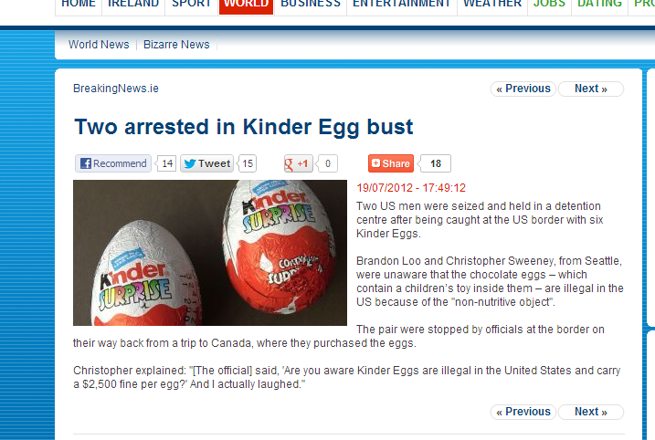
…and there’s Compliance
Clear and Present Danger!!

Slide 34
Update:
Kinder eggs are now legal in the USA.
You’re Welcome!!

Slide 35
Problem
Explain issues in “Developer speak” (AKA English)

Slide 36
Is Cross-Site Scripting the same as SQL injection?
Both are injection attacks -> code and data being confused by system.
LDAP Injection, Command Injection, Log Injection, XSS, SQLI etc etc

Slide 37
XSS causes the browser to execute user supplied input as code. The input breaks out of the [data context] and becomes [execution context].
SQLI causes the database or source code calling the database to confuse [data context] and ANSI SQL [ execution context].
Command injection mixes up [data context] and the [execution context].

Slide 38
To Conclude….
We need to understand what we are protecting against.
We need to understand that a pentest alone is a loosing battle.
You can only improve what you can measure
Not all bugs are created equal.
Bugs are Bugs. Explain security issues to developers in “Dev speak”

Slide 39
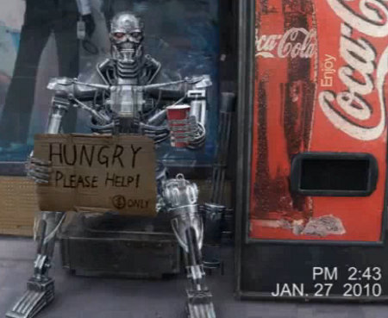
Thanks for Listening
eoin@bccriskadvisory.com
Eoin.Keary@owasp.org
@eoinkeary
www.bccriskadvisory.com
© BCC Risk Advisory Ltd 2013 .. All rights reserved.

