Slide 1
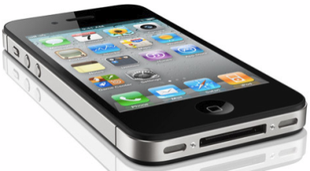
iOS Mobile Application Security (iMAS)
FY13 -14 MITRE Research
November 2013
Research Team: Gregg Ganley(PI) and Gavin Black

Slide 2
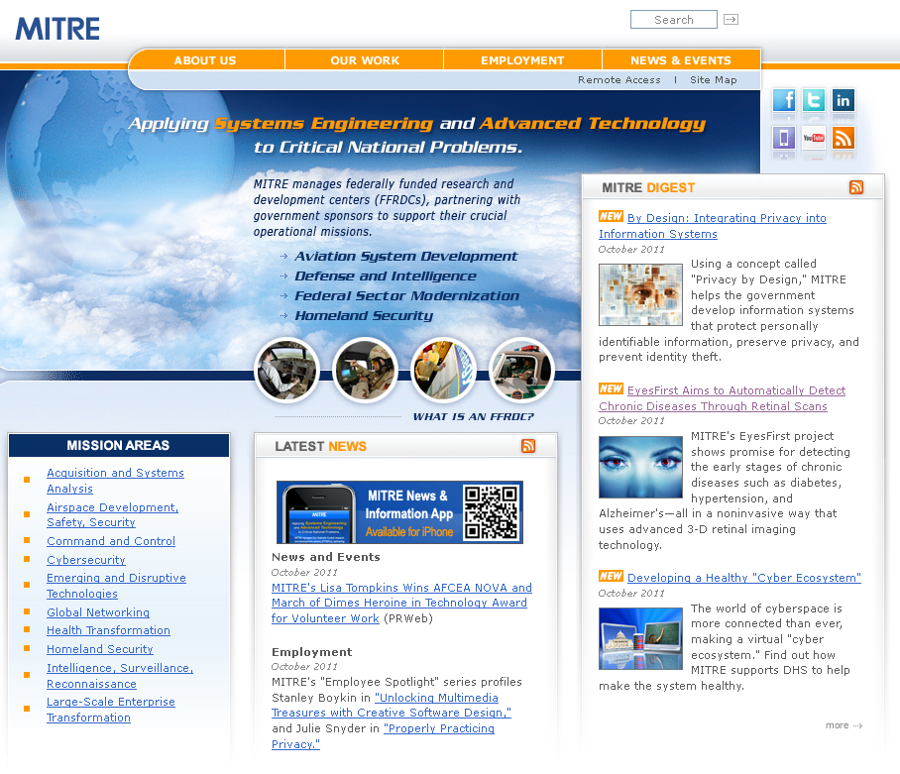
About MITRE
Not for profit, working in the public interest
MITRE does not manufacture products, enabling us to provide conflict-free guidance
MITRE operates several FFRDCs
DoD, FAA, IRS, VA, DHS, U.S. Courts
MITRE invests in an independent R&D (IR&D) program to ‘look ahead’ for our sponsors
© 2013 The MITRE Corporation. All rights reserved. Approved for Public Release: Case #13-2148

Slide 3
iOS Mobile App Security (iMAS) Elevator Pitch
iMAS – iOS Application Defense
iMAS – iOS secure, open source application framework to reduce iOS application vulnerabilities and information loss
© 2013 The MITRE Corporation. All rights reserved. Approved for Public Release: Case #13-2148

Slide 4
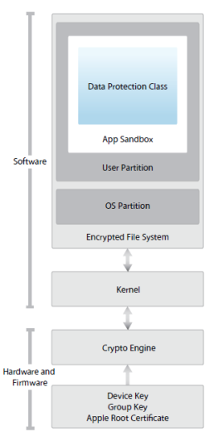
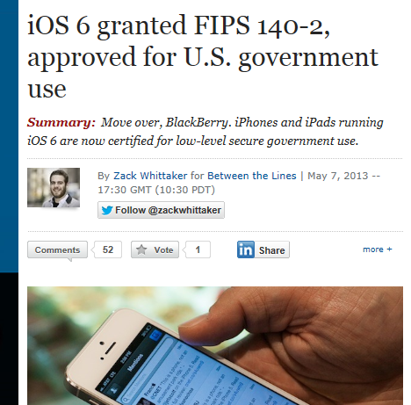
iOS Security Model
iOS four layers
Device - prevents unauthorized access to device
Data - protects data stored on the device
Network - protects data in transit
Application security – protects OS and isolates applications while they are running
iOS security
Reduced attack surface; no Java or Flash support, reduced PDF/.MOV features, stripped down system apps from full Mac OS X
iOS smaller footprint; no shell (/bin/sh), or rm, ls, ps, avail for exploit
Privilege separation; several iOS users (e.g., mobile, _wireless, root is limited)
Code Signing; binaries, libs, and pages in memory must be signed to exec
DEP / ASLR in place; limits exploits to ROP
Sandboxing; limits damage, makes exploitation harder
Security model is comprehensive; has evolved considerably since 2007; malware is difficult to craft and proliferate on iOS
FIPS compliance means custom enterprise apps, and the need for iMAS app security
© 2013 The MITRE Corporation. All rights reserved. Approved for Public Release: Case #13-2148
Notes:
http://en.wikipedia.org/wiki/Return-oriented_programming
http://en.wikipedia.org/wiki/Return-to-libc_attack
http://www.infosecwriters.com/text_resources/pdf/return-to-libc.pdf

Slide 5
Research Scope
iOS attack surface is multi-faceted
Threat vectors
Lost/stolen device, physical access attacks
Malware inserted via
Browser JavaScript engine
Apps downloaded from Enterprise App store
Attacker purpose
Steal application data, find enterprise credentials
Eavesdropping on video, microphone, and phone calls
C2/Recon into Enterprise networks
iMAS focus - Application use and its data as the target
Enterprise data, tactical operational data, patient health info
Protect against: malware and physical access attacks
Secure Static and Dynamic application controls
© 2013 The MITRE Corporation. All rights reserved. Approved for Public Release: Case #13-2148

Slide 6
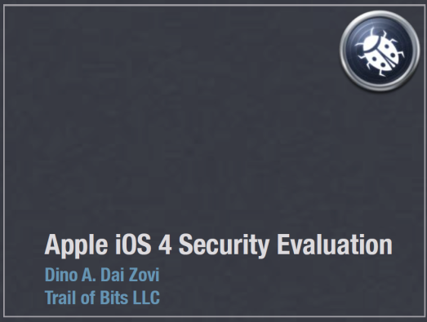
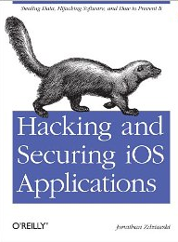
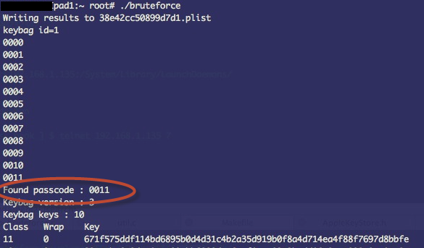
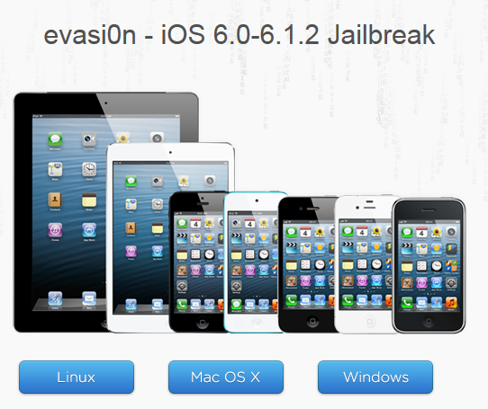
Hacking and Jailbreaking iOS
Attacks and weaknesses are well documented:
Recent Jailbreak: http://evasi0n.com/
Passcode
guessing:

Slide 7
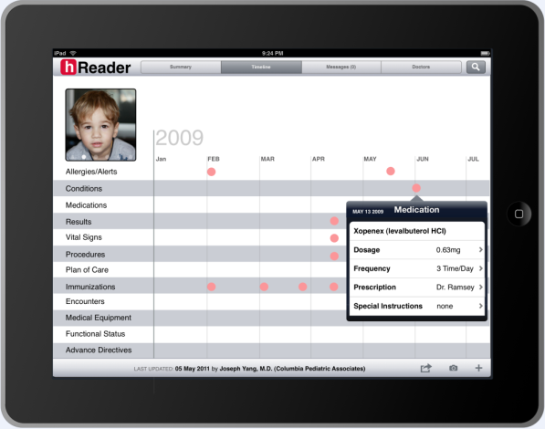
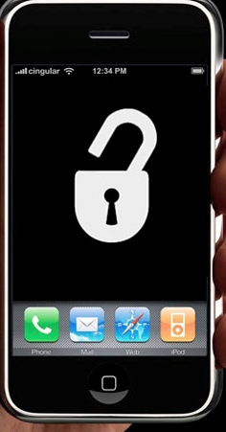
Problem: Standard iOS Application Today
4 Digit Passcode
Native iOS Application
App Store
App Signing
System components:
RAM and Debugger
Jailbreak / Root Access
User Auth
App Access
Keychain
Flash Data Storage
iOS Core Services
Internet
SSH / Debugger
iOS
iPhone / iPad Hardware
Vulnerable Areas

Slide 8
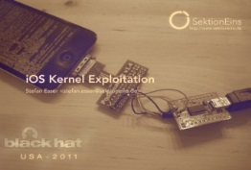
Research Idea: iMAS Secure Application Framework
Security Areas:
iMAS Secure Application Container
App authentication
Data at rest protection
App at rest security
Device Passcode check
Jailbreak detection
Debugger attach detect
Encrypted SQLite
FIPS compliance
Lighting Connector Off Device Trust
Dynamic application security bundle
Secure Keychain
Memory scrub after use
Dynamic memory usage check
Remote Wipe
iMAS
Native iOS Application
Secure MDM Control
AppPassword
Passcode
Check
Security-Check
Jailbreak / debugger attach
Encrypted Core Data
ECM
Encrypted Code Modules
AppIntegrity Check
AppSignature
Check
Encrypted RAM Disk
Memory Check
Secure Foundation OpenSSL FIPS
Dynamic App Bundling
Off Device Trust Check
iOS Core Services
App Store
SSH / Debugger
iOS
Malware
Tolerable
Security Risk
iPhone / iPad Hardware
Enterprise
App Store
Security Controls beyond Apple iOS
Reduces iOS app attack surface
Vetted, prioritized security control set
Open source, grow community
Open Source
github.com/project-imas

Slide 9
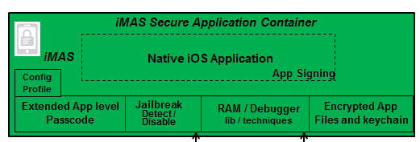
iOS Security Architecture
Developer Access
Apple Only
Apple Only
© 2013 The MITRE Corporation. All rights reserved. Approved for Public Release: Case #13-2148

Slide 10
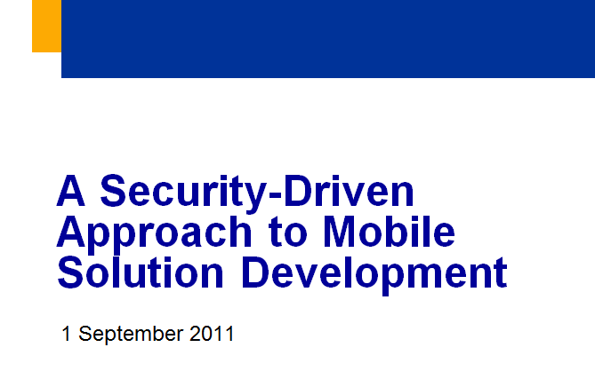
Mobile Threats
DoD CIO Report FY11
24 threats most relevant to the mobile environment
Software-Based Threats
Malware
Exploitation of Vulnerable App
Exploitation of Vulnerable OS
Physical-Based Threats
Loss of Device
Data recovered by unauthorized party
Use of authorized Credentials
Physical Tamper
Supply Chain
Web-Based Threats
Mobile Code
Drive-By-Downloads
Exploitation of Vulnerable Browser
Enterprise-Based Threats
Access to Enterprise Resources
Network-Based Threats
Data/Voice Collection over the air
Bluetooth
WiFi
Cellular
Data/Voice Collection over the network
Manipulation of data-in-transit
Connection to Masqueraded service
Jamming
GPS
Mobile Carrier
WiFi
Flooding
User-Based Threats
Social Engineering
Phishing / Spear Phishing
Theft/Misuse of Services
Malicious Insider
Tracking
Geolocation
Tower/Signal Traingulation
Geotagging
Mining of Call Records / Billing
Usage Patterns
50% (12) iMAS Applicable
© 2013 The MITRE Corporation. All rights reserved. Approved for Public Release: Case #13-2148

Slide 11
OWASP Mobile Top Ten
60% (6) iMAS Apply

Slide 12
iMAS App Security “trade-space” Comparison Sep 2013
Security Controls
iOS w/iMAS
Open Source
Art of the Possible (2014+)
iOS w/iMAS
iMAS
with or without COTS
iMAS (Sep 2014)
Sept 2013 level
iMAS (Sep 2013)
iOS w/COTS
iOS
MDM
App
Containers
iOS v4/5
iOS v6
iMAS controls raise security levels, bringing it closer to the Art of the Possible
iMAS
State of the Art (Sep 2013)
Consumer
Enterprise
Enterprise+
Classified (SIPRNET/JWICS)
Unclassified (Internet)
Sensitive (NIPRNET/MITRE)
iOS v7 security TBD needs +investigation
iMAS (Sep 2014)
Mobile App Classification Level
State of the Art (Sep 2013)

Slide 13
iMAS Security Controls

Slide 14
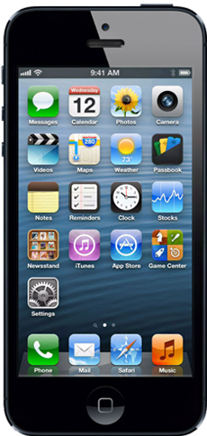
iMAS – Security Controls
Device Access:
Run-time:
AppStore / Malware:
4 Digit Passcode
RAM and Debugger
App Tampering
Passcode
Check
Forced-inlining
Jailbreak / Root Access
App Access:
AppIntegrity Check
Security-Check
Jailbreak / debugger attach
None
Encrypted Code Modules (ECM)
AppPassword
Memory Security
Data in Transit:
Data At Rest:
Encrypted RAM Disk
Keychain
CoreData
Encrypted Core Data
Lightning Connector
MDM Remote Control
iMAS
Vulnerable Areas
Secure Foundation OpenSSL / FIPS
Future Research

Slide 15
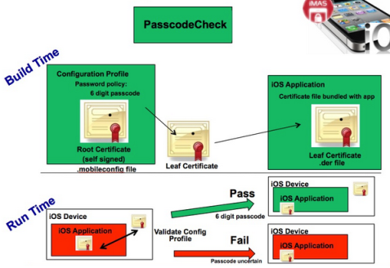
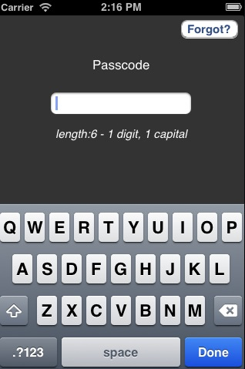
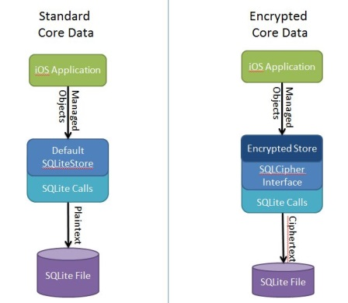
Security Controls Breakout
Passcode Check
Programmatic library and method to enforce complex device passcode use
When in place, extends jailbreak bruteforce passcode guessing duration to years from minutes
App-Password
Secure, simple, user resettable password to protect access to an application and its data
App level authentication enhances defense in depth
Rotating keypad
Encrypted-core-data
iOS CoreData encrypted SQLite store using SQLCipher
iMAS has made it easy for developers to incorporate a secure SQL DB

Slide 16
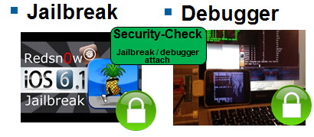
Security Controls Breakout (cont.)
Security-Check
Application level, attached debug detect and jailbreak testing
iMAS added extensive anti-forensic techniques to this library including; C macro functions, nameless function blocks, callback based, easy thread spawn for continuous checking.
Secure Foundation
OpenSSL based secure components enabling application authentication, secure file storage, and app level file-based keychain
iMAS alternative to Apple provided crypto support
iOS OpenSSL FIPS
FIPS compliant openSSL drop-in ready for iOS

Slide 17
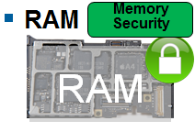
Security Controls Breakout (cont.)
Memory-Security
Provides a set of tools for memory regions or individual variables
Securing through encryption
Clearing and zeroing
Data sections overwritten either with an encrypted version or null bytes
Automatic on App exit
Anti-tamper with checksum
For validating secure memory

Slide 18
Security Controls Breakout (cont.)
Forced-inlining with Objective C
Inlining is considered an optimization technique. Using it for security requires compiler specific knowledge
Both Apple’s LLVM compiler and GNU’s GCC LLVM compiler honor the same set of directives and flags
GCC has the benefit of broader community that has documented quirks
always_inline directive will force functions to be inlined in binary output, provided the compiler flags are appropriately set
Example: inline void debug_check()__attribute__((always_inline));
Only needed on function declarations, and not implementations
Safest to use optimization at the lowest level (-O1)
Not setting optimization will remove inline functions
Difficult to reason what higher optimizations are doing (-O3 and above)
Inline functions have a compiler limited size, must explicitly set the size as a compiler flag(-finline-limit) to ensure always_inline is honored

Slide 19
iMAS Availability
Security Areas:
Available Today on github
Oct - Dec 2013: Active Research
Future
AppPassword
App authentication
Encrypted SQLite
Data at rest protection
App at rest security
Device Passcode check
Jailbreak detection
Debugger attach detect
FIPS compliance openSSL
Passcode
Check
Security-Check
Jailbreak / debugger attach
Encrypted Core Data
Secure Foundation OpenSSL
OpenSSL FIPS
Forced-inlining
Memory Security
MDM Remote Control
iMAS
Applicable OWASP Mobile Risks (6 out of 10)
AppIntegrity Check
Encrypted Code Modules (ECM)
Secure MDM Remote Control
Encrypted RAM Disk
Dynamic App Bundling
Off-device Trust Check
© 2013 The MITRE Corporation. All rights reserved. Approved for Public Release: Case #13-2148

Slide 20
iMAS Deep Dive

Slide 21
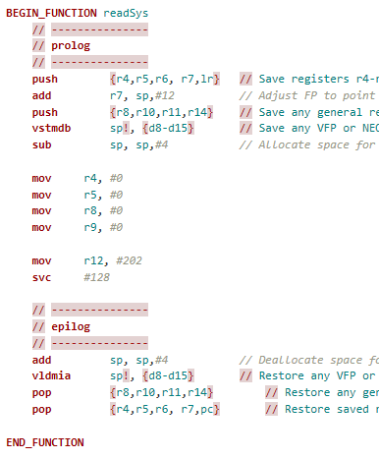
Security Check Deep Dive
Jailbreak and debug attach detection
Two Interesting iMAS techniques
Sysctl
Using sysctl call to detect if debugger is attached
Forensically attacker can “catch” this and simply override to return false
Instead, iMAS is making direct assembly call to read process flag directly
LW Threads
Making calls to JB and debugger detect repeatedly
Both techniques are enormously more difficult to work around

Slide 22
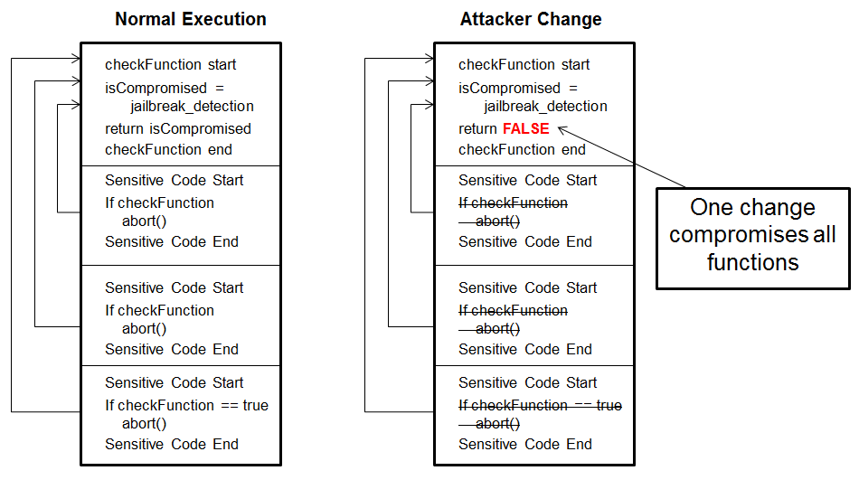
Forced Inlining Compromising Security Checks

Slide 23
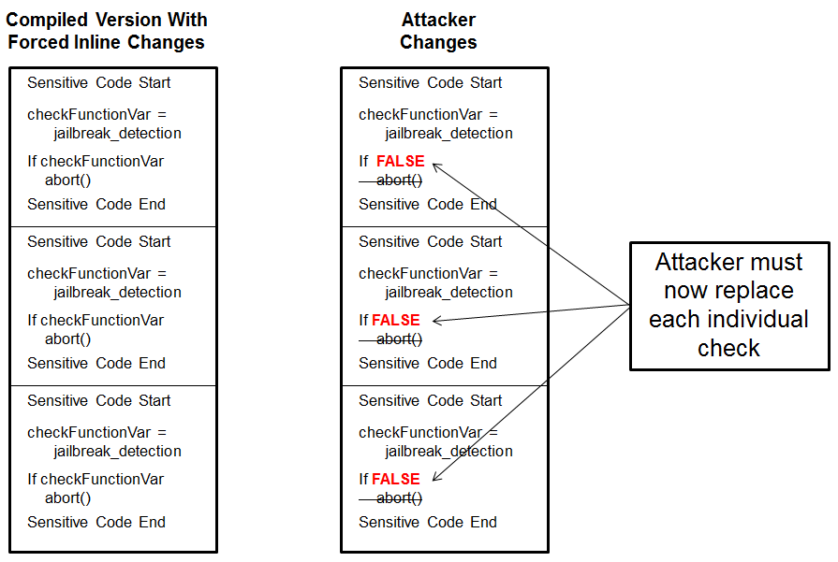
Forced Inlining Inlining Compiled in

Slide 24
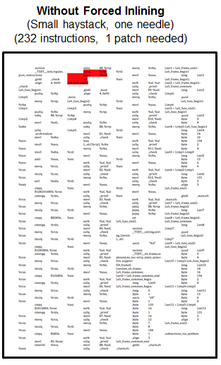
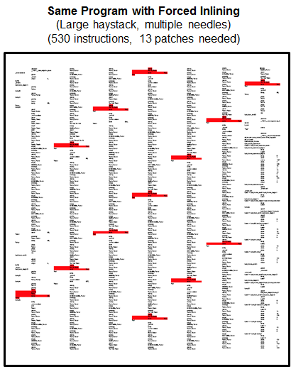
Forced Inlining Increases Exploit Time

Slide 25
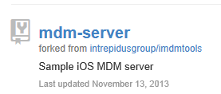
Mobile Device Management (MDM) Research
iMAS Possibilities:
Single sign on app
Remote App lock
Remote App password reset
Remote Jailbreak reporting
Apple Push Notification Servers
Find limitations
Of MDM specification
2. Push Notification To Contact Server
1. Push Notification Request
Understand and test low level command structure
iOS Device
Open Source
MDM Server
3. JSON formatted commands and acknowledgements
iMAS
App
0. Device Enrollment (Root Certificate, Enroll.mobileconfig)
Maintain and enhance open source MDM server
Provide scripts and guidance for initial setup
Ability to secure individual apps
Notes:
Maintain and enhance existing open source MDM server
Additional commands for managed applications
Scripts for autogenerating certificates and needed plist files
Updating server to handle multiple enrolled devices
Understand and test low level command structure
JSON formatted commands directly communicated to server
Direct communication with server after initial Apple push request
Still need to test iOS 7 MDM improvements (Application specific configuration dictionaries)
Find limitations of MDM
Messages sent to a device in standby or off are not received
Must continually send until receiving an acknowledgment
No application specific management, besides uninstall, until iOS 7
Ability to secure individual applications
Managed application removal, deletes entire sandbox for app
Monitoring application that provides additional security to iMAS enabled apps

Slide 26
iMAS Applied

Slide 27
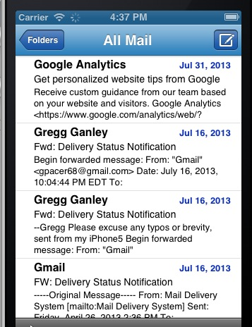
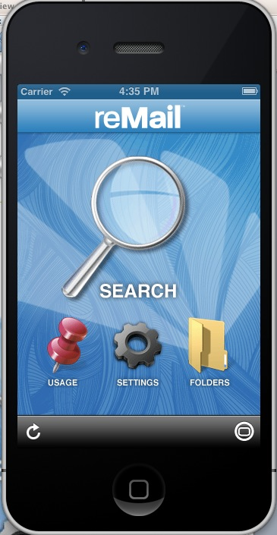
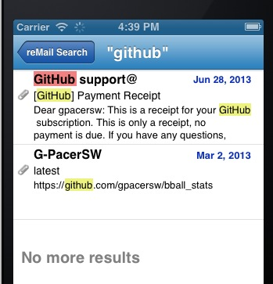
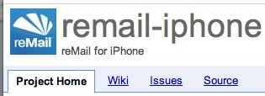
reMail http://code.google.com/p/remail-iphone/
FOSS project acquired by Google in 2010
Email client for iOS
Project site TODO lists “security needed”
iMAS test app
Wrap app with iMAS security controls
Github project started

Slide 28
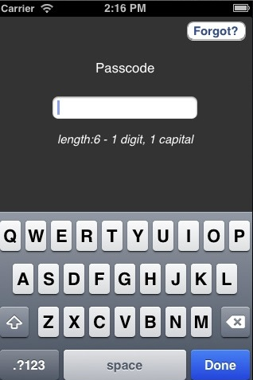
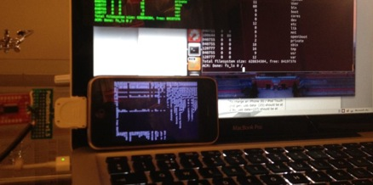
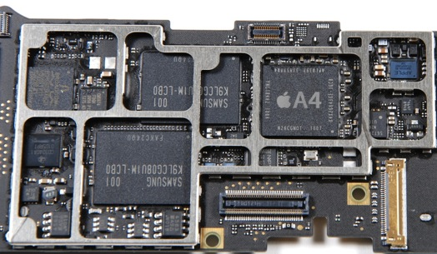
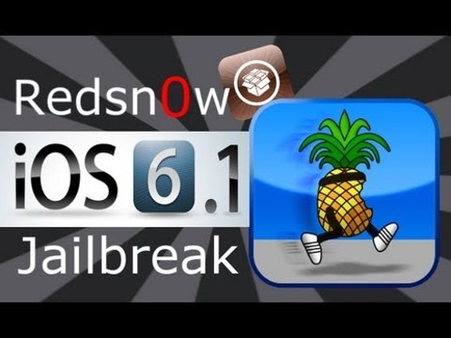
reMail – iMAS Security Integration
Access
User resettable
Securing
Access
Data at rest
Run-time
Anti-tampering
FIPS Compliance
Data Storage
openSSL crypto
Keychain
AppPassword
Secure Foundation OpenSSL / FIPS
Database
Jailbreak
Debugger
RAM
Memory Security
Security-Check
Jailbreak / debugger attach
RAM

Slide 29
Outreach

Slide 30
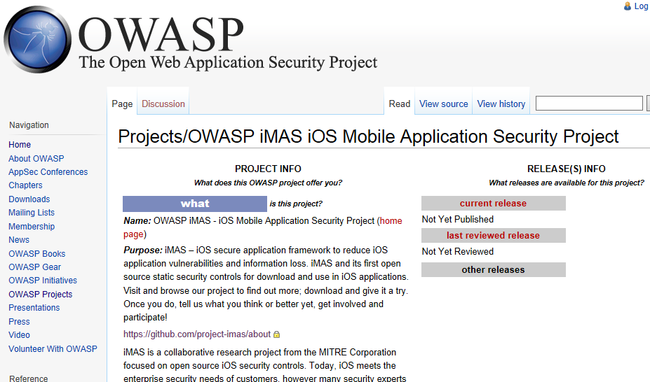
iMAS Now an OWASP Project

Slide 31
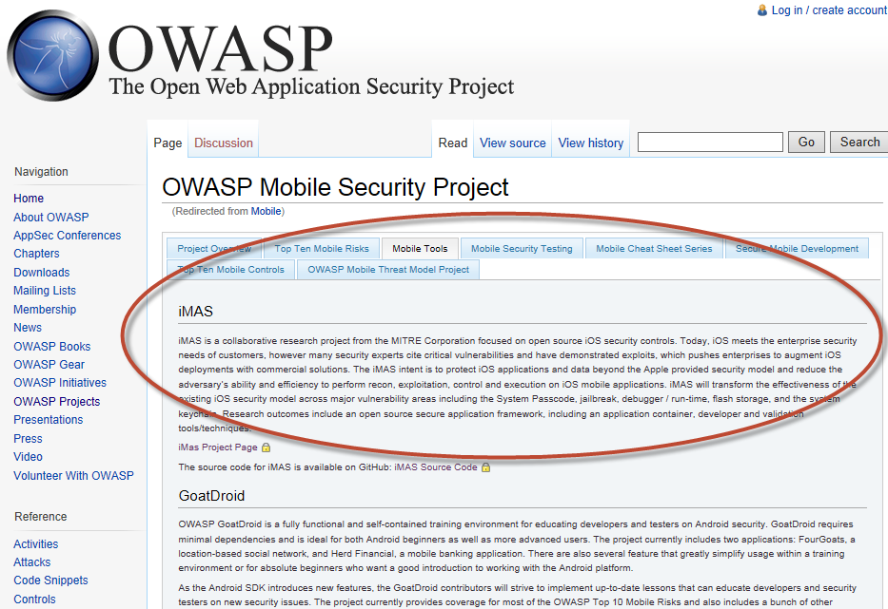
iMAS listed as OWASP Mobile Security Project – Mobile Tool

Slide 32
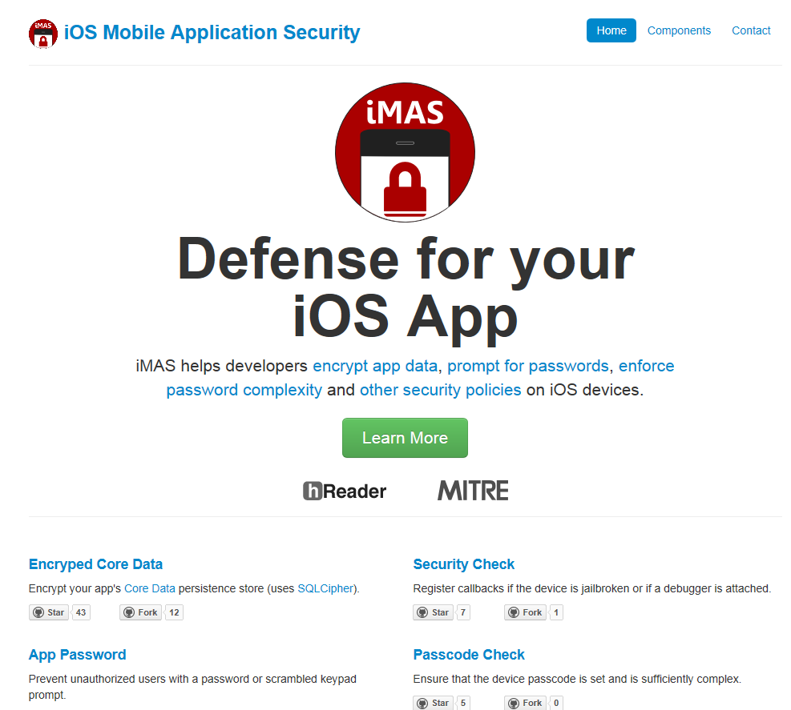
Web Site project-imas.github.com

Slide 33
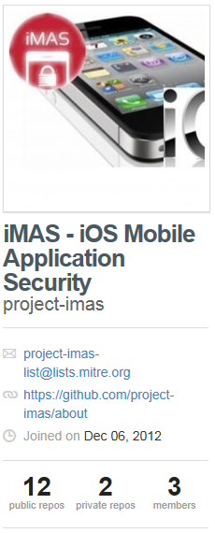
Github.com site Eight (8) iMAS security controls available

Slide 34
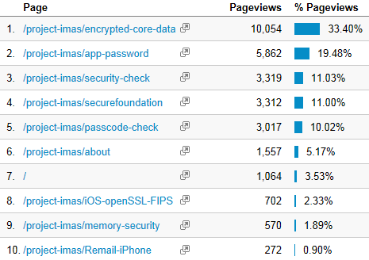
Github Use and Value Claim: value = visits and use
Open source statistics
Leveraging githalytics.com
Adds a Google analytics link to each iMAS security control README file
Since March 4 (~ 8 months)
Over 25,000 unique visitors, 30,000 page views (90% new, 10% returning)
Visits from 108 countries (mostly US, Germany, India, UK, Canada, China)
Site Numbers
Community starting to
follow:
Star count 307 (up from 278 10/5)
61 forks (up from 57 on 10/5)
Value measure
Moderate, steadily increasing

Slide 35
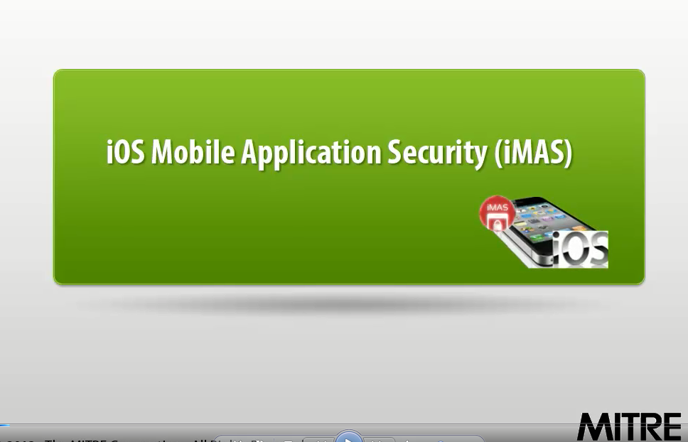
iMAS Video
Produced as part of MITRE’s Mobile Computing Security Initiative (MOCSI) integration effort
Short, 3.5 minutes
http://youtu.be/92A3kg_kUSc

Slide 36
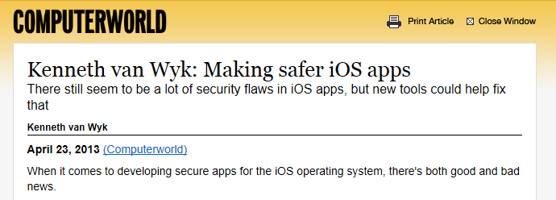
iMAS in the news …
…
…
© 2013 The MITRE Corporation. All rights reserved. Approved for Public Release: Case #13-2148

Slide 37
iMAS Future

Slide 38
FY14 Technical Approach and Research
Deeper security controls
Continue researching security controls (those not finished in FY13)
Advanced resilience and disruption techniques
MDM remote control
Explore securing MDM interface and remote C2 capabilities for iMAS controls (remote wipe etc.)
iMAS Encrypted Code Modules research
Implement portions of security controls using iMAS ECM technique
Off device trust
iOS Lightning Connector and trusted smart charger research
Dynamic App Bundling research
Research app repackaging techniques; wrap app after build time
Reference app bolstering
Implement iOS reference app (reMail) using iMAS ECM / SMIME
Third Party Audit reMail

Slide 39
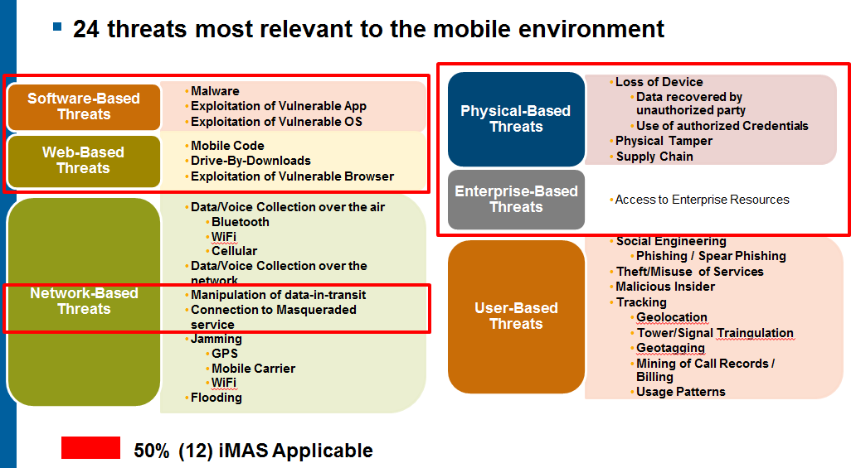
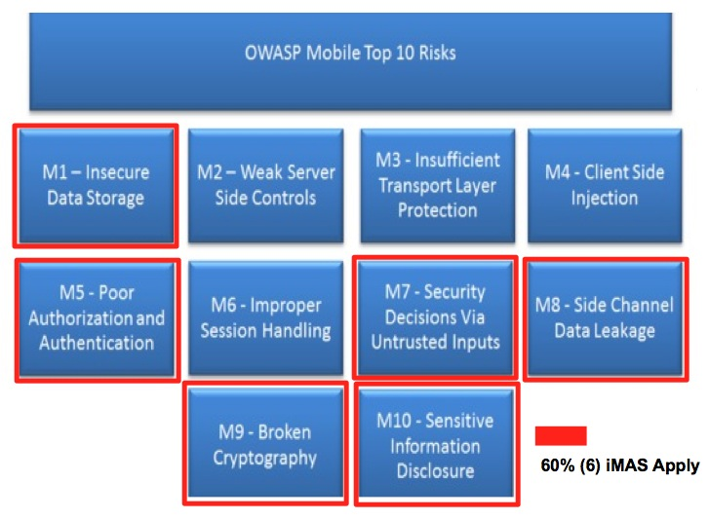
End Game iMAS Goals
Targeting “secure complete” when applicable OWASP mobile top 10 and 12/24 mobile threats are mitigated
Open Source is self sustaining
Transition Research
Govt. and / or Commercial entity

Slide 40
Demonstration

Slide 41
Questions?
iMAS - iOS Mobile Application Security
Github:
https://project-imas.github.com
POC:
MITRE, Bedford MA
Gregg Ganley
781-271-2739
gganley@mitre.org
Gavin Black
781-271-4771
gblack@mitre.org
Please !
Share iMAS with SW Devs
Visit and Discover
Download and Experiment
Feedback and push requests
© 2013 The MITRE Corporation. All rights reserved. Approved for Public Release: Case #13-2148

Slide 42
Backup

Slide 43
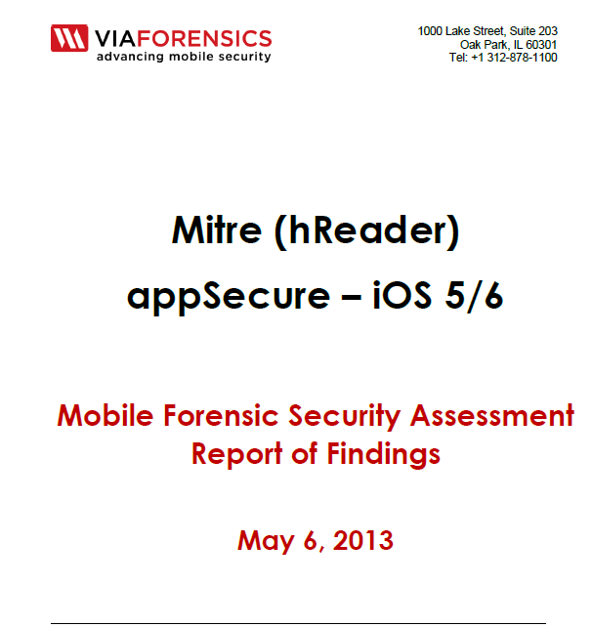
Third Party Audit
Report completed on May 6, 2013
Failed Network security testing
High risk found: network cache.db file had server password and patient information present
Related to backend server access
Other medium and low security risks found
SQLlite DB key was found in memory
Jailbreak detection and counter-debugging worked; patched over
Feedback from viaForensics
hReader with iMAS is much more secure than most
Encouraged us to make changes to above and re-test for their “appSecure” certification
Fixed cited issues and concluded exercise
PASSED “FINAL EXAM”

Slide 44
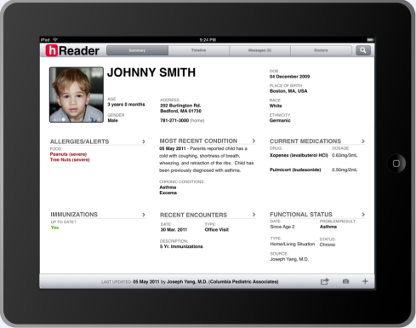
FY12
MITRE Internal Research - MIP
mobile Patient Health Reader
© 2013 The MITRE Corporation. All rights reserved. Approved for Public Release: Case #13-2148

Slide 45
Audit Summary August 2012
hReader team targeting Open Source space for hReader application
hReader would be used mostly offline
Application security needs to be bolstered
Production hReader app would be contain sensitive patient health information
hReader requested a red-team to security audit the application
Test app contains “synthetic” patient data; NOT real patient data
A DISA App security STIG checklist was used to measure the security compliance
Iterative process over several months
First pass, many areas were found to be exposed
Third pass, considerably more secure
© 2013 The MITRE Corporation. All rights reserved. Approved for Public Release: Case #13-2148

Slide 46
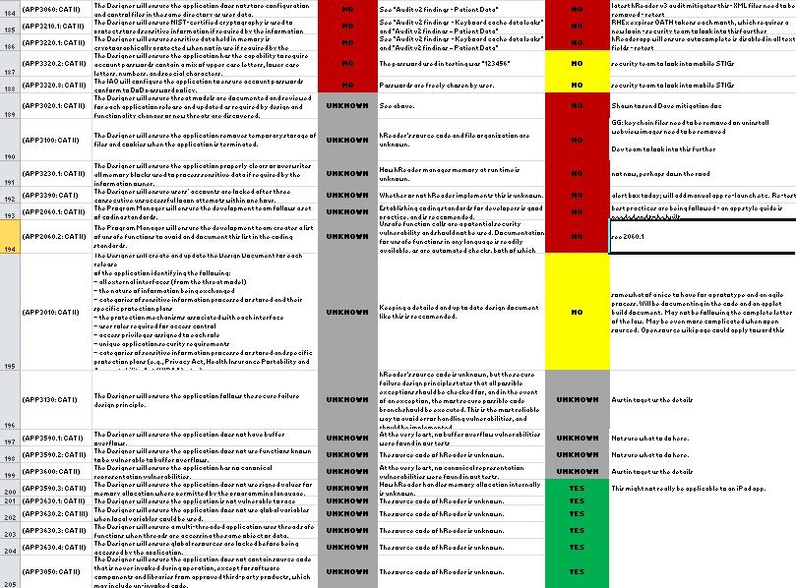
STIG Compliance Security Technical Implementation Guide
DISA / DoD Application STIG
255 total criteria
78 Applicable to hReader as a mobile prototype
Initial assessment
27 pass (16%), 10 fail, 129 unsure (166 Total), 89 NA
After several audits
72 pass (90%), 8 fail (80 total), 175 NA
hReader application security compliance increased to 90% criteria met – about a 5X increase from original design
STIG – A specification that defines the configuration standards for DOD IA and IA-enabled devices/systems
STIG used: Application Security and Development STIG Version 3, Release 3
© 2013 The MITRE Corporation. All rights reserved. Approved for Public Release: Case #13-2148

Slide 47
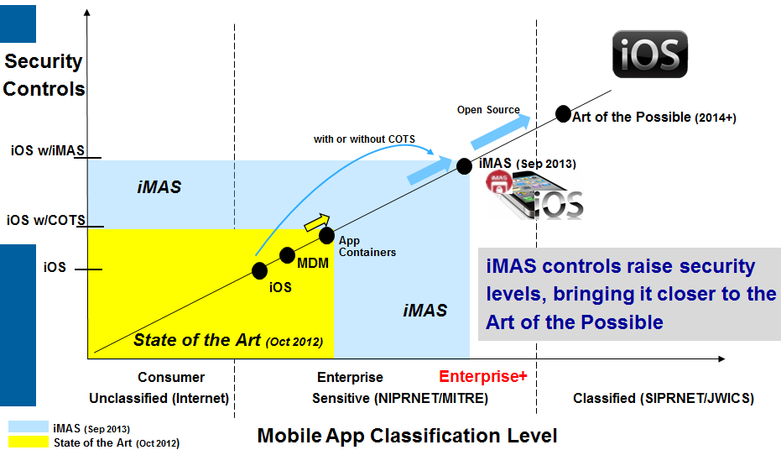
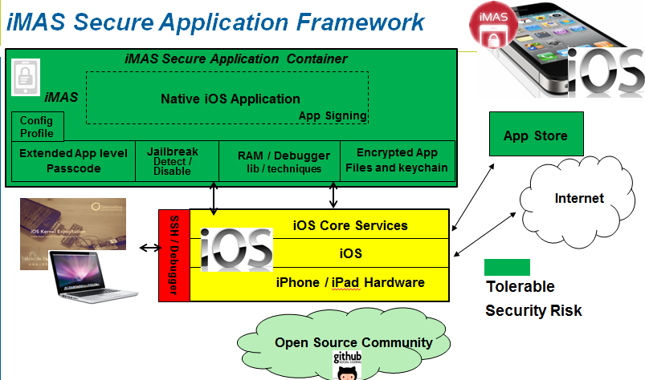
iMAS iOS Mobile Application Security
Gregg Ganley
Gavin Black
Problem
iOS is considered secure, but out of the box security is not enough
Simple device passcodes enable easy compromise of applications and data
Solution
Additional security controls beyond Apple
Reduce iOS app attack surface
Extends security with or without MDM and COTS solutions
Measurable security (DISA Mobile App SRG)
Controls open source available
project-imas.github.com
Raise iOS app security levels - closer to the Art of the Possible

Slide 48
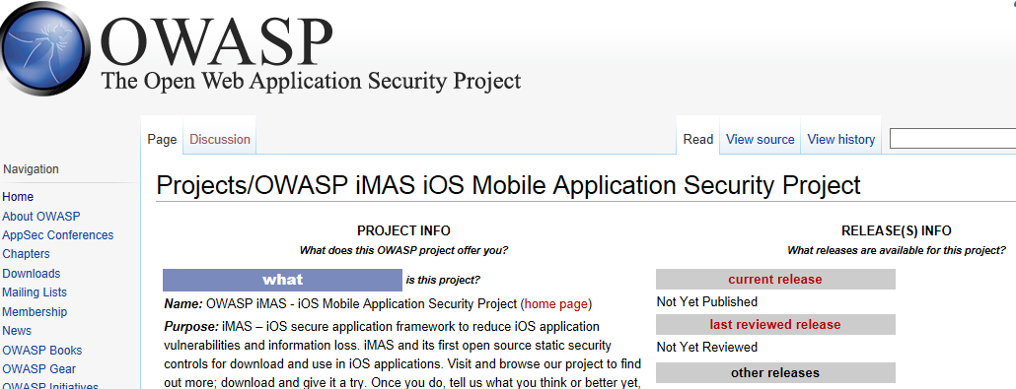
iMAS Secure Application Framework FY13
iMAS Secure Application Container
iMAS
Native iOS Application
Config Profile
App Signing
App Store
Extended App level Passcode
Jailbreak Detect / Disable
RAM / Debugger lib / techniques
Encrypted App Files and keychain
Internet
iOS Core Services
SSH / Debugger
iOS
iPhone / iPad Hardware
Tolerable Security Risk
Security Controls beyond Apple iOS
Reduces iOS app attack surface
Vetted security control set using CWE
Extends security with or without MDM and COTS solutions
Measurable security (DISA Mobile App SRG)
Open source, grow community
Open Source Community

Slide 49
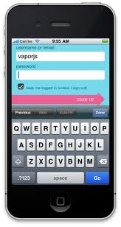
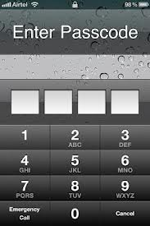
ECM – Encrypted Code Modules Concept
Build Time
ECM built into iOS App
ECM
DynamicLib
Builder
At Install User enters ECM App Key
iOS App
iOS App
ECM
DynamicLib
Encrypted w/User app password
ECM
DynamicLib
Plaintext
.dylib
ciphertext
DynamicLib
ECM Decoder
ECM Decoder
Protected Functionality
Secured with ECM App Key
iMAS Security
iMAS Security
On Device
In Use:
At Rest:
iOS App
iOS App
Critical Functionality Encrypted
ECM
DynamicLib
ECM
DynamicLib
ECM Decoder
ECM Decoder
iMAS Security
User Enters app password
iMAS Security
Critical Functionality Unlocked
Invulnerable to Decompiling

